Slide 1
Topic 8: Energy, power, climate change 8.3 Fossil fuel power production
8.3.1 Outline the historical and geographical reasons for the widespread use of fossil fuels.
8.3.2 Discuss the energy density of fossil fuels with respect to the demands of power stations.
8.3.3 Discuss the relative advantages and disadvantages associated with the transportation and storage of fossil fuels.
8.3.4 State the overall efficiency of power stations fueled by different fossil fuels.
8.3.5 Describe the environmental problems associated with the recovery of fossil fuels and their use in power stations.
Notes:
© 2006 By Timothy K. Lund

Slide 2
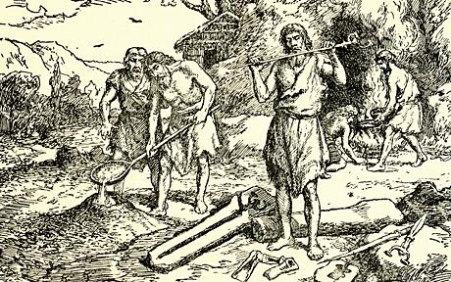
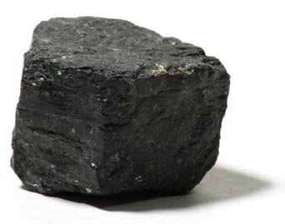
Topic 8: Energy, power, climate change 8.3 Fossil fuel power production
Outline the historical and geographical reasons for the widespread use of fossil fuels.
•Plant material subjected to great pressure over a long time becomes coal and oil - the fossil fuels.
•There is evidence that man used coal as a fuel since at least the bronze age, 4000 years ago.
•However, for most of that 4000 year period, wood has been the prevalent fuel. Why?
•With modern civilization's growing need for energy, coal became the fuel of choice. Recall:
Fuel
Fuel Type
Energy Density (MJ/kg)
Coal
Fossil
32.5
Wood
Biomass
17.0
Cow Dung
Biomass
15.5
Notes:
© 2006 By Timothy K. Lund

Slide 3
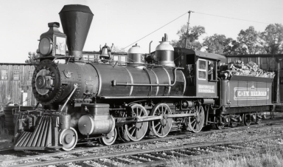
Topic 8: Energy, power, climate change 8.3 Fossil fuel power production
Outline the historical and geographical reasons for the widespread use of fossil fuels.
EXAMPLE: Suppose a steam locomotive is rated at 5000 horsepower. If its efficiency is 8%, how much wood must be burned in a 2 hour trip? 1 hp = 750 W.
SOLUTION: The power needed is
P_{out} = (5000 hp)(750 W/hp)(1 MW/10⁶ W) = 3.75 MW
.08 = P_{out}/P_{in} ⇒ P_{in} = P_{out}/.08 = 47 MW.
The energy required in 2 h is
E = Pt = (47 MJs⁻¹)(2 h)(3600 s/h) = 340000 MJ.
Finally,
m = (340000 MJ)(1 kg / 17 MJ) = 20000 kg.
Wood
17.0 MJ kg⁻¹
efficiency
efficiency = P_{out} / P_{in}
Notes:
© 2006 By Timothy K. Lund

Slide 4
Topic 8: Energy, power, climate change 8.3 Fossil fuel power production
Outline the historical and geographical reasons for the widespread use of fossil fuels.
EXAMPLE: Suppose a steam locomotive is rated at 5000 horsepower. If its efficiency is 8%, how much coal must be burned in a 2 hour trip? 1 hp = 750 W.
SOLUTION: The power needed is
P_{out} = (5000 hp)(750 W/hp)(1 MW/10⁶ W) = 3.75 MW
.08 = P_{out}/P_{in} ⇒ P_{in} = P_{out}/.08 = 47 MW.
The energy required in 2 h is
E = Pt = (47 MJs⁻¹)(2 h)(3600 s/h) = 340000 MJ.
Finally,
m = (340000 MJ)(1 kg / 32.5 MJ) = 10500 kg.
Coal
32.5 MJ kg⁻¹
efficiency
efficiency = P_{out} / P_{in}
Notes:
© 2006 By Timothy K. Lund

Slide 5
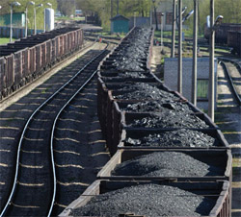
Topic 8: Energy, power, climate change 8.3 Fossil fuel power production
Outline the historical and geographical reasons for the widespread use of fossil fuels.
•Coal can be relatively easy to mine .
•Coal is geographically well-distributed.
Notes:
© 2006 By Timothy K. Lund

Slide 6
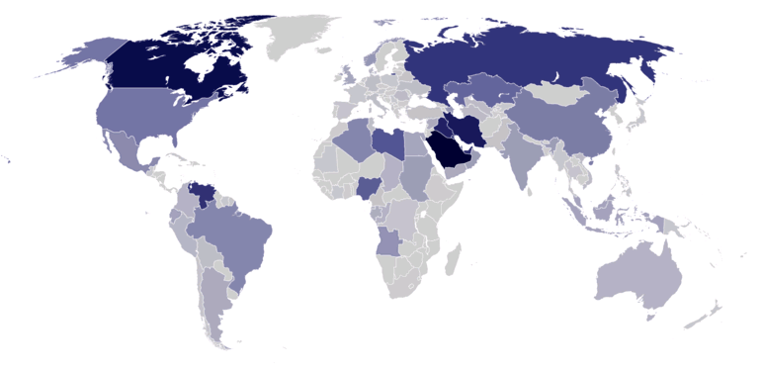
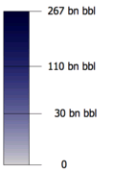
Topic 8: Energy, power, climate change 8.3 Fossil fuel power production
Outline the historical and geographical reasons for the widespread use of fossil fuels.
•With further need for energy, and general availability, oil has attained predominance.
Notes:
© 2006 By Timothy K. Lund

Slide 7
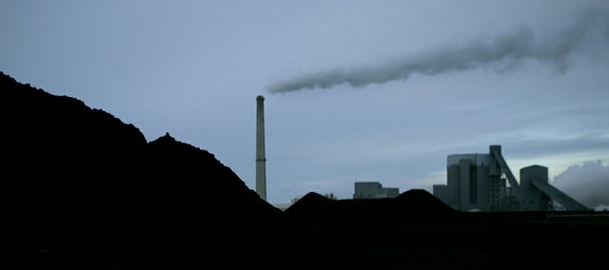
Topic 8: Energy, power, climate change 8.3 Fossil fuel power production
Discuss the energy density of fossil fuels with respect to the demands of power stations.
•Obviously the greater the energy density of the fossil fuel the fewer kilograms of that fuel we need to refine, transport, and store on site.
Notes:
© 2006 By Timothy K. Lund

Slide 8
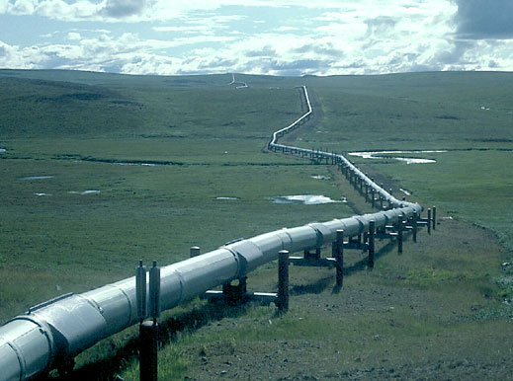
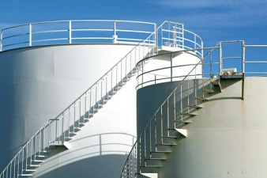
Topic 8: Energy, power, climate change 8.3 Fossil fuel power production
Discuss the relative advantages and disadvantages associated with the transportation and storage of fossil fuels.
•Natural gas and oil-fired power plants have the advantage of fuels with a higher energy density:
•They have the additional advantage of using fossil fuels in the liquid or gaseous state, thereby allowing transport through pipelines.
•On site storage is also easier since there is no wasted volume.
Fuel
Fuel Type
Energy Density (MJ/kg)
Petrol
Fossil
46.9
Diesel
Fossil
45.8
Biodiesel
Biomass
42.2
Crude Oil
Fossil
41.9
Coal
Fossil
32.5
Notes:
© 2006 By Timothy K. Lund

Slide 9
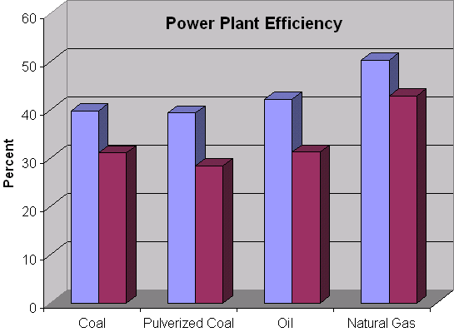
Topic 8: Energy, power, climate change 8.3 Fossil fuel power production
State the overall efficiency of power stations fueled by different fossil fuels.
•Comparison of power plant efficiencies for various fossil fuels are shown in the bar graph.
•With CO₂ capture the efficiencies of all of the fossil fuels go down by about 25%.
W/CO₂ capture
W/CO₂ capture
W/CO₂ capture
W/CO₂ cap
Notes:
© 2006 By Timothy K. Lund

Slide 10
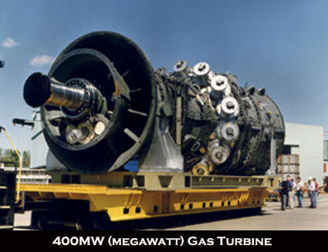
Topic 8: Energy, power, climate change 8.3 Fossil fuel power production
State the overall efficiency of power stations fueled by different fossil fuels.
•Oil and natural gas burn more completely than coal. Both are also easier to transport than coal.
•And with natural gas, a very efficient power plant can be designed which has a gas turbine driven directly by the burning methane, and a steam turbine which uses heat from the initial combustion process. Both turbines drive generators.
•The next slides show the block diagrams for a coal/oil power plant and a gas-fired power plant.
Notes:
© 2006 By Timothy K. Lund

Slide 11
Topic 8: Energy, power, climate change 8.3 Fossil fuel power production
Coal- and oil-fired plant block diagram.
exhaust gas
BOILER
friction
STEAM TURBINE
GENERATOR
COAL
CONDENSER
cold water
wasted heat
CHEMICAL ENERGY
HOT STEAM
KINETIC
ELECTRICITY
friction
exhaust gas
wasted heat
40% efficient
Notes:
© 2006 By Timothy K. Lund

Slide 12
Topic 8: Energy, power, climate change 8.3 Fossil fuel power production
Natural gas fired plant block diagram.
exhaust gas
BOILER
friction
GAS
STEAM TURBINE
GENERATOR
GENERATOR
friction
GAS TURBINE
CONDENSER
cold water
wasted heat
friction
CHEMICAL ENERGY
ELECTRICITY
HOT STEAM
KINETIC
ELECTRICITY
friction
wasted heat
50% efficient
exhaust
Notes:
© 2006 By Timothy K. Lund

Slide 13
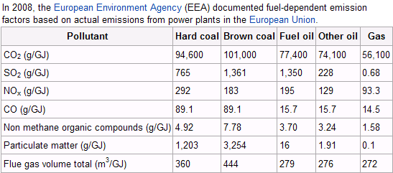
Topic 8: Energy, power, climate change 8.3 Fossil fuel power production
Describe the environmental problems associated with the recovery of fossil fuels and their use in power stations.
•The table below compares the pollutants (in grams per gigajoule) for coal, oil and gas-fired power plants in the European Union.
Greenhouse gases
Smog
Notes:
© 2006 By Timothy K. Lund

Slide 14
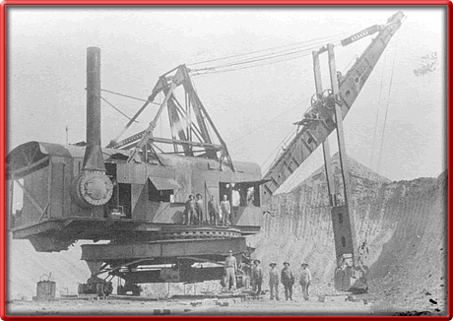
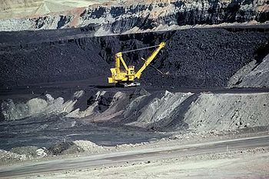
Topic 8: Energy, power, climate change 8.3 Fossil fuel power production
Describe the environmental problems associated with the recovery of fossil fuels and their use in power stations.
•Recover of fossil fuels is a messy business for the environment.
Notes:
© 2006 By Timothy K. Lund

Slide 15
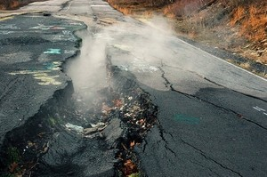
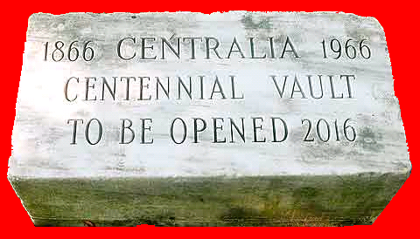
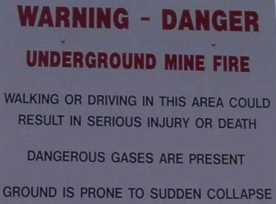
Topic 8: Energy, power, climate change 8.3 Fossil fuel power production
Describe the environmental problems associated with the recovery of fossil fuels and their use in power stations.
•Besides groundwater disruption and contamination, coal seam fires are burning all over the world
•This one, in Centralia, PA, has been going strong since 1962, undermining and destroying a whole town!
Notes:
© 2006 By Timothy K. Lund

Slide 16
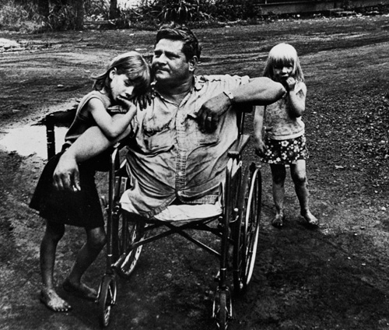
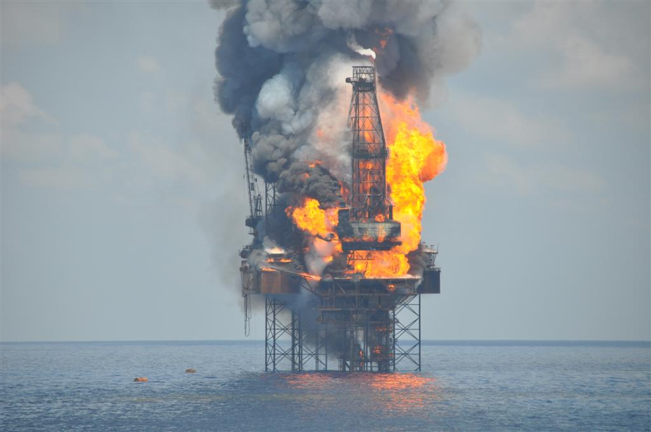
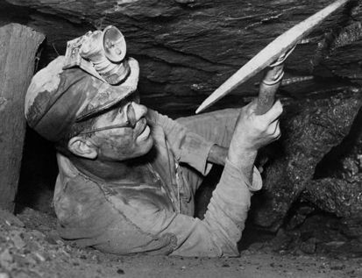
Topic 8: Energy, power, climate change 8.3 Fossil fuel power production
Describe the environmental problems associated with the recovery of fossil fuels and their use in power stations.
•Besides the danger of the actual jobs in the recovery of fossil fuels…
Notes:
© 2006 By Timothy K. Lund

Slide 17
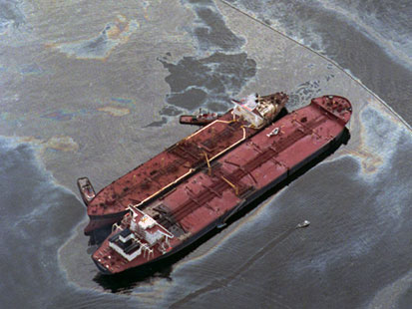
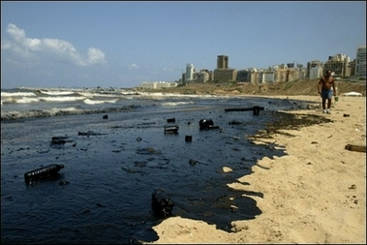
Topic 8: Energy, power, climate change 8.3 Fossil fuel power production
Describe the environmental problems associated with the recovery of fossil fuels and their use in power stations.
•…there is a high probability that the environment will be contaminated.
Notes:
© 2006 By Timothy K. Lund

