Slide 1
Topic 8: Energy, power, climate change 8.4 Non-fossil fuel power production
Nuclear power
8.4.1 Describe how neutrons produced in a fission reaction may be used to initiate further fission reactions (chain reactions).
8.4.2 Distinguish between controlled nuclear and uncontrolled nuclear fission.
8.4.3 Describe what is meant by fuel enrichment.
Notes:
© 2006 By Timothy K. Lund

Slide 2
Topic 8: Energy, power, climate change 8.4 Non-fossil fuel power production
Nuclear power
Describe how neutrons produced in a fission reaction may be used to initiate further fission reactions (chain reactions).
•Nuclear fission is the splitting of a large nucleus into two smaller (daughter) nuclei.
•An example of fission is
•In the animation, ²³⁵U is hit by a neutron, and capturing it, becomes excited and unstable:
•It quickly splits into two smaller daughter nuclei, and two neutrons, each of which can split another nucleus of ²³⁵U.
²³⁵U + ¹n → (²³⁶U*) → ¹⁴⁰Xe + ⁹⁴Sr + 2(¹n)
⁹² ⁰ ⁹² ⁵⁴ ³⁸ ⁰
⁹⁴Sr
¹⁴⁰Xe
Notes:
© 2006 By Timothy K. Lund

Slide 3
Topic 8: Energy, power, climate change 8.4 Non-fossil fuel power production
Nuclear power
Describe how neutrons produced in a fission reaction may be used to initiate further fission reactions (chain reactions).
•Note that the splitting was triggered by a single neutron that had just the right energy to excite the nucleus.
•Note also that during the split, two more neutrons were released.
•If each of these neutrons splits subsequent nuclei, we have what is called a chain reaction.
²³⁵U + ¹n → (²³⁶U*) → ¹⁴⁰Xe + ⁹⁴Sr + 2(¹n)
⁹² ⁰ ⁹² ⁵⁴ ³⁸ ⁰
1
2
Primary
4
Secondary
8
Tertiary
Exponential Growth
Notes:
© 2006 By Timothy K. Lund

Slide 4
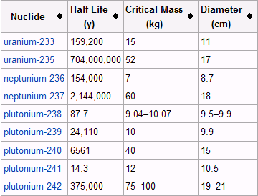
Topic 8: Energy, power, climate change 8.4 Non-fossil fuel power production
Nuclear power
Describe how neutrons produced in a fission reaction may be used to initiate further fission reactions (chain reactions).
We call the minimum mass of a fission- able material which will sustain the fission process by itself the critical mass.
Note that ²³⁸U is not in this list.
Notes:
© 2006 By Timothy K. Lund

Slide 5
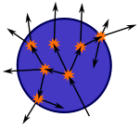
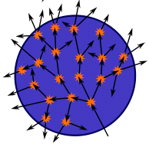
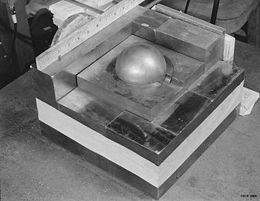
Topic 8: Energy, power, climate change 8.4 Non-fossil fuel power production
Nuclear power
Describe how neutrons produced in a fission reaction may be used to initiate further fission reactions (chain reactions).
•The most compact geometry for critical mass is the sphere because the sphere will “intercept” the most product neutrons.
•The larger the diameter the greater the ratio of volume to surface area:
V / A = (4/3)πr³ /(4πr²) = (1/3)r.
Mockup of a subcritical sphere of plutonium
Notes:
© 2006 By Timothy K. Lund

Slide 6
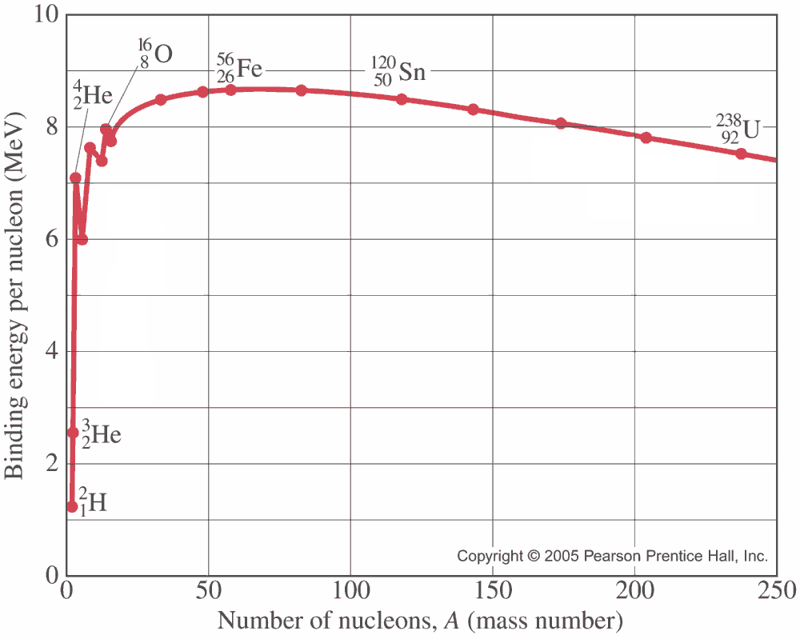
Topic 8: Energy, power, climate change 8.4 Non-fossil fuel power production
Nuclear power
Describe how neutrons produced in a fission reaction may be used to initiate further fission reactions (chain reactions).
•Recall that the binding energy per nucleon graph tells which elements can be split to produce energy:
•Present day nuclear energy is produced from fission.
fission
fusion
splitting releases energy
joining releases energy
Notes:
© 2006 By Timothy K. Lund

Slide 7
Topic 8: Energy, power, climate change 8.4 Non-fossil fuel power production
Nuclear power
Distinguish between controlled nuclear and uncontrolled nuclear fission.
•In a nuclear reactor, a controlled nuclear reaction is desired so that we merely sustain the reaction without growing it.
•In a nuclear bomb, an uncontrolled nuclear reaction is desired so that we have an immense and very rapid energy release.
Half of the product neutrons are absorbed by the control rods
controlled
None of the product neutrons are absorbed
uncontrolled
Notes:
© 2006 By Timothy K. Lund

Slide 8
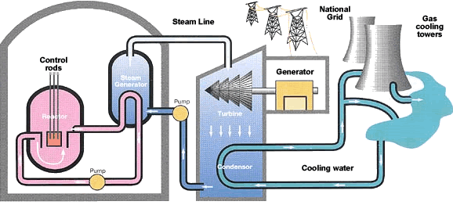
Topic 8: Energy, power, climate change 8.4 Non-fossil fuel power production
Nuclear power
Distinguish between controlled nuclear and uncontrolled nuclear fission.
•A nuclear power plant is pictured here.
Controlled nuclear fission
Notes:
© 2006 By Timothy K. Lund

Slide 9
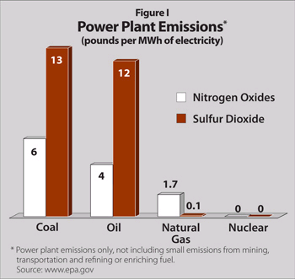
Topic 8: Energy, power, climate change 8.4 Non-fossil fuel power production
Nuclear power
Distinguish between controlled nuclear and uncontrolled nuclear fission.
•Coal, oil and natural gas plants all produce CO₂.
•They also produce particulate pollution in the form of oxides of nitrogen and sulfur.
•Smog and acid rain are a byproduct of these emissions.
•Nuclear power plants produce none of these emissions.
Notes:
© 2006 By Timothy K. Lund

Slide 10
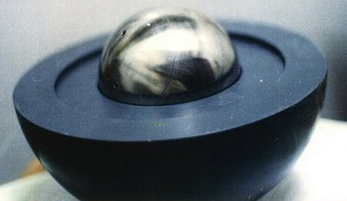
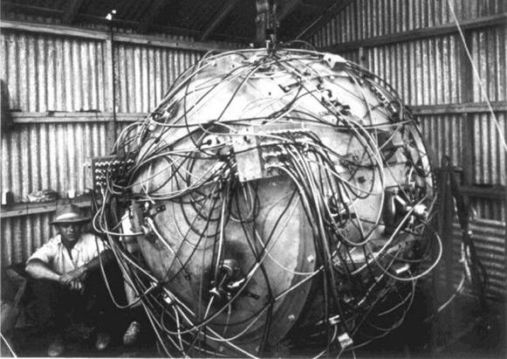
Topic 8: Energy, power, climate change 8.4 Non-fossil fuel power production
Nuclear power
Distinguish between controlled nuclear and uncontrolled nuclear fission.
•A sub-critical mass will not sustain the fission chain reaction.
•However, if a sub-critical sphere is surrounded by high explosives which are detonated in a focused inward explosion, the density of the sphere will increase to the point that the critical mass is attained.
Detonation circuit
Explosive lens
Notes:
© 2006 By Timothy K. Lund

Slide 11
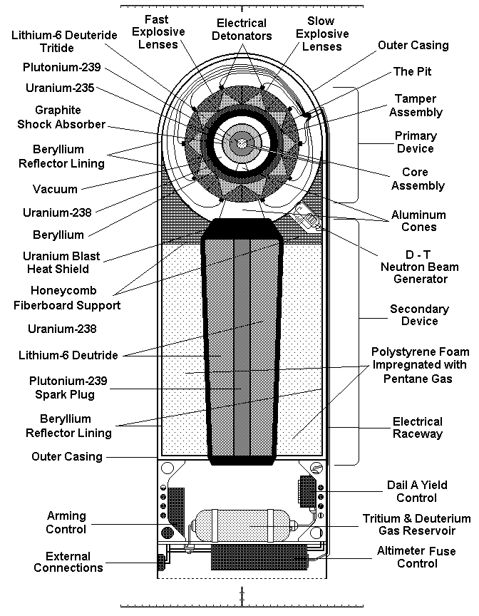
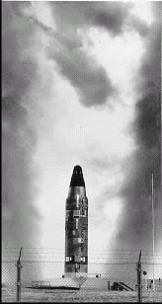
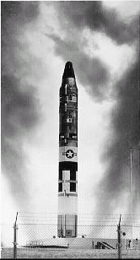
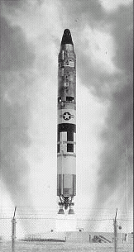
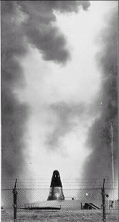
Topic 8: Energy, power, climate change 8.4 Non-fossil fuel power production
Nuclear power
Distinguish between controlled nuclear and uncontrolled nuclear fission.
•The hydrogen bomb (fission- fusion-fission) is shown.
delivery vehicle
FYI
•Do you think plans for such weapons of mass destruction should be available on the Internet?
physics package
Notes:
© 2006 By Timothy K. Lund

Slide 12
Topic 8: Energy, power, climate change 8.4 Non-fossil fuel power production
Nuclear power
Describe what is meant by fuel enrichment.
•Natural uranium is made up of uranium-238 (99.3%) and uranium-235 (0.7%).
•²³⁸U will release neutrons when split (similar to the reaction shown for ²³⁵U). However, rather than sustaining further fissions, most of the product neutrons are absorbed by the uranium-238 and the chain reaction does not sustain itself.
•The process of increasing the concentration of uranium-235 in a natural uranium sample is called enrichment.
•Reactor grade uranium has been enriched to about 3-5% uranium-235.
•Weapons grade uranium has been enriched to about 99% uranium-235.
Notes:
© 2006 By Timothy K. Lund

Slide 13
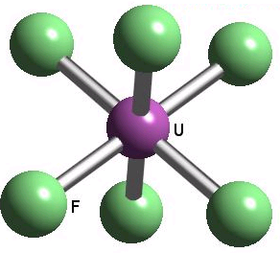
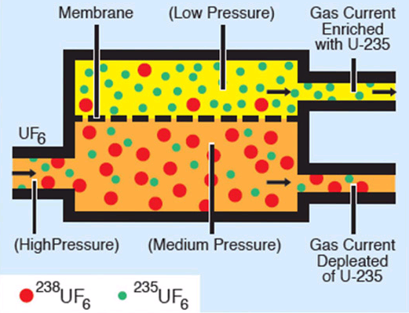
Topic 8: Energy, power, climate change 8.4 Non-fossil fuel power production
Nuclear power
Describe what is meant by fuel enrichment.
•The two slow and expensive means of enrichment for uranium are diffusion and centrifuge.
•Uranium is purified and combined with fluorine to produce a gas called uranium hexafluoride UF₆.
•The different isotopes of uranium will lead to slightly different UF₆ masses.
•The process of diffusion uses many stages of membrane filters.
Notes:
© 2006 By Timothy K. Lund

Slide 14
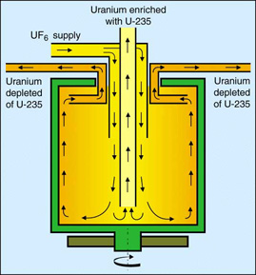
Topic 8: Energy, power, climate change 8.4 Non-fossil fuel power production
Nuclear power
Describe what is meant by fuel enrichment.
•The two slow and expensive means of enrichment for uranium are diffusion and centrifuge.
•Uranium is purified and combined with fluorine to produce a gas called uranium hexafluoride UF₆.
•The different isotopes of uranium will lead to slightly different UF₆ masses.
•Centrifuging spins the gas and the heavier isotopes are decanted while the lighter ones are sent to the next stage.
Notes:
© 2006 By Timothy K. Lund

Slide 15
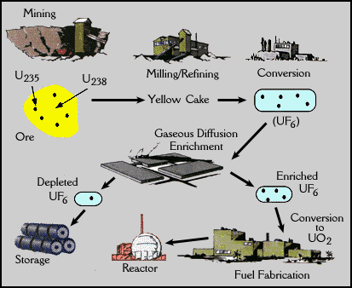
Topic 8: Energy, power, climate change 8.4 Non-fossil fuel power production
Nuclear power
Describe what is meant by fuel enrichment.
•The enrichment process…
•…increases the proportion of highly fissionable uranium-235 so that the chain reaction can be sustained.
Notes:
© 2006 By Timothy K. Lund

Slide 16
Topic 8: Energy, power, climate change 8.4 Non-fossil fuel power production
Nuclear power
8.4.4 Describe the main energy transformations that take place in a nuclear power station.
8.4.5 Discuss the role of the moderator and the control rods in the production of controlled fission in a thermal fission reactor.
8.4.6 Discuss the role of the heat exchanger in a fission reactor.
Notes:
© 2006 By Timothy K. Lund

Slide 17
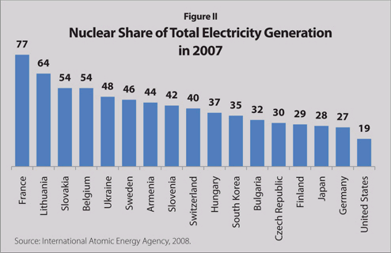
Topic 8: Energy, power, climate change 8.4 Non-fossil fuel power production
Nuclear power
Describe the main energy transformations that take place in a nuclear power station.
•Obviously, the final energy trans- formation leaves us with electrical energy.
•France uses nuclear power for 77% of its electricity.
•The US lags behind most other countries.
Notes:
© 2006 By Timothy K. Lund

Slide 18
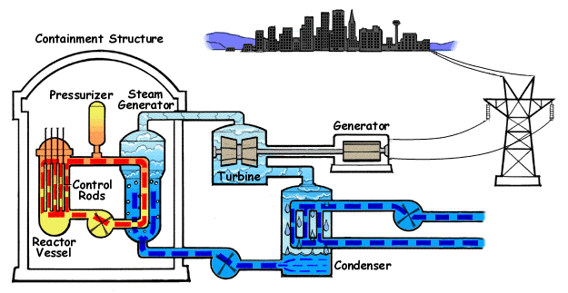
Topic 8: Energy, power, climate change 8.4 Non-fossil fuel power production
Nuclear power
Describe the main energy transformations that take place in a nuclear power station.
•Nuclear
⇒ Heat
⇒ Kinetic
⇒ Electrical
Notes:
© 2006 By Timothy K. Lund

Slide 19
Topic 8: Energy, power, climate change 8.4 Non-fossil fuel power production
Nuclear power
Describe the main energy transformations that take place in a nuclear power station.
EXAMPLE: Create a Sankey diagram for a typical nuclear reactor: Because of the difficulty of enrichment, include that energy in the diagram.
SOLUTION:
ENERGY USED IN PROCESSING FUEL
ENERGY IN URANIUM ORE
ENERGY IN ENRICHED URANIUM
ELECTRICAL ENERGY
ENERGY REMAINING IN SPENT FUEL
HEAT LOSS
Notes:
© 2006 By Timothy K. Lund

Slide 20
Topic 8: Energy, power, climate change 8.4 Non-fossil fuel power production
Nuclear power
Describe the main energy transformations that take place in a nuclear power station.
PRACTICE:
What transformations were not shown in the previous Sankey diagram?
SOLUTION:
•Between ENERGY IN ENRICHED URANIUM and ELECTRICAL there should be HOT STEAM and KINETIC.
•From HOT STEAM and KINETIC there should be a HEAT LOSS and FRICTION.
ENERGY USED IN PROCESSING FUEL
ENERGY IN URANIUM ORE
ENERGY IN ENRICHED URANIUM
ELECTRICAL ENERGY
ENERGY REMAINING IN SPENT FUEL
HEAT LOSS
Notes:
© 2006 By Timothy K. Lund

Slide 21
Topic 8: Energy, power, climate change 8.4 Non-fossil fuel power production
Nuclear power
Discuss the role of the moderator and the control rods in the production of controlled fission in a thermal fission reactor.
•Recall that a typical fission of ²³⁵U will produce two (and sometimes 3) product neutrons.
•These neutrons have a wide range of kinetic energies E_{K}.
•If the E_{K} value of a neutron is too high, it can pass through a ²³⁵U nucleus without causing it to split.
•If the E_{K} value is too small, it will just bounce off of the ²³⁵U nucleus without exciting it at all.
too slow
too fast
Notes:
© 2006 By Timothy K. Lund

Slide 22
Topic 8: Energy, power, climate change 8.4 Non-fossil fuel power production
Nuclear power
Discuss the role of the moderator and the control rods in the production of controlled fission in a thermal fission reactor.
•Most of the neutrons produced in a reactor are fast neutrons, unable to split the ²³⁵U nucleus.
•These fast neutrons will eventually be captured by ²³⁸U, or they will leave the surface of the fuel rod, without sustaining the fission reaction.
•Moderators such as graphite, light water and heavy water slow down these fast neutrons to about 0.02 eV so that they can contri- bute to the fission process.
1-2 MeV average
fuel rod
0
5
10
Neutron energy MeV
moderator
moderator
moderator
moderator
Notes:
© 2006 By Timothy K. Lund

Slide 23
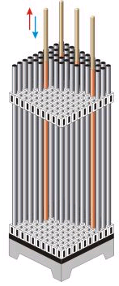
Topic 8: Energy, power, climate change 8.4 Non-fossil fuel power production
Nuclear power
Discuss the role of the moderator and the control rods in the production of controlled fission in a thermal fission reactor.
•In order to shut down, start up, and change the reaction rate in a reactor, neutron-absorbing control rods are used.
•Retracting the control rods will increase the reaction rate.
•Inserting the control rods will decrease the reaction rate.
•Control rods are made of cadmium or boron steel.
moderator
moderator
moderator
moderator
Notes:
© 2006 By Timothy K. Lund

Slide 24
Topic 8: Energy, power, climate change 8.4 Non-fossil fuel power production
Nuclear power
Discuss the role of the heat exchanger in a fission reactor.
•The whole purpose of the reactor core is to produce heat through fission.
•The fuel rods, moderator and control rods are all surrounded by water, or some other thermal absorber that can be circulated (some reactors use liquid sodium!).
•The extremely hot water from the reactor core is sent to the heat exchanger which acts like a boiler in a fossil fuel power plant.
moderator
moderator
moderator
moderator
Notes:
© 2006 By Timothy K. Lund

Slide 25
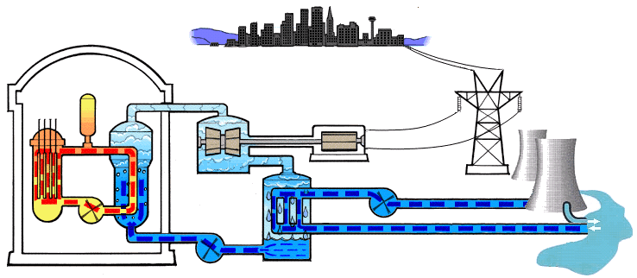
Topic 8: Energy, power, climate change 8.4 Non-fossil fuel power production
Nuclear power
Discuss the role of the heat exchanger in a fission reactor.
•The heat exchanger extracts heat from the circulating reactor coolant and makes steam to run the turbine.
heat exchanger
control rods
turbine
generator
cooling tower
condenser
Notes:
© 2006 By Timothy K. Lund

Slide 26
Topic 8: Energy, power, climate change 8.4 Non-fossil fuel power production
Nuclear power
Discuss the role of the heat exchanger in a fission reactor.
•Note the three isolated circulation zones whose purpose is to protect the environment.
Zone 1:
Reactor coolant
Zone 2:
Heat exchanger
Zone 3:
Cooling tower
Notes:
© 2006 By Timothy K. Lund

Slide 27
Topic 8: Energy, power, climate change 8.4 Non-fossil fuel power production
Nuclear power
8.4.7 Describe how neutron capture by a nucleus of uranium-238 results in the production of a nucleus of plutonium-239.
8.4.8 Describe the importance of plutonium-239 as a nuclear fuel.
Notes:
© 2006 By Timothy K. Lund

Slide 28
Topic 8: Energy, power, climate change 8.4 Non-fossil fuel power production
Nuclear power
Describe how neutron capture by a nucleus of uranium-238 results in the production of a nucleus of plutonium-239.
•During the course of operation a nuclear reactor’s uranium-238 will absorb neutrons without fissioning according to
²³⁸U + ¹n → ²³⁹U* → ²³⁹U + γ
²³⁹U → ²³⁹Np + ⁰e + ν_{e}
²³⁹Np → ²³⁹Pu + ⁰e + ν_{e}
₉₂ ₀ ₉₂ ₉₂
₉₂ ₉₃ ₋₁
₉₃ ₉₄ ₋₁
Plutonium can be used in nuclear weapons or breeder reactors.
Notes:
© 2006 By Timothy K. Lund

Slide 29
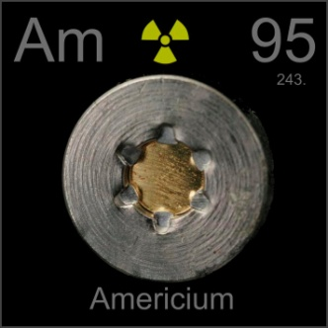
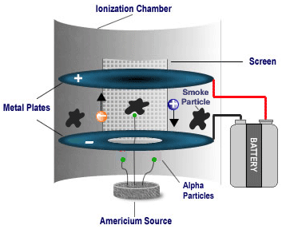
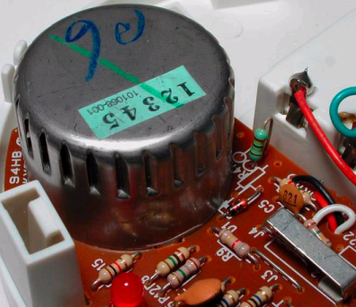
Topic 8: Energy, power, climate change 8.4 Non-fossil fuel power production
Nuclear power
Describe the importance of plutonium-239 as a nuclear fuel.
•Fast breeder reactors (FBRs) use plutonium-239 as a fuel.
•The reaction looks like this:
²³⁹Pu + ¹n → ²⁴⁰Pu
²⁴⁰Pu + ¹n → ²⁴¹Pu
²⁴¹Pu → ²⁴¹Am + ⁰e + ν_{e}
•As the next slide will show, FBRs have a blanket of uranium-238 surrounding a plutonium core.
•As the U-238 is bombarded with neutrons from the core, more plu- tonium is made, hence the term “breeder.”
₉₄ ₀ ₉₄
₉₄ ₀ ₉₄
₉₄ ₉₅ ₋₁
Notes:
© 2006 By Timothy K. Lund

Slide 30
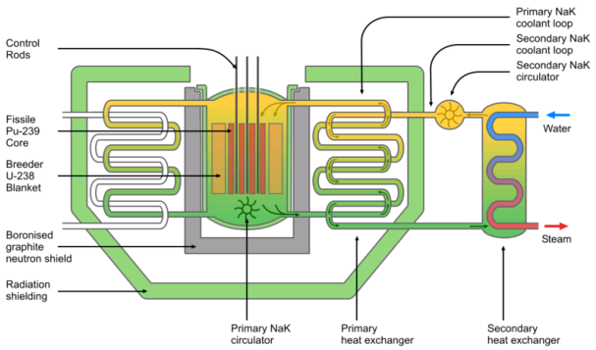
Topic 8: Energy, power, climate change 8.4 Non-fossil fuel power production
Nuclear power
Describe the importance of plutonium-239 as a nuclear fuel.
Fast breeder reactor (FBR)
Notes:
© 2006 By Timothy K. Lund

Slide 31
Topic 8: Energy, power, climate change 8.4 Non-fossil fuel power production
Nuclear power
8.4.9 Discuss safety issues and risks associated with the production of nuclear power.
Notes:
© 2006 By Timothy K. Lund

Slide 32
Topic 8: Energy, power, climate change 8.4 Non-fossil fuel power production
Nuclear power
Discuss safety issues and risks associated with the production of nuclear power.
•A simple formula may be used to assess the risk involved in any undertaking:
•The probability is a number between 0 and 1,
0 means an event will not happen
1 means an event will happen.
•The formula shows that the smaller the probability, the bigger the consequence that can be tolerated.
•For a complex system like a nuclear reactor, risks assessments are estimated by a "probabilistic risk analysis" (PRA), which is applied to each individual power plant.
risk = (probability)×(consequence)
risk
Notes:
© 2006 By Timothy K. Lund

Slide 33
Topic 8: Energy, power, climate change 8.4 Non-fossil fuel power production
Nuclear power
Discuss safety issues and risks associated with the production of nuclear power.
•PRA typical results are:
•A core melt-down might be expected once in 20,000 years of reactor operation.
- In 2 out of 3 melt-downs there would be no deaths.
- In 1 out of 5 melt-downs there would be over 1000 deaths.
- In 1 out of 100,000 melt-downs there would be 50,000 deaths.
•Transport and storage of waste:
High level waste (HLW) would result in 1 death per 50 years worth of spent fuel.
Low level waste (LLW) would be 5% of HLW.
Notes:
© 2006 By Timothy K. Lund

Slide 34
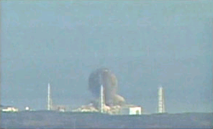
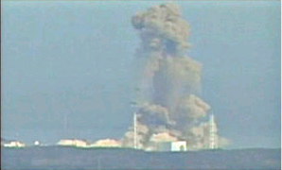
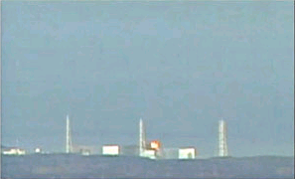
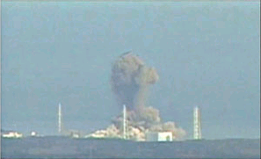
Topic 8: Energy, power, climate change 8.4 Non-fossil fuel power production
Nuclear power
Discuss safety issues and risks associated with the production of nuclear power.
•Since air pollution from coal burning is estimated to be causing 10,000 deaths per year, there would have to be 25 melt-downs each year for nuclear power to be as dangerous as coal burning.
Fukushima Power Plant
Hydrogen explosion
Notes:
© 2006 By Timothy K. Lund

Slide 35
Topic 8: Energy, power, climate change 8.4 Non-fossil fuel power production
Nuclear power
8.4.10 Outline problems associated with the production of nuclear power using fusion.
8.4.11 Solve problems on the production of nuclear power. Be able to construct and balance nuclear reaction equations.
Notes:
© 2006 By Timothy K. Lund

Slide 36
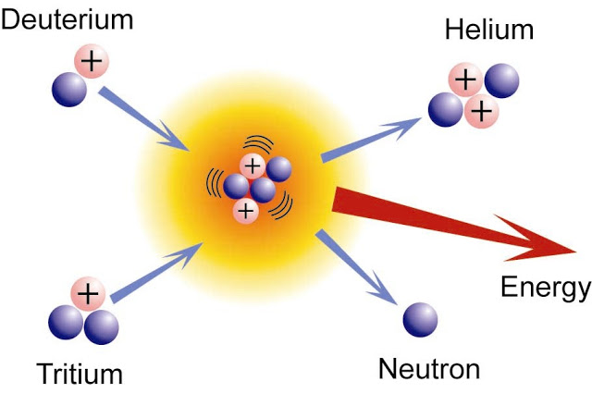
Topic 8: Energy, power, climate change 8.4 Non-fossil fuel power production
Nuclear power
Outline problems associated with the production of nuclear power using fusion.
•If nuclei at the lower end of the periodic table are heated to 100 mil- lion K, their E_{K} is great enough to overcome their Coulomb repulsion and cause them to undergo fusion.
•The two main difficulties with fusion are…
- giving the nuclei enough energy to overcome the Coulomb repulsion, and
- keeping them in close enough proximity (called confinement) to fuse.
Notes:
© 2006 By Timothy K. Lund

Slide 37
Topic 8: Energy, power, climate change 8.4 Non-fossil fuel power production
Nuclear power
Outline problems associated with the production of nuclear power using fusion.
•Three advantages of fusion are…
- Fusion releases 3 to 4 times the energy that is released by fission,
- Fusion produces no radioactive waste, and
- Fuel for fusion is plentiful.
•The two main types of controlled fusion are inertial confinement fusion (ICF) and magnetic confinement fusion (MCF).
Fuel
Fuel Type
Energy Density (MJ/kg)
Protons
Nuclear
300,000,000
Uranium-235
Nuclear
90,000,000
Petrol
Fossil
46.9
Notes:
© 2006 By Timothy K. Lund

Slide 38
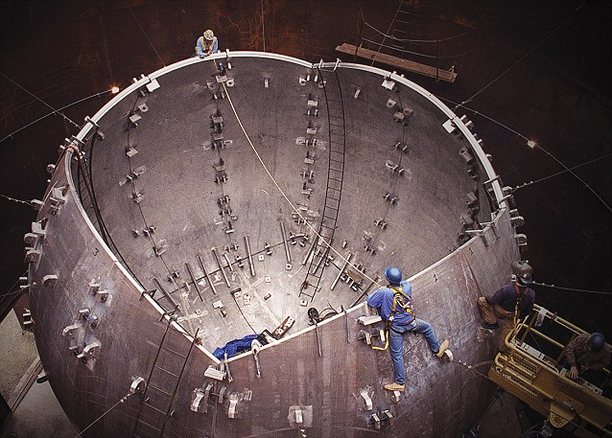
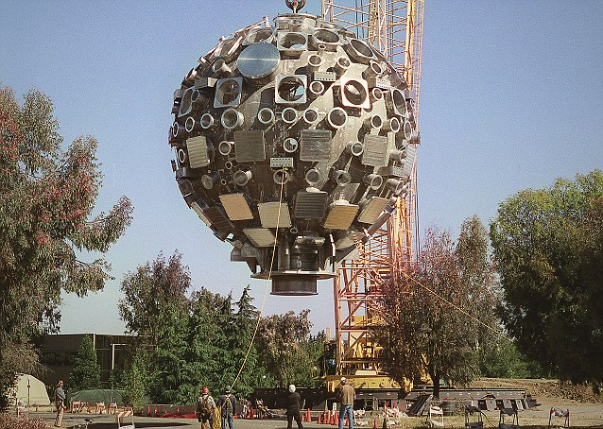
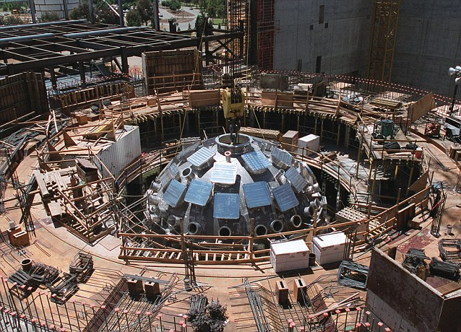
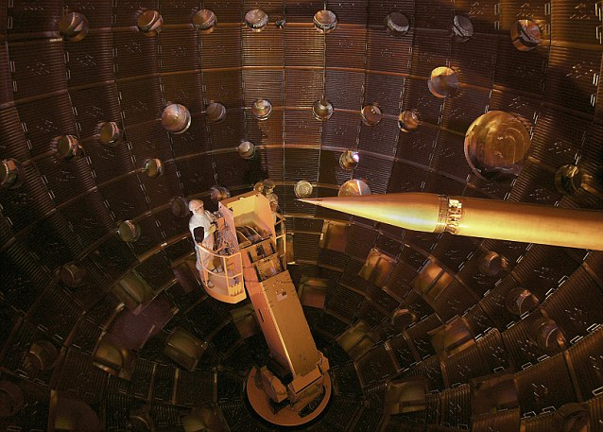
Topic 8: Energy, power, climate change 8.4 Non-fossil fuel power production
Nuclear power
Outline problems associated with the production of nuclear power using fusion.
•Inertial confinement fusion energizes an inertial (stationary) tritium- deuterium target with many high-energy lasers.
Notes:
© 2006 By Timothy K. Lund

Slide 39
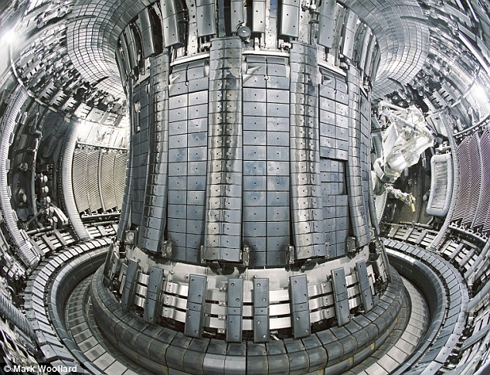
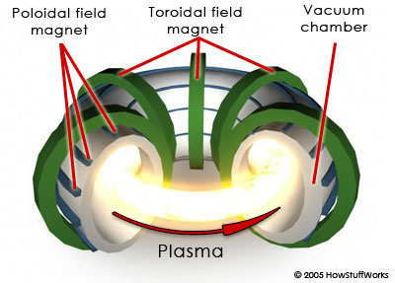
Topic 8: Energy, power, climate change 8.4 Non-fossil fuel power production
Nuclear power
Outline problems associated with the production of nuclear power using fusion.
•Magnetic confinement fusion runs an electric current through a deuterium-tritium plasma and “squeezes” it with a magnetic field.
•So far both types of fusion require more energy than is harvested from the fusion reaction.
Notes:
© 2006 By Timothy K. Lund

Slide 40
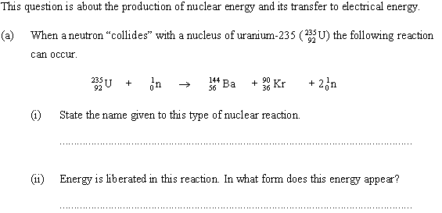
Topic 8: Energy, power, climate change 8.4 Non-fossil fuel power production
Nuclear power
Solve problems on production of nuclear power.
This is a fission reaction.
Heat and some kinetic energy of the product neutrons.
Notes:
© 2006 By Timothy K. Lund

Slide 41
Topic 8: Energy, power, climate change 8.4 Non-fossil fuel power production
Nuclear power
Solve problems on production of nuclear power.
Looking at the reaction we see that one neutron initiates one fission…
but each reaction produces two neutrons.
Thus the fission process can produce a self-sustaining chain reaction.
Notes:
© 2006 By Timothy K. Lund

Slide 42
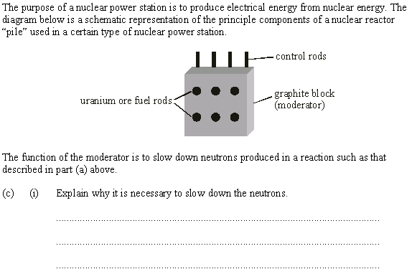
Topic 8: Energy, power, climate change 8.4 Non-fossil fuel power production
Nuclear power
Solve problems on production of nuclear power.
Product neutrons are too fast to cause fissioning.
The moderator slows them down to the right speed.
Notes:
© 2006 By Timothy K. Lund

Slide 43
Topic 8: Energy, power, climate change 8.4 Non-fossil fuel power production
Nuclear power
Solve problems on production of nuclear power.
The control rods absorb neutrons produced by fission.
This allow a reactor to just maintain its reaction rate at the self-sustaining level, rather than becoming a dangerous chain reaction.
Notes:
© 2006 By Timothy K. Lund

Slide 44
Topic 8: Energy, power, climate change 8.4 Non-fossil fuel power production
Nuclear power
Solve problems on production of nuclear power.
Reactor coolant from the pile is circulated through a heat exchanger.
The heat exchanger heats up water to boiling to run a steam turbine.
The steam turbine turns a generator to produce electricity.
Notes:
© 2006 By Timothy K. Lund

Slide 45
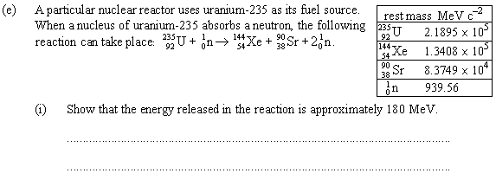
Topic 8: Energy, power, climate change 8.4 Non-fossil fuel power production
Nuclear power
Solve problems on production of nuclear power.
The reactants: U-235 and 1n:
218950 + 940 = 219890 MeV.
The products: Xe-144, Sr 90 and 2n:
134080 + 83749 + 2(940) = 219709 MeV.
The mass defect is 219890 – 219709 = 181 MeV.
(This is the energy released through mass loss according to E = mc²).
Notes:
© 2006 By Timothy K. Lund

Slide 46
Topic 8: Energy, power, climate change 8.4 Non-fossil fuel power production
Solar power
8.4.12 Distinguish between a photovoltaic cell and a heating panel.
8.4.13 Outline reasons for seasonal and regional variations in the solar power incident per unit area of the Earth’s surface.
8.4.14 Solve problems involving specific applications of photovoltaic cells and solar heating panels.
Notes:
© 2006 By Timothy K. Lund

Slide 47
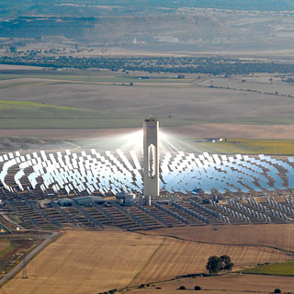
Topic 8: Energy, power, climate change 8.4 Non-fossil fuel power production
Solar power
•The energy of the sun produced the fossil fuels.
•Hydroelectric dams operate using sun-lifted water.
•Wind turbines use sun-driven wind currents.
•In a sense, all of these energy sources are indirectly due to the sun.
•When we speak of solar power it is in the direct sense, meaning energy gotten directly from the sun's rays.
•The two direct solar energy devices we will discuss in this section are solar heating panels and photovoltaic cells.
Notes:
© 2006 By Timothy K. Lund

Slide 48
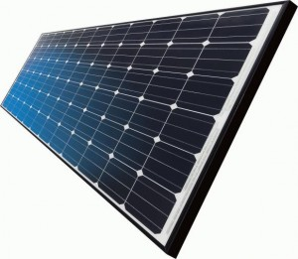
Topic 8: Energy, power, climate change 8.4 Non-fossil fuel power production
Solar power
Distinguish between a photovoltaic cell and a heating panel.
•The photovoltaic cell converts sunlight directly into electricity.
•The cell is made of crystalline silicon (a semiconductor) doped with phosphorus and boron impurities.
N-type silicon
P-type silicon
Notes:
© 2006 By Timothy K. Lund

Slide 49
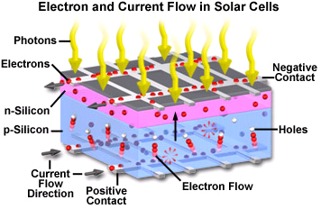
Topic 8: Energy, power, climate change 8.4 Non-fossil fuel power production
Solar power
Distinguish between a photovoltaic cell and a heating panel.
Notes:
© 2006 By Timothy K. Lund

Slide 50
Topic 8: Energy, power, climate change 8.4 Non-fossil fuel power production
Solar power
Distinguish between a photovoltaic cell and a heating panel.
•The heating panel converts sunlight directly into heat.
•The slower the water is circulated, the hotter it can get.
sunlight
glass
insulation
black absorber
cold water in
water pipe
hot water out
Notes:
© 2006 By Timothy K. Lund

Slide 51
Topic 8: Energy, power, climate change 8.4 Non-fossil fuel power production
Solar power
Outline reasons for seasonal and regional variations in the solar power incident per unit area of the Earth’s surface.
PRACTICE: The sun radiates energy at a rate of 3.90×10²⁶ W. What is the rate at which energy from the sun reaches earth if our orbital radius is 1.5×10¹¹ m?
SOLUTION:
•The surface area of a sphere is A = 4πr².
•Recall that intensity is the rate at which energy is being gained per unit area. Thus
or I = P/[4πr²] = 3.90×10²⁶/[4π(1.5×10¹¹)²]
I = 1380 W m⁻².
•This is 1380 J/s per m².
intensity = power / A
wave power
Notes:
© 2006 By Timothy K. Lund

Slide 52
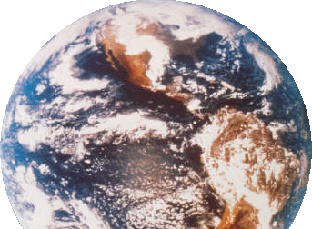
Topic 8: Energy, power, climate change 8.4 Non-fossil fuel power production
Solar power
Outline reasons for seasonal and regional variations in the solar power incident per unit area of the Earth’s surface.
PRACTICE: Explain why the solar intensity is different for different parts of the earth.
SOLUTION:
•The following diagram shows how the same intensity is spread out over more area the higher the latitude.
1380 W/m²
Notes:
© 2006 By Timothy K. Lund

Slide 53
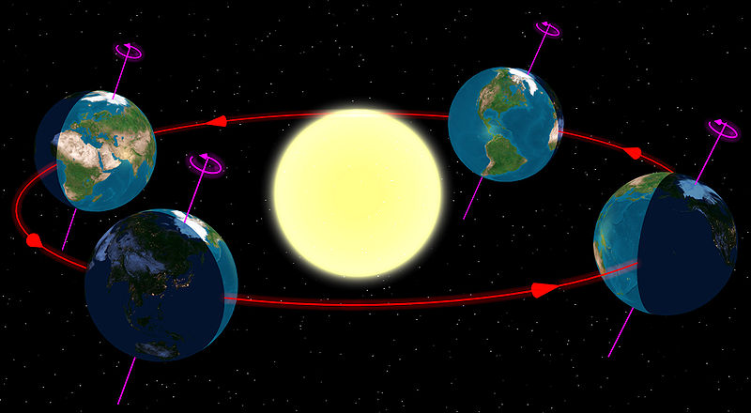
Topic 8: Energy, power, climate change 8.4 Non-fossil fuel power production
Solar power
Outline reasons for seasonal and regional variations in the solar power incident per unit area of the Earth’s surface.
Intensity also varies with season, which is due to the tilt of Earth.
Notes:
© 2006 By Timothy K. Lund

Slide 54
Topic 8: Energy, power, climate change 8.4 Non-fossil fuel power production
Solar power
Solve problems involving specific applications of photovoltaic cells and solar heating panels.
EXAMPLE: A photovoltaic cell has an area of 1.00 cm² and an efficiency of 10.5%.
(a) If the cell is placed in a position where the sun's intensity is I = 1250 W m⁻², what is the power output of the cell?
SOLUTION:
A = (1 cm²)(1 m / 100 cm)² = 0.0001 m².
P_{in}/A = I so P_{in} = IA = 1250(0.0001) = 0.125 W.
•The cell is only 10.5% efficient so that
P_{out} = 0.105P_{in} = 0.105(.125) = 0.0131 W.
Notes:
© 2006 By Timothy K. Lund

Slide 55
Topic 8: Energy, power, climate change 8.4 Non-fossil fuel power production
Solar power
Solve problems involving specific applications of photovoltaic cells and solar heating panels.
EXAMPLE: A photovoltaic cell has an area of 1.00 cm² and an efficiency of 10.5%.
(b) If the cell is rated at 0.500 V, what is its current output?
(c) If ten of these cells are placed in series, what will the voltage and the current be?
SOLUTION:
(b) P = IV so that I = P/V = 0.0131/.5 = 0.0262 A
(c) In series the voltage increases.
In series the current stays the same.
Thus V = 10(0.500) = 5.00 V and I = 0.0262 A.
Notes:
© 2006 By Timothy K. Lund

Slide 56
Topic 8: Energy, power, climate change 8.4 Non-fossil fuel power production
Solar power
Solve problems involving specific applications of photovoltaic cells and solar heating panels.
EXAMPLE: A photovoltaic cell has an area of 1.00 cm² and an efficiency of 10.5%.
(d) If ten of these cells are placed in parallel, what will the voltage and the current be?
(e) How many cells would you need to operate a 100 W circuit?
SOLUTION:
(d) In parallel the voltage stays the same.
In parallel the current increases.
Thus V = 0.500 V and I = (10)(0.0262) = 0.262 A.
(e) P_{out} = 0.0131 W/cell. Thus
(100 W)/(.0131 W/cell) = 7630 cells!
Notes:
© 2006 By Timothy K. Lund

Slide 57
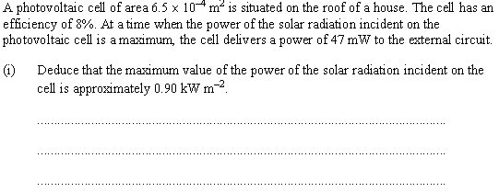
Topic 8: Energy, power, climate change 8.4 Non-fossil fuel power production
Solar power
Solve problems involving specific applications of photovoltaic cells and solar heating panels.
Eff = P_{out} / P_{in} so that
P_{in} = P_{out} / Eff = 47×10⁻³ / 0.08 = 0.5875 W.
Thus I = P_{in} / A = 0.5875 W / 6.5×10⁻⁴ m²
I = 900 W m⁻² = 0.90 kW m⁻².
Notes:
© 2006 By Timothy K. Lund

Slide 58
Topic 8: Energy, power, climate change 8.4 Non-fossil fuel power production
Solar power
Solve problems involving specific applications of photovoltaic cells and solar heating panels.
Cloud cover variation is one reason.
Season is another reason.
FYI
•Do NOT use latitude as a reason for this question.
•The question specifically states that it is concerned with only a particular region having a variation.
Notes:
© 2006 By Timothy K. Lund

Slide 59
Topic 8: Energy, power, climate change 8.4 Non-fossil fuel power production
Solar power
Solve problems involving specific applications of photovoltaic cells and solar heating panels.
PRACTICE: Draw a Sankey diagram for a photovoltaic cell having an efficiency of 18%.
•Perhaps, like the nuclear reactor, we could also show the energy needed to process the materials that go into a photovoltaic cell.
ENERGY IN INCIDENT SUNLIGHT
USEABLE ELECTRICITY
WASTED HEAT
Notes:
© 2006 By Timothy K. Lund

Slide 60
Topic 8: Energy, power, climate change 8.4 Non-fossil fuel power production
Solar power
Solve problems involving specific applications of photovoltaic cells and solar heating panels.
Because of the tilt of Earth’s axis southern exposures get more sun in the northern hemisphere, and northern exposures get more sun in the southern hemisphere.
Notes:
© 2006 By Timothy K. Lund

Slide 61
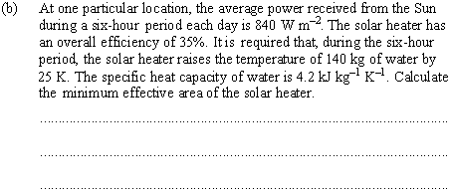
Topic 8: Energy, power, climate change 8.4 Non-fossil fuel power production
Solar power
Solve problems involving specific applications of photovoltaic cells and solar heating panels.
•From Topic 3 the energy needed for ∆T = 25 K is
Q = mc∆T = 140(4200)(25) = 1.47×10⁷ J.
•But P_{out} = Q/t = 1.47×10⁷ J / (6 h)(3600 s / h)
so that P_{out} = 681 W.
•Since Efficiency = P_{out} / P_{in} = 0.35 then
P_{in} = P_{out} / Eff. = 681/0.35 = 1944 W
•From I = P_{in}/A we get A = P_{in}/I so that
A = 1944/840 = 2.3 m².
Notes:
© 2006 By Timothy K. Lund

Slide 62
Topic 8: Energy, power, climate change 8.4 Non-fossil fuel power production
Hydroelectric power
8.4.15 Distinguish between different hydroelectric schemes.
8.4.16 Describe the main energy transformations that take place in a hydroelectric scheme.
8.4.17 Solve problems involving hydroelectric schemes.
Notes:
© 2006 By Timothy K. Lund

Slide 63
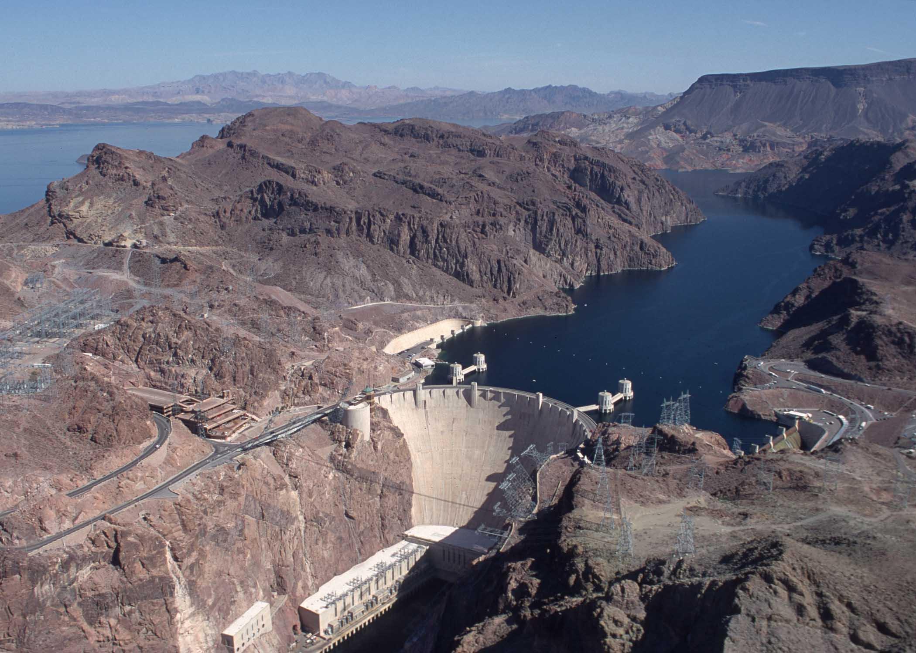
Topic 8: Energy, power, climate change 8.4 Non-fossil fuel power production
Hydroelectric power
Distinguish between different hydroelectric schemes.
•We can divide hydroelectric power production into two groups:
•Sun-derived uses sun-driven potential energy.
•Moon-derived uses tidal-driven potential energy.
Hoover Dam: 1.5×10⁹ W
Rance Tidal Barrage: 2.4×10⁸ W
Notes:
© 2006 By Timothy K. Lund

Slide 64
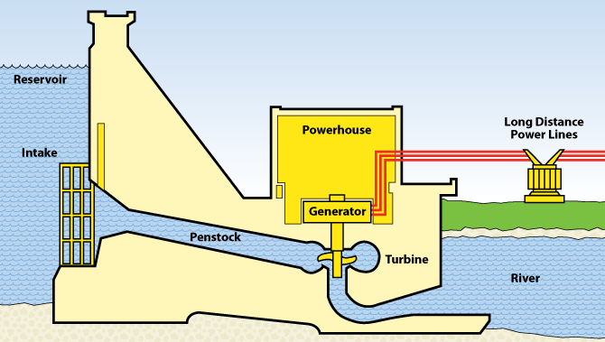
Topic 8: Energy, power, climate change 8.4 Non-fossil fuel power production
Hydroelectric power
Distinguish between different hydroelectric schemes.
•A typical hydroelectric dam:
•Evaporation and rainfall place water at a high potential energy.
•During times of less energy demand, excess power plant electricity can be used to pump water back up into the reservoir for later use.
•This is called the pumped storage scheme.
Notes:
© 2006 By Timothy K. Lund

Slide 65
Topic 8: Energy, power, climate change 8.4 Non-fossil fuel power production
Hydroelectric power
Distinguish between different hydroelectric schemes.
•A typical tidal barrage:
•The turbine can be driven both ways during a tidal cycle.
Ocean side
Estuary side
Notes:
© 2006 By Timothy K. Lund

Slide 66
Topic 8: Energy, power, climate change 8.4 Non-fossil fuel power production
Hydroelectric power
Describe the main energy transformations that take place in a hydroelectric scheme.
•In the sun- or tide-driven scheme there is a conversion of the potential energy of the water into the kinetic energy of a turbine and thus to electricity.
ENERGY IN SUNLIGHT /OR TIDE
POTENTIAL ENERGY IN RESERVOIR
KINETIC ENERGY OF TURBINE
ELECTRICITY
FRICTION
FRICTION
EVAPORATION FROM RESERVOIR
Notes:
© 2006 By Timothy K. Lund

Slide 67
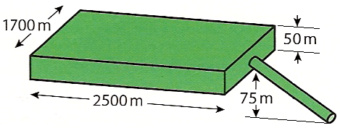
Topic 8: Energy, power, climate change 8.4 Non-fossil fuel power production
Hydroelectric power
Solve problems involving hydroelectric schemes.
PRACTICE: A reservoir for a hydroelectric dam is shown.
(a) Calculate the potential energy yield.
SOLUTION:
•The total volume of water is
V = 1700(2500)(50) = 2.125×10⁸ m³.
•The mass of the water is
m = ρV = (1000 kg m⁻³)(2.125×10⁸ m³)
= 2.125×10¹¹ kg.
•The average height of the water is
h = 75 + 50/2 = 100 m.
•The potential energy yield will then be
E_{P} = mgh = (2.125×10¹¹)(10)(100) = 2.125×10¹⁴ J.
Notes:
© 2006 By Timothy K. Lund

Slide 68
Topic 8: Energy, power, climate change 8.4 Non-fossil fuel power production
Hydroelectric power
Solve problems involving hydroelectric schemes.
PRACTICE: A reservoir for a hydroelectric dam is shown.
(b) If the water flow rate is 25 m³ per second, what is the power provided by the moving water?
SOLUTION:
•Each cubic meter has a mass of 1000 kg.
•Thus each second m = 25(1000) = 25000 kg falls.
•Thus each second the reservoir relinquishes
E_{P} = mgh = (25000)(10)(100) = 2.5×10⁷ J.
•Since power is measured in W (or J s⁻¹) the power provided is 2.5×10⁷ W.
Average height is 100 m.
Notes:
© 2006 By Timothy K. Lund

Slide 69
Topic 8: Energy, power, climate change 8.4 Non-fossil fuel power production
Hydroelectric power
Solve problems involving hydroelectric schemes.
PRACTICE: A reservoir for a hydroelectric dam is shown.
(c) If the water is not replenished, how long can this reservoir produce power at this rate?
SOLUTION:
•The total volume of water is
V = 1700(2500)(50) = 2.125×10⁸ m³.
•The volume flow rate is 25 m³ s⁻¹.
•Thus the time is given by
t = (2.125×10⁸ m³) / (25 m³ s⁻¹)
= 8.5×10⁶ s = 2361 h = 100 d.
Notes:
© 2006 By Timothy K. Lund

Slide 70
Topic 8: Energy, power, climate change 8.4 Non-fossil fuel power production
Wind power
8.4.18 Outline the basic features of a wind generator.
8.4.19 Determine the power that may be delivered by a wind generator, assuming that the wind kinetic energy is completely converted into mechanical energy, and explain why this is impossible.
8.4.20 Solve problems involving wind power.
Notes:
© 2006 By Timothy K. Lund

Slide 71
Topic 8: Energy, power, climate change 8.4 Non-fossil fuel power production
Wind power
Outline the basic features of a wind generator.
•Heated land air becomes less dense, and rises.
•Cooler air then fills the low pressure left behind.
•A convection current forms.
Air Falls
Air Rises
Convection Current
Partial Vacuum
Low Pressure
Land (c is small)
Wind Turbine
Heats/cools QUICKLY
Water (c is big)
Heats/cools SLOWLY
Notes:
© 2006 By Timothy K. Lund

Slide 72
Topic 8: Energy, power, climate change 8.4 Non-fossil fuel power production
Wind power
Outline the basic features of a wind generator.
•The most obvious features are the rotor blades.
•The nacelle contains a gearbox, and a generator.
Notes:
© 2006 By Timothy K. Lund

Slide 73
Topic 8: Energy, power, climate change 8.4 Non-fossil fuel power production
Wind power
Determine the power that may be delivered by a wind generator, assuming that the wind kinetic energy is completely converted into mechanical energy, and explain why this is impossible.
•Assume a rotor blade radius of r.
•The volume of air that moves through the blades in a time t is given by V = Ad = Avt, where v is the speed of the air and A = πr².
•The mass m is thus m = ρV = ρAvt.
•The kinetic energy of the air is thus
E_{K} = (1/2)mv² = (1/2)ρAvtv² = (1/2)ρAv³t.
•Power is E_{K}/t so that
d = vt
r
where A = πr²
wind generator
power = (1/2)Aρv³
Notes:
© 2006 By Timothy K. Lund

Slide 74
Topic 8: Energy, power, climate change 8.4 Non-fossil fuel power production
Wind power
Solve problems involving wind power.
PRACTICE: Since the air is still moving after passing through the rotor area, obviously not all of the kinetic energy can be used. The maximum theoretical efficien- cy of a wind turbine is about 60%. Given a turbine having a blade length of 12 m, a wind speed of 15 ms⁻¹ and an efficiency of 45%, find the power output. The density of air is ρ = 1.2 kg m⁻³.
SOLUTION:
A = πr² = π(12²) = 452 m².
power = (0.45)(1/2)Aρv³
= (0.45)(1/2)(452)(1.2)(15³)
= 411885 W = 410 kW.
Notes:
© 2006 By Timothy K. Lund

Slide 75
Topic 8: Energy, power, climate change 8.4 Non-fossil fuel power production
Wind power
Solve problems involving wind power.
A = πr² = π(7.5²) = 177
power_{in} = (1/2)Aρv³ = (1/2)(177)(1.2)9³ = 77420
power_{thru} = (1/2)Aρv³ = (1/2)(177)(2.2)5³ = 24338
power_{ext} = power_{in} - power_{thru}
power_{ext} = 77420 – 24338 = 53082 W = 53 kW.
Notes:
© 2006 By Timothy K. Lund

Slide 76
Topic 8: Energy, power, climate change 8.4 Non-fossil fuel power production
Wind power
Solve problems involving wind power.
P_{out} = (efficiency)P_{extracted}
P_{out} = (0.72)(53 kW) = 38 kW
Notes:
© 2006 By Timothy K. Lund

Slide 77
Topic 8: Energy, power, climate change 8.4 Non-fossil fuel power production
Wind power
Solve problems involving wind power.
Power is proportional to v³.
The wind speed had doubled (from 6 to 12 m s⁻¹).
Thus the power should increase by 2³ = 8 times.
Output will now be 8(5 kW) = 40 kW.
Notes:
© 2006 By Timothy K. Lund

Slide 78
Topic 8: Energy, power, climate change 8.4 Non-fossil fuel power production
Wave power
8.4.21 Describe the principle of operation of an oscillating water column (OWC) ocean-wave energy converter.
8.4.22 Determine power per unit length of a wavefront, assuming a rectangular profile for the wave.
8.4.23 Solve problems involving wave power.
Notes:
© 2006 By Timothy K. Lund

Slide 79
Topic 8: Energy, power, climate change 8.4 Non-fossil fuel power production
Wave power
Describe the principle of operation of an oscillating water column (OWC) ocean-wave energy converter.
•The following diagram illustrates the function of an oscillating water column:
air column - compressed and rarefied by rising and falling wave.
wind turbine generator
Turbine generates electricity in both directions
Notes:
© 2006 By Timothy K. Lund

Slide 80
Topic 8: Energy, power, climate change 8.4 Non-fossil fuel power production
Wave power
Determine power per unit length of a wavefront, assuming a rectangular profile for the wave.
•Let A be the amplitude of the wave.
•Let L be the length of shoreline meeting the wave. Then…
E_{P} = mgh
E_{P} = mgA/2 (h_{avg})
E_{P} = ρVgA/2 (m = ρV)
E_{P} = ρλLAgA/2 (V = λLA)
A
E_{P} = ρλLgA²/2
A/2
E_{P} = ρvTLgA²/2 (λ = vT)
E_{P}/TL = (1/2)A²ρgv
λ = vT
L
λ
power per unit length = (1/2)A²ρgv
wave power
Notes:
© 2006 By Timothy K. Lund

Slide 81
Topic 8: Energy, power, climate change 8.4 Non-fossil fuel power production
Wave power
Solve problems involving wave power.
power per unit length = (1/2)A²ρgv
Increase from 2A is thus 2² = 4 times.
Increase from 2v is thus 2 times.
This gives an overall increase of 8 times.
8(4.0 kW m⁻¹) = 32 kW m⁻¹.
Notes:
© 2006 By Timothy K. Lund

Slide 82
Topic 8: Energy, power, climate change 8.4 Non-fossil fuel power production
Wave power
Solve problems involving wave power.
PRACTICE: Waves having an amplitude of 4.0 m roll onto a beach at a rate of one every 5.0 seconds. The wave crests are 60. meters apart. (a) How much wave power is there, per unit length? (b) How much energy is there on a 25 km coast?
SOLUTION:
(a) v = λ/T = 60/5 = 12 m s⁻¹.
power/length = (1/2)A²ρgv
= (1/2)4²(1000)(10)(12)
= 960000 W m⁻¹ = 960 kW m⁻¹.
(b) power = (960000 W m⁻¹)(25000 m)
= 2.4×10¹⁰ W.
Notes:
© 2006 By Timothy K. Lund

