Slide 1
Topic 8: Energy, power, climate change 8.5 Greenhouse effect
Solar radiation
8.5.1 Calculate the intensity of the Sun’s radiation incident on a planet.
8.5.2 Define albedo.
8.5.3 State factors that determine a planet’s albedo.
Notes:
© 2006 By Timothy K. Lund

Slide 2
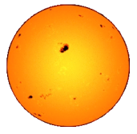
Topic 8: Energy, power, climate change 8.5 Greenhouse effect
Solar radiation
Calculate the intensity of the Sun’s radiation incident on a planet.
PRACTICE: The sun radiates energy at a rate of 3.90×10²⁶ W. What is the rate at which energy from the sun reaches Earth if our orbital radius is 1.5×10¹¹ m?
SOLUTION:
•The surface area of a sphere is A = 4πr².
•Recall that intensity is the rate at which energy is being gained per unit area. Thus
so I = P/[4πr²] = 3.90×10²⁶/[4π(1.5×10¹¹)²]
I = 1380 W m⁻².
•This is 1380 J/s per m².
intensity = power / A
intensity
Notes:
© 2006 By Timothy K. Lund

Slide 3
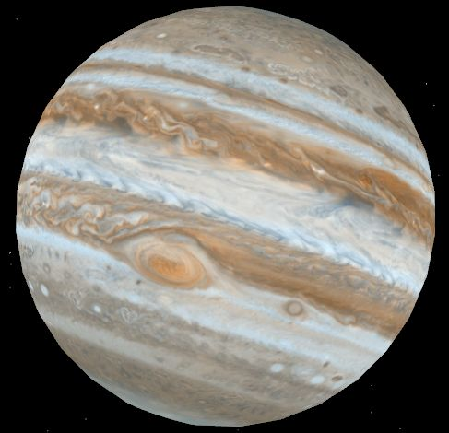
Topic 8: Energy, power, climate change 8.5 Greenhouse effect
Solar radiation
Calculate the intensity of the Sun’s radiation incident on a planet.
PRACTICE: The sun radiates energy at a rate of 3.90×10²⁶ W. What is the rate at which energy from the sun reaches Jupiter if its orbital radius is 7.8×10¹¹ m?
SOLUTION:
•I = P/[4πr²] = 3.90×10²⁶/[4π(7.8×10¹¹)²]
I = 51 W m⁻².
•This is 51 J/s per m².
Notes:
© 2006 By Timothy K. Lund

Slide 4
Topic 8: Energy, power, climate change 8.5 Greenhouse effect
P_{incident}
Solar radiation
Define albedo.
•When light strikes an object, some of it is absorbed, and some of it is scattered.
•If light strikes a mirror, nearly all of it will be scattered:
•If light strikes a surface covered with lamp black, nearly all of it will be absorbed:
•We define albedo in terms of scattered and incident power as
P_{scattered}
heat
P_{scattered}
P_{incident}
heat
albedo
albedo = P_{scattered} / P_{incident}
FYI
•The mirror has an albedo of almost 1.
•The black body has an albedo of almost 0.
Notes:
© 2006 By Timothy K. Lund

Slide 5
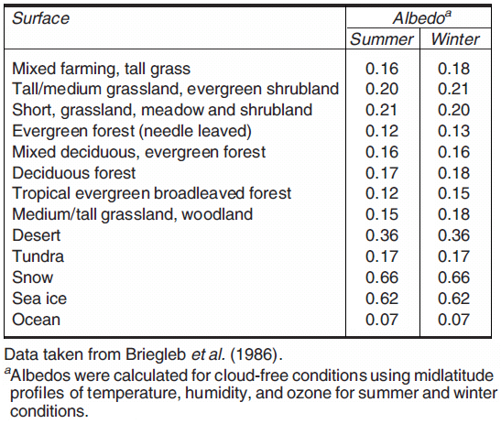
Topic 8: Energy, power, climate change 8.5 Greenhouse effect
Solar radiation
State factors that determine a planet’s albedo.
•Observing the table we can see that different terrains have a variety of albedos.
•Ocean water scatters little light (7%).
•Snow and ice scatter a lot of light (62% to 66%).
•Desert (36%).
Notes:
© 2006 By Timothy K. Lund

Slide 6
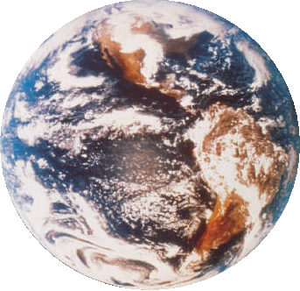
Topic 8: Energy, power, climate change 8.5 Greenhouse effect
Solar radiation
State factors that determine a planet’s albedo.
•From the previous table it is clear that calculating the overall albedo of a planet is quite complex.
•Clouds also contribute to the albedo.
•Even plane contrails!
•Overall, Earth’s mean yearly albedo is about 0.3 (or 30%).
•The actual albedo depends on season, latitude, cloud cover, and snow cover.
•It varies daily!
Notes:
© 2006 By Timothy K. Lund

Slide 7
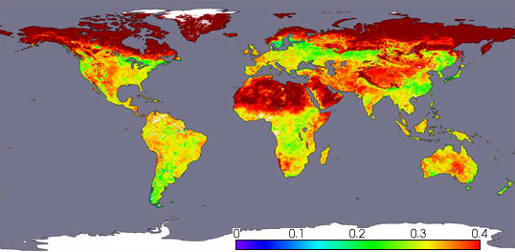
Topic 8: Energy, power, climate change 8.5 Greenhouse effect
Solar radiation
State factors that determine a planet’s albedo.
White and gray areas: No data.
Albedo
April, 2002, Terra satellite, NASA
Notes:
© 2006 By Timothy K. Lund

Slide 8
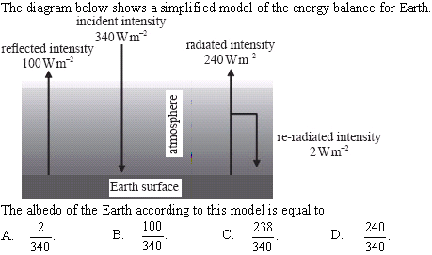
Topic 8: Energy, power, climate change 8.5 Greenhouse effect
Solar radiation
State factors that determine a planet’s albedo.
•albedo = P_{scattered}/P_{incident}
•P_{incident} = 340 W m⁻²
•P_{scattered} = 100 W m⁻²
•albedo = 100/340
Notes:
© 2006 By Timothy K. Lund

Slide 9
Topic 8: Energy, power, climate change 8.5 Greenhouse effect
The greenhouse effect
8.5.4 Describe the greenhouse effect.
8.5.5 Identify the main greenhouse gases and their sources.
8.5.6 Explain the molecular mechanisms by which greenhouse gases absorb infrared radiation.
8.5.7 Analyze absorption graphs to compare the relative effects of different greenhouse gases.
Notes:
© 2006 By Timothy K. Lund

Slide 10
Topic 8: Energy, power, climate change 8.5 Greenhouse effect
Net heat gain
The greenhouse effect
Describe the greenhouse effect.
•When solar radiation strikes a planet that has a gaseous atmosphere, the gases comprising the atmosphere can absorb infrared radiation (heat).
•The remainder of the incoming radiation then reaches the ground to either be scattered back into the atmosphere, or absorbed.
•Solids can absorb all frequencies of radiation, and convert them to infrared wavelengths.
•The heated ground can then emit infrared radiation back into the atmosphere, which then intercepts more of the energy on the way out.
•The result is that the atmosphere traps heat and causes the temperature of the planet to rise.
•This is the so-called greenhouse effect.
Notes:
© 2006 By Timothy K. Lund

Slide 11
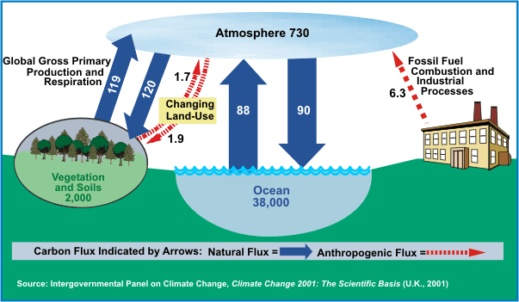
Topic 8: Energy, power, climate change 8.5 Greenhouse effect
The greenhouse effect
Identify the main greenhouse gases and their sources.
•The main gases that are particularly effective in absorbing infrared radiation are methane (CH₄), water vapor (H₂O), carbon di- oxide (CO₂), and nitrous oxide (N₂O).
•Note that there are both natural and man-made changes.
C-sink
C-sink
C-sink
Global Carbon Cycle (Billion Metric Tons Carbon)
Notes:
© 2006 By Timothy K. Lund

Slide 12
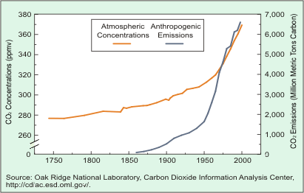
Topic 8: Energy, power, climate change 8.5 Greenhouse effect
The greenhouse effect
Identify the main greenhouse gases and their sources.
•This graph shows the correlation between increasing atmospheric concentration of CO₂ and our fossil fuel emissions of CO₂.
•Anthropogenic means “human.”
Trends in Atmospheric Concentrations and Anthropogenic Emissions of Carbon Dioxide
Notes:
© 2006 By Timothy K. Lund

Slide 13
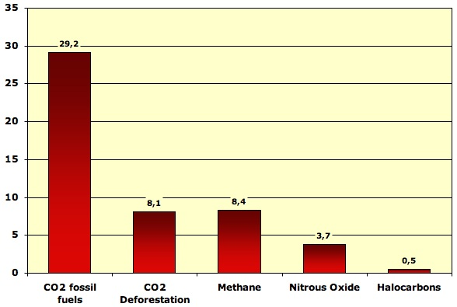
Topic 8: Energy, power, climate change 8.5 Greenhouse effect
The greenhouse effect
Identify the main greenhouse gases and their sources.
•This graph shows relative emissions of the main five human- contributed greenhouse gases.
•Note that deforestation accounts for 8.1/(8.1 + 29.2) = 22% of human- caused CO₂ increase.
Breakdown of world greenhouse gas emissions in 2004 by gas (except ozone), in billion tonnes CO₂ equivalent. From IPCC, 2007.
Notes:
© 2006 By Timothy K. Lund

Slide 14
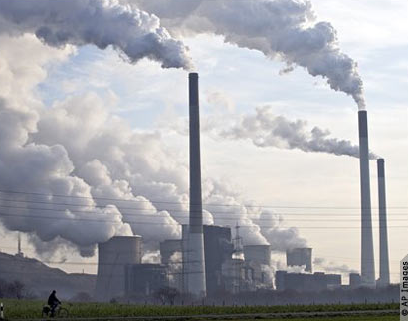
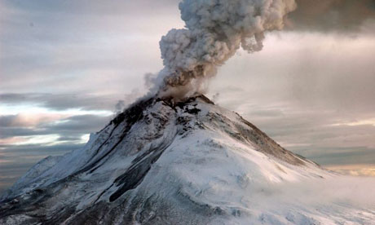
Topic 8: Energy, power, climate change 8.5 Greenhouse effect
The greenhouse effect
Identify the main greenhouse gases and their sources.
•Volcanoes also produce greenhouse gases.
•It is estimated that humans produce about 35 billion metric tons of CO₂ per year, whereas volcanoes produce about .14 to .44 billion metric tons (or about 1.2% of CO₂ emissions at the most).
Notes:
© 2006 By Timothy K. Lund

Slide 15
Topic 8: Energy, power, climate change 8.5 Greenhouse effect
The greenhouse effect
Explain the molecular mechanisms by which greenhouse gases absorb infrared radiation.
•Recall that solar radiation strikes the earth at a rate of 1380 W m⁻² or less, the farther from the equator you are.
•That energy is carried in the form of photons, which are quanta of light.
•The atmosphere is made up of gases, which are the first layer of matter that the sun's rays interact with.
•If a photon is at the precise energy for an electron to jump to a different energy level in an atom, it will be absorbed.
Small, medium and large electron jumps may occur, even to the point of ionization
Notes:
© 2006 By Timothy K. Lund

Slide 16
Topic 8: Energy, power, climate change 8.5 Greenhouse effect
The greenhouse effect
Explain the molecular mechanisms by which greenhouse gases absorb infrared radiation.
•The excited gases will eventually de-excite and release photons.
•The absorption and release of photons by the gases is called scattering.
•Scattering does not produce a net increase in heat energy in the atmosphere.
•However, some of the scattered photons may be in the infrared region-able to be absorbed as internal energy and kinetic energy via the mechanisms illustrated on the next slide.
Notes:
© 2006 By Timothy K. Lund

Slide 17
Topic 8: Energy, power, climate change 8.5 Greenhouse effect
The greenhouse effect
Explain the molecular mechanisms by which greenhouse gases absorb infrared radiation.
•Greenhouse gases are all molecular in nature, (meaning comprised of more than one atom).
•For our purposes we will consider the triatomic molecule CO₂.
•A simple model of CO₂ has springs connecting the two oxygen atoms to the carbon atom:
•Recall that heat energy can be stored in molecules as internal energy in the form of potential (the springs) and kinetic (the vibrations).
O
C
O
Notes:
© 2006 By Timothy K. Lund

Slide 18
Topic 8: Energy, power, climate change 8.5 Greenhouse effect
The greenhouse effect
Explain the molecular mechanisms by which greenhouse gases absorb infrared radiation.
•The difference between these two CO₂ molecules is in their internal potential energies:
•The above E_{P} storage does not contribute to the increase in temperature of the CO₂. Rather, it is the kinetic energy E_{K} of the molecule that determines its temperature.
•There are three ways an extended molecule such as CO₂ can store kinetic energy: Via vibration, via translation, and via rotation.
O
C
O
O
C
O
E_{P} big
E_{P} small
Notes:
© 2006 By Timothy K. Lund

Slide 19
Topic 8: Energy, power, climate change 8.5 Greenhouse effect
The greenhouse effect
Explain the molecular mechanisms by which greenhouse gases absorb infrared radiation.
•Vibration refers to the molecules oscillating in conjunction with the springs:
•The natural frequency of greenhouse gases is in the infrared region of the spectrum and thus greenhouse gases are prone to absorb such frequencies.
C
O
O
C
O
O
vibration
Notes:
© 2006 By Timothy K. Lund

Slide 20
Topic 8: Energy, power, climate change 8.5 Greenhouse effect
The greenhouse effect
Explain the molecular mechanisms by which greenhouse gases absorb infrared radiation.
•Translation refers to the molecule moving as a unit in a straight line:
•Rotation refers to the molecule spinning about its center of mass.
•All three E_{k} modes can absorb and hold infrared radiation simultaneously.
O
C
O
translation
O
C
O
rotation
Notes:
© 2006 By Timothy K. Lund

Slide 21
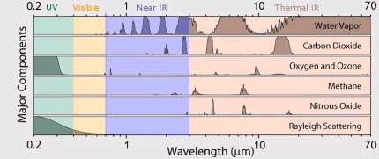
Topic 8: Energy, power, climate change 8.5 Greenhouse effect
The greenhouse effect
Analyze absorption graphs to compare the relative effects of different greenhouse gases.
Notes:
© 2006 By Timothy K. Lund

Slide 22
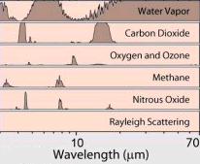
Topic 8: Energy, power, climate change 8.5 Greenhouse effect
The greenhouse effect
Analyze absorption graphs to compare the relative effects of different greenhouse gases.
PRACTICE: Consider the absorption graphs for the greenhouse gases.
(a) Which portion of the electromagnetic spectrum is represented?
(b) Which greenhouse gas contributes the most to the greenhouse effect?
(c) Which is the least significant contributor?
SOLUTION:
(a) Infrared (heat).
(b) Water vapor!
(c) Oxygen and ozone.
Notes:
© 2006 By Timothy K. Lund

Slide 23
Topic 8: Energy, power, climate change 8.5 Greenhouse effect
The greenhouse effect
8.5.8 Outline the nature of blackbody radiation
8.5.9 Draw and annotate a graph of the emission spectra of black bodies at different temperatures.
8.5.10 State the Stefan-Boltzmann law and apply it to compare emission rates from the different surfaces.
8.5.11 Apply the concept of emissivity to compare the emission rates from the different sources.
Notes:
© 2006 By Timothy K. Lund

Slide 24
Topic 8: Energy, power, climate change 8.5 Greenhouse effect
The greenhouse effect
Outline the nature of blackbody radiation.
•Solids can absorb many more wavelengths than the atmospheric gases.
•Depending on the color of a solid you can determine what wavelengths it cannot absorb.
•For example, a green object reflects (and therefore does not absorb) green light.
•A black object absorbs all wavelengths.
When bathed in ambient white light a solid is the color of the light that it cannot absorb.
FYI
•A black body absorbs all wavelengths. As it heats up it also emits all wavelengths, called blackbody radiation.
Notes:
© 2006 By Timothy K. Lund

Slide 25
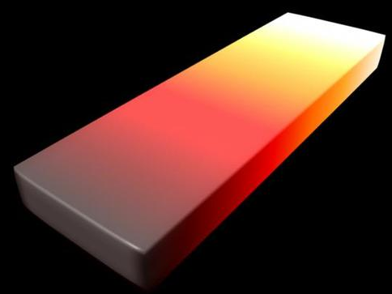
Topic 8: Energy, power, climate change 8.5 Greenhouse effect
The greenhouse effect
Draw and annotate a graph of the emission spectra of black bodies at different temperatures.
•Solids can be heated to incandescence (glowing) and different temperatures will have different visible radiation.
•If we heat a black body to incandescence we observe:
•Two trends emerge:
-The higher the tempera- ture the greater the intensity at all wavelengths.
-The higher temperature the smaller the wavelength of the maximum intensity.
Intensity
visible radiation
UV radiation
IR radiation
1000
2000
3000
4000
5000
Wavelength (nm)
Notes:
© 2006 By Timothy K. Lund

Slide 26
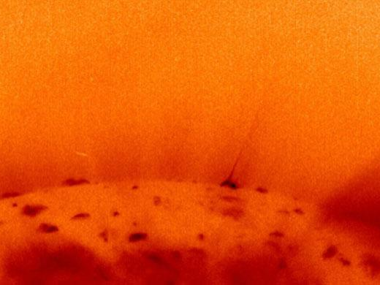
Topic 8: Energy, power, climate change 8.5 Greenhouse effect
700 600 500 400
Wavelength λ / nm
Visible Light
The greenhouse effect
Draw and annotate a graph of the emission spectra of black bodies at different temperatures.
•A simple law called Wein’s displacement law tells us the wavelength of the maximum intensity λ_{max} for blackbodies at temperature T in Kelvin:
λ_{max}T = 2.90×10⁻³ m K
Wien’s displacement law
EXAMPLE: The sun’s surface has a temperature of 4500 K. What is the prevalent wavelength of light?
SOLUTION:
λ_{max}T = 2.90×10⁻³
λ_{max} = 2.90×10⁻³/4500
λ_{max} = 6.44×10⁻⁷ m = 644 nm
Intensity
1000
2000
3000
4000
5000
Wavelength (nm)
Notes:
© 2006 By Timothy K. Lund

Slide 27
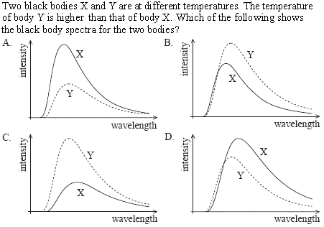
Topic 8: Energy, power, climate change 8.5 Greenhouse effect
The greenhouse effect
Draw and annotate a graph of the emission spectra of black bodies at different temperatures.
• Higher temperature = higher intensity so Y is above X.
• Higher temperature = smaller wave-length at peak
Notes:
© 2006 By Timothy K. Lund

Slide 28
Topic 8: Energy, power, climate change 8.5 Greenhouse effect
The greenhouse effect
State the Stefan-Boltzmann law and apply it to compare emission rates from the different surfaces.
•Without proof, the Stefan-Boltzmann law is as follows:
•σ is called the Stefan-Boltzmann constant.
•The Stefan-Boltzmann law shows the relationship between the temperature of a black body and the power emitted by the black body’s surface area.
P = σAT⁴
Stefan-Boltzmann law
where σ = 5.67×10⁻⁸ W m⁻² K⁻⁴.
FYI
•A black body emits as much power as it absorbs.
•Thus the Stefan-Boltzmann law works for both emission and absorption problems.
Notes:
© 2006 By Timothy K. Lund

Slide 29
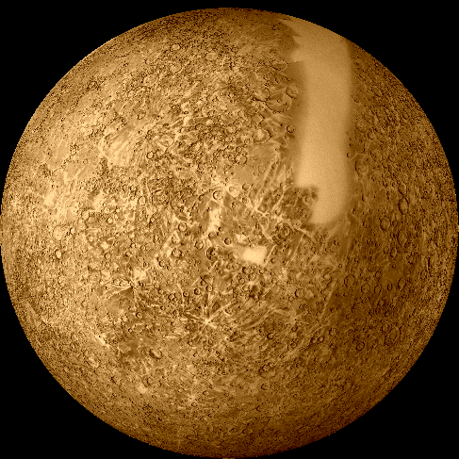
Topic 8: Energy, power, climate change 8.5 Greenhouse effect
The greenhouse effect
State the Stefan-Boltzmann law and apply it to compare emission rates from the different surfaces.
EXAMPLE: Mercury has a radius of 2.50×10⁶ m. Its sunny side has a temperature of 400°C (673 K) and its shady side -200°C (73 K). Treating it like a black body, find its power.
SOLUTION:
•A_{sphere} = 4π(2.50×10⁶)² = 7.85×10¹³ m².
•For T use T_{AVG} = (673 + 73) / 2 = 373 K
P = σAT⁴ = (5.67×10⁻⁸)(7.85×10¹³)373⁴ = 8.62×10¹⁶ W.
FYI
•Since no body is at absolute zero (K = 0) it follows from the Stefan-Boltzmann law that all bodies radiate.
Notes:
© 2006 By Timothy K. Lund

Slide 30
Topic 8: Energy, power, climate change 8.5 Greenhouse effect
The greenhouse effect
State the Stefan-Boltzmann law and apply it to compare emission rates from the different surfaces.
EXAMPLE: Assuming an albedo of 0.30, find, for Earth,
(a) the power of the sunlight received.
SOLUTION: Use I = 1380 W m⁻² and I = P/A.
•The radius of Earth is r = 6.37×10⁶ m so its cross-sectional area is
A = πr² = π(6.37×10⁶)² = 1.27×10¹⁴ m².
•An albedo of 0.30 means that 70% of the sunlight is absorbed (because 30% is scattered). Thus
P =(0.70)IA =(0.70)(1380)(1.27×10¹⁴) = 1.23×10¹⁷ W.
•Thus Earth intercepts energy from the sun at a rate of 1.23×10¹⁷ W.
Notes:
© 2006 By Timothy K. Lund

Slide 31
Topic 8: Energy, power, climate change 8.5 Greenhouse effect
The greenhouse effect
State the Stefan-Boltzmann law and apply it to compare emission rates from the different surfaces.
EXAMPLE: Assuming an albedo of 0.30, find, for Earth,
(b) the predicted temperature due to the sunlight reaching it.
SOLUTION:
•From the previous example:P = 1.23×10¹⁷ W.
•But this power is distributed over the whole planet, which has an area A_{sphere} = 4πr².
•From Stefan-Boltzmann we have
P = σAT⁴
1.23×10¹⁷ = (5.67×10⁻⁸)4π(6.37×10⁶)²T⁴
T = 255 K (-18°C).
Notes:
© 2006 By Timothy K. Lund

Slide 32
Topic 8: Energy, power, climate change 8.5 Greenhouse effect
The greenhouse effect
Apply the concept of emissivity to compare the emission rates from the different sources.
•The emissivity e of a body is a number between 0 and 1 that describes the emission and absorption properties of that body.
•A blackbody is a perfect emitter/absorber of radiation and has an emissivity of e = 1.
•Bodies that cannot emit/absorb radiation at all have e = 0.
•The emissivity of a body can be determined using
Mirror
e = 0.05
Charcoal
e = 0.95
energy radiated by body
energy radiated by blackbody
emissivity
e =
Notes:
© 2006 By Timothy K. Lund

Slide 33
Topic 8: Energy, power, climate change 8.5 Greenhouse effect
The greenhouse effect
Apply the concept of emissivity to compare the emission rates from the different sources.
•A blackbody is a perfect emitter/absorber (e = 1).
•A small sphere covered with lamp black makes a pretty good blackbody and has an emissivity somewhat close to 1.
•An even better black body is the metal- cavity blackbody:
•If we know e, the Stefan-Boltzmann law can be amended:
e = 0.9
e = 0.5
better blackbody
tallow candle
incident thermal radiation
P = eσAT⁴
Stefan-Boltzmann law
Notes:
© 2006 By Timothy K. Lund

Slide 34
Topic 8: Energy, power, climate change 8.5 Greenhouse effect
The greenhouse effect
State the Stefan-Boltzmann law and apply it to compare emission rates from the different surfaces.
EXAMPLE: If the average temperature of Earth is 289 K, find its emissivity.
SOLUTION: Use e = P_{body} / P_{blackbody}.
•We determined that Earth absorbs energy from the sun at a rate of P = 1.23×10¹⁷ W.
•Since the temperature of Earth is relativity constant, we can assume it is radiating power at the same rate of P_{body} = 1.23×10¹⁷ W.
•At 289 K the power radiated by a blackbody of the same size as Earth is
P_{bb} = (5.67×10⁻⁸)4π(6.37×10⁶)²289⁴ = 2.02×10¹⁷ W.
•Thus e = P_{body} / P_{blackbody} = 1.23/2.02 = 0.61.
Notes:
© 2006 By Timothy K. Lund

Slide 35
Topic 8: Energy, power, climate change 8.5 Greenhouse effect
The greenhouse effect
8.5.12 Define the surface heat capacity C_{s}.
8.5.13 Solve problems on the greenhouse effect and the heating of planets using a simple energy balance climate model.
Notes:
© 2006 By Timothy K. Lund

Slide 36
Topic 8: Energy, power, climate change 8.5 Greenhouse effect
The greenhouse effect
Define the surface heat capacity C_{s}.
•Recall thermal capacity C from Topic 3:
•The larger C is, the smaller the change in temperature of a substance.
•Because the ground is comprised of many different materials, each of which has a different thermal capacity, we define a new heat capacity (C_{s}) that effectively “averages” out the effects of the individual capacities over an area.
•The surface heat capacity is the amount of energy needed to raise the temperature of 1 m² of ground by 1 K. For Earth the average is about
Q = CΔT
thermal capacity C defined
C_{s} = Q / (AΔT)
surface heat capacity
C_{s} = 4×10⁸ J K⁻¹ m²
Surface heat capacity
Notes:
© 2006 By Timothy K. Lund

Slide 37
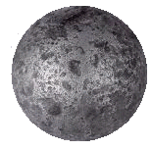
Topic 8: Energy, power, climate change 8.5 Greenhouse effect
The greenhouse effect
Define the surface heat capacity C_{s}.
C_{s} = Q / (AΔT)
Surface heat capacity
C_{s} = 4×10⁸ J K⁻¹ m²
Surface heat capacity
EXAMPLE: Assuming no Earth radiation, determine the amount of time it would take the sun to warm up Earth by 1 K.
SOLUTION:
•From previous example: P = 1.23×10¹⁷ W.
•From C_{s} = Q/(AΔT) we see that
Q = C_{s}AΔT = (4×10⁸)4π(6.37×10⁶)²(1) = 2.04×10²³ J.
•From P = Q/t we obtain
t = Q/P = (2.04×10²³) / (1.23×10¹⁷) = 1.66×10⁶ s.
•This is equivalent to t = 460 h = 19 d.
•If Earth trapped all of the sun’s energy it would soon become as hot as Venus-enough to melt lead!
Notes:
© 2006 By Timothy K. Lund

Slide 38
Topic 8: Energy, power, climate change 8.5 Greenhouse effect
The greenhouse effect
Solve problems on the greenhouse effect and the heating of planets using a simple energy balance climate model.
•Although we calculated the intensity of solar radiation to be 1380 W m⁻² by the time it reaches Earth, the earth is spherical, and so not all surfaces will receive this intensity.
•We will take the average for our models to be
I_{AVG} = 340 W m⁻²
Average incident solar radiation
1380 W/m²
Notes:
© 2006 By Timothy K. Lund

Slide 39
Topic 8: Energy, power, climate change 8.5 Greenhouse effect
The greenhouse effect
Solve problems on the greenhouse effect and the heating of planets using a simple energy balance climate model.
EXAMPLE: Draw a Sankey diagram for a model of the earth without greenhouse gases.
SOLUTION: First draw Earth/atmosphere blocks:
•Draw incoming solar energy (340 W m⁻²):
•Draw energy reflected by atmosphere (clouds):
•Draw energy reflected by ground (snow, etc.):
•Draw energy absorbed by ground (Q = C_{s}AΔT):
•Draw energy radiated by Earth (P = σAT⁴):
340
75
235
30
235
NON-GREENHOUSE ATMOSPHERE
235
GROUND
Notes:
© 2006 By Timothy K. Lund

Slide 40
Topic 8: Energy, power, climate change 8.5 Greenhouse effect
The greenhouse effect
Solve problems on the greenhouse effect and the heating of planets using a simple energy balance climate model.
PRACTICE: Show that at the space/atmosphere interface and at the ground/atmosphere interface the net power flow is zero.
SOLUTION:
•Space/atmosphere interface:
340 IN
235 + 75 + 30 = 340 OUT.
•Ground/atmosphere interface:
235 IN and 235 OUT.
340
75
235
30
235
FYI
•Since E_{in} = E_{out}, the temperature in each region is constant.
NON-GREENHOUSE ATMOSPHERE
235
GROUND
Notes:
© 2006 By Timothy K. Lund

Slide 41
Topic 8: Energy, power, climate change 8.5 Greenhouse effect
The greenhouse effect
Solve problems on the greenhouse effect and the heating of planets using a simple energy balance climate model.
EXAMPLE: Draw a Sankey diagram for a model of the earth with greenhouse gases.
SOLUTION: Blocks first (Greenhouse gases):
•E_{in} (340 W m⁻²):
•E_{reflect} (105 W m⁻²):
•E_{GND,abs} (165 W m⁻²):
•E_{ATMOS,abs} (70 W m⁻²):
•E_{GND,radiate} (390 W m⁻²):
•E_{convection} (100 W m⁻²):
•E_{atm,radiate} (195 W m⁻²):
340
75
195
30
165
520
70
GREENHOUSE ATMOSPHERE
350
325
40
100
490
GROUND
Notes:
© 2006 By Timothy K. Lund

Slide 42
Topic 8: Energy, power, climate change 8.5 Greenhouse effect
The greenhouse effect
Solve problems on the greenhouse effect and the heating of planets using a simple energy balance climate model.
PRACTICE: Show that at the space/atmosphere interface and at the ground/atmosphere interface the net power flow is zero.
SOLUTION:
•Space/atmosphere interface:
340 IN
195+75+30+40=340 OUT.
•Ground/atmosphere interface:
165+325 = 490 IN
350+40+100 = 340 OUT.
340
75
195
30
165
520
70
GREENHOUSE ATMOSPHERE
350
325
40
100
490
GROUND
Notes:
© 2006 By Timothy K. Lund

Slide 43
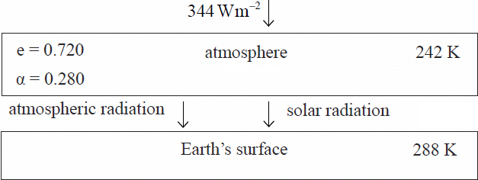
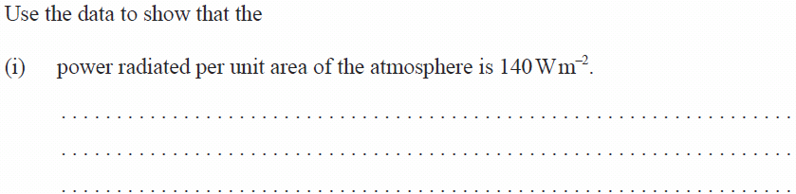
Topic 8: Energy, power, climate change 8.5 Greenhouse effect
The greenhouse effect
Solve problems on the greenhouse effect and the heating of planets using a simple energy balance climate model.
From Stefan-Boltzmann we have P = eσAT⁴ so that
P/A = (0.72)(5.67×10⁻⁸)242⁴ = 140 W m⁻².
Notes:
© 2006 By Timothy K. Lund

Slide 44
Topic 8: Energy, power, climate change 8.5 Greenhouse effect
The greenhouse effect
Solve problems on the greenhouse effect and the heating of planets using a simple energy balance climate model.
P/A = (1)(5.67×10⁻⁸)288⁴ = 390 W m⁻² (amount radiated)
P/A = 140 W m⁻² (amount absorbed from atmosphere)
390 - 140 = 250 W m⁻² (amount absorbed from sun)
Notes:
© 2006 By Timothy K. Lund

Slide 45
Topic 8: Energy, power, climate change 8.5 Greenhouse effect
The greenhouse effect
Solve problems on the greenhouse effect and the heating of planets using a simple energy balance climate model.
P/A = (0.72)(5.67×10⁻⁸)(242+6)⁴ = 154 W m⁻².
Notes:
© 2006 By Timothy K. Lund

Slide 46
Topic 8: Energy, power, climate change 8.5 Greenhouse effect
The greenhouse effect
Solve problems on the greenhouse effect and the heating of planets using a simple energy balance climate model.
Amount absorbed from sun 250 W m⁻² is still same.
P/A = 154 W m⁻² + 250 W m⁻² = 404 W m⁻².
Notes:
© 2006 By Timothy K. Lund

Slide 47
Topic 8: Energy, power, climate change 8.5 Greenhouse effect
The greenhouse effect
Solve problems on the greenhouse effect and the heating of planets using a simple energy balance climate model.
From Stefan-Boltzmann we have P = σAT⁴.
Thus P/A = σT⁴ or 404 = 5.67×10⁻⁸T⁴, and
T = 291 K, or an increase of 291 – 288 = 3 K.
Notes:
© 2006 By Timothy K. Lund

