Slide 1
Option B: Engineering physics
B.1 – Rigid bodies and rotational dynamics
Essential idea: The basic laws of mechanics have an extension when equivalent principles are applied to rotation. Actual objects have dimensions and they require the expansion of the point particle model to consider the possibility of different points on an object having different states of motion and/or different velocities.
Notes:
© 2016 by Timothy K. Lund

Slide 2
Option B: Engineering physics
B.1 – Rigid bodies and rotational dynamics
Nature of science: Modelling: The use of models has different purposes and has allowed scientists to identify, simplify and analyze a problem within a given context to tackle it successfully. The extension of the point particle model to actually consider the dimensions of an object led to many groundbreaking developments in engineering.
Notes:
© 2016 by Timothy K. Lund

Slide 3
Option B: Engineering physics
B.1 – Rigid bodies and rotational dynamics
Understandings:
• Torque
• Moment of inertia
• Rotational and translational equilibrium
• Angular acceleration
• Equations of rotational motion for uniform angular acceleration
• Newton’s second law applied to angular motion
• Conservation of angular momentum
Notes:
© 2016 by Timothy K. Lund

Slide 4
Option B: Engineering physics
B.1 – Rigid bodies and rotational dynamics
Applications and skills:
• Calculating torque for single forces and couples
• Solving problems involving moment of inertia, torque and angular acceleration
• Solving problems in which objects are in both rotational and translational equilibrium
• Solving problems using rotational quantities analogous to linear quantities
• Sketching and interpreting graphs of rotational motion
• Solving problems involving rolling without slipping
Notes:
© 2016 by Timothy K. Lund

Slide 5
Option B: Engineering physics
B.1 – Rigid bodies and rotational dynamics
Guidance:
• Analysis will be limited to basic geometric shapes
• The equation for the moment of inertia of a specific shape will be provided when necessary
• Graphs will be limited to angular displacement–time, angular velocity–time and torque–time
Notes:
© 2016 by Timothy K. Lund

Slide 6
Option B: Engineering physics
B.1 – Rigid bodies and rotational dynamics
Data booklet reference:
• Γ = Fr sin θ
• I = Σ mr ²
• Γ = Iα
• ω = 2πf
• ω_{f} = ω_{i} + α t
• ω_{f} ² = ω_{i}² + 2α θ
• θ = ω_{i}t + (1/2)α t ²
• L = Iω
• E_{K rot} = (1/2) Iω²
Notes:
© 2016 by Timothy K. Lund

Slide 7
Option B: Engineering physics
B.1 – Rigid bodies and rotational dynamics
Theory of knowledge:
• Models are always valid within a context and they are modified, expanded or replaced when that context is altered or considered differently. Are there examples of unchanging models in the natural sciences or in any other areas of knowledge?
Utilization:
• Structural design and civil engineering relies on the knowledge of how objects can move in all situations
Aims:
• Aim 7: technology has allowed for computer simulations that accurately model the complicated outcome of actions on bodies
Notes:
© 2016 by Timothy K. Lund

Slide 8
Option B: Engineering physics
B.1 – Rigid bodies and rotational dynamics
Torque
•A torque Γ is just a force that can cause a rotation about a pivot point.
•Consider a door as viewed from above:
•The location of the force and its size will determine the ease with which the door opens.
•The torque is proportional to both the force F and the moment arm r. Thus Γ = Fr.
•But we note that the angle θ between F and r also plays a role. The closer to 90° the angle is, the more efficiently the door is opened (or closed).
WALL
r
WALL
r₁
r₂
θ₂
θ₃
θ₁
F₀
F₁
F₂
Notes:
© 2016 by Timothy K. Lund

Slide 9
Option B: Engineering physics
B.1 – Rigid bodies and rotational dynamics
Torque
•In fact, the following equation describes the torque completely.
•Torque is a vector since it has a direction. For now we can say clockwise (cw) or counterclockwise (ccw).
•The r is just the distance that the force is from the pivot point.
Γ = Fr sin θ
where θ is the angle between F and r
definition of torque
FYI
•Note that torque has the units of a force (N) times a distance (m) and is thus measured in Nm.
•Recall the work was also measured in Nm, which we called Joules (J). Never express torque as a Joule.
Notes:
© 2016 by Timothy K. Lund

Slide 10

Option B: Engineering physics
B.1 – Rigid bodies and rotational dynamics
Torque
EXAMPLE: Suppose we apply a force of 80. N to a door at a distance of 25 cm from the hinge, and at an angle of 30° with respect to r. Find the torque.
SOLUTION:
•Use Γ = Fr sin θ. Then
Γ = Fr sin θ
= (80. N)(0.25 m) sin 30°
= 10. Nm.
•Never write the units for torque as J. Torque is not an energy quantity.
Notes:
© 2016 by Timothy K. Lund

Slide 11
Option B: Engineering physics
B.1 – Rigid bodies and rotational dynamics
F
Moment arm (lever arm)
•Consider a disk that is free to rotate about its center.
•The application of the identical forces to the disk’s edge at points A, B, C, and D, will produce very different outcomes:
•We define the moment arm or the lever arm as that component of r that is perpendicular to F.
•It turns out that that component is just r sin θ and that the force F times the lever arm r sin θ is the torque.
F
F
B
C
A
F
r
r
r
θ
r
D
θ
moment arm or lever arm
r sin θ
line of action
definition of torque (alt.)
Γ = force × moment arm
Notes:
© 2016 by Timothy K. Lund

Slide 12
Option B: Engineering physics
B.1 – Rigid bodies and rotational dynamics
Translational and rotational equilibrium
•Recall that translational equilibrium was the state of a system in which the sum of the forces was zero:
•Now we have an analogous condition for rotational equilibrium – the state of a system in which the sum of the torques is zero:
condition for translational equilibrium
ΣF = 0
condition for rotational equilibrium
ΣΓ = 0
FYI
•Note that the condition for translation equilibrium DOES NOT imply that the system is not translating. As long as it is not accelerating ΣF = 0 is still true.
•Similarly, the condition for rotational equilibrium ΣΓ = 0
DOES NOT imply that the system is not rotating.
Notes:
© 2016 by Timothy K. Lund

Slide 13


Option B: Engineering physics
B.1 – Rigid bodies and rotational dynamics
Translational and rotational equilibrium
•Suppose a uniform beam of mass m and length L is placed on two scales, as shown.
•It is expected that each scale will read the same, namely half the weight of the beam.
•Now we place a block of mass M on the beam, closer to the left-hand scale.
•It is expected that the left scale will read higher than the right one, because the block is closer to it.
M
x
Notes:
© 2016 by Timothy K. Lund

Slide 14
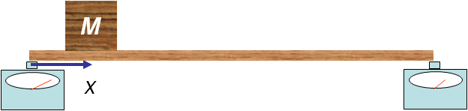
Option B: Engineering physics
B.1 – Rigid bodies and rotational dynamics
Translational and rotational equilibrium
•To analyze an extended system we use what we will call an extended free-body diagram. Suppose M, m and L are known.
•Find N₁ and N₂ in terms of x, L, m, M and g.
•From our balance of forces we have ΣF = 0:
N₁ + N₂ – Mg – mg = 0
L / 2
x
mg
N₁
Mg
N₂
FYI
•We have one equation with two unknown normal forces.
•We will use ΣΓ = 0 for our second equation.
Notes:
© 2016 by Timothy K. Lund

Slide 15
Option B: Engineering physics
B.1 – Rigid bodies and rotational dynamics
Translational and rotational equilibrium
•In order to use our balance of torques we need to choose a pivot point. If a system is in static equilibrium you can use ANY point! I have chosen N₁’s location.
•For bookkeeping purposes choose a torque direction.
•Note that Mg and mg want to rotate (+), and N₂ (–).
•From our balance of torques we have ΣΓ = 0:
N₁ ⋅ 0 + Mg ⋅ x + mg ⋅ L / 2 – N₂ ⋅ L = 0
L / 2
+
x
mg
N₁
Mg
N₂
FYI
•Choosing the pivot (fulcrum) at the point of a force removes that force from the torque equation! Why?
Notes:
© 2016 by Timothy K. Lund

Slide 16
Option B: Engineering physics
B.1 – Rigid bodies and rotational dynamics
Translational and rotational equilibrium
•We now resolve our system of equations:
N₁ + N₂ – Mg – mg = 0
N₁ ⋅ 0 + Mg ⋅ x + mg ⋅ L / 2 – N₂ ⋅ L = 0
•Our second equation gives us N₂:
N₂ = ( Mx / L + m / 2)g.
•Our first equation gives us
N₁ = (M + m)g – N₂.
PRACTICE: If the 2.75-m long wood plank has a mass of 45 kg, the box has a mass of 85 kg, and x = 0.50 m, what do the two scales read?
SOLUTION: N₂ = (85⋅0.50 / 2.75 + 45 / 2)⋅10 = 380 kg.
N₁ = (85 + 45)⋅10 – 380 = 920 kg.
Notes:
© 2016 by Timothy K. Lund

Slide 17

Option B: Engineering physics
B.1 – Rigid bodies and rotational dynamics
Translational and rotational equilibrium
•The last example had all right angles. Since sin 90 ° = 1, the angles were not needed.
•Now consider a boom crane whose components must be strong enough to withstand any force a client might apply.
•We need to know the required tensions in the cables.
•We need to know the strength of the pin.
Notes:
© 2016 by Timothy K. Lund

Slide 18
Option B: Engineering physics
B.1 – Rigid bodies and rotational dynamics
Translational and rotational equilibrium
•Here are the variables:
•And an extended FBD is the way to go:
•Let x be the distance mg is from the pin.
•Note that the weight of the boom itself acts as if all of its mass is located at its center, which is a distance of L / 2 from the pin.
•In general M, m, L, and θ will be known.
T
M
θ
mg
F_{H}
m
Mg
F_{V}
T
x
θ
L / 2
mg
F_{H}
Mg
F_{V}
Notes:
© 2016 by Timothy K. Lund

Slide 19
Option B: Engineering physics
B.1 – Rigid bodies and rotational dynamics
Translational and rotational equilibrium
•Suppose M = 400. kg, m = 200. kg, L = 20.0 m, x = 15.0 m, and θ = 30°.
•Then our diagram reduces to:
•Note that the angles between the black forces and the boom are 60°.
•From ΣF = 0 we see that F_{V} = 6000 N.
•We also see that F_{H} = T.
•For the torques, lets choose the location of the two pin forces as our pivot, cw = (+):
•From ΣΓ = 0 we see that
4000⋅10 ⋅sin 60° + 2000 ⋅15 ⋅sin 60° – T sin 30° = 0
T = 121000 N = F_{H}.
T
15
30°
10
60°
F_{H}
60°
2000
x
4000
F_{V}
Notes:
© 2016 by Timothy K. Lund

Slide 20
Option B: Engineering physics
B.1 – Rigid bodies and rotational dynamics
Translational and rotational equilibrium – stability
•Consider the following three scenarios:
•Two bowls and one flat surface.
•A marble is carefully placed on each surface so that it remains at rest: All marbles are in static equilibrium.
•Each ball is displaced a small amount.
•The three different types of equilibrium are illustrated.
STABLE
NEUTRAL
UNSTABLE
EQUILIBRIUM
EQUILIBRIUM
EQUILIBRIUM
FYI
•Note that the stable equilibrium has a restoring force.
Notes:
© 2016 by Timothy K. Lund

Slide 21
Option B: Engineering physics
B.1 – Rigid bodies and rotational dynamics
Extended bodies
•Up to this point we have talked about moving particles, and moving bodies comprised of many particles (atoms) moving as a group without rotation.
•In this topic we will discuss the characteristics of a set of particles, moving as a group with rotation.
•In order to make our analysis easier, we will review the idea of the center of mass (cm) - the “balance point” of an extended body, or set of particles.
•To illustrate cm, consider Albert the physics cat who has been thrown as shown:
Albert the physics cat
Notes:
© 2016 by Timothy K. Lund

Slide 22

Option B: Engineering physics
B.1 – Rigid bodies and rotational dynamics
Extended bodies
•Suppose we place a blue dot on Albert’s cm (his balance point) and a red dot Albert’s tail and we give him another toss:
•Note that Albert’s cm follows a perfect parabolic trajectory, whereas his tail does not.
•Furthermore, every point on Albert will have a different equation of motion.
•Add to this yet another level of complexity: Albert can change his shape!
•Looks to me like we are entering a whole new world of hurt…
Notes:
© 2016 by Timothy K. Lund

Slide 23

Option B: Engineering physics
B.1 – Rigid bodies and rotational dynamics
Extended bodies
•We call Albert a non-rigid extended body because he can change his shape.
•A wrench, on the other hand, is a rigid extended body, because its shape does not change.
•A wrench can be translated (moved without rotation)…
•Note that every point in the wrench has the same velocity (this includes speed and direction).
•This is why in the past we could treat an extended mass in translation as a single particle.
Notes:
© 2016 by Timothy K. Lund

Slide 24

Option B: Engineering physics
B.1 – Rigid bodies and rotational dynamics
Extended bodies
•A wrench can be rotated without translation.
•Note that every point in the wrench has a different velocity (speed and direction).
•We have already studied this sort of circular motion in Topic 6.
•And if we rotate and translate a body, we get this:
•Just as we studied pure translational dynamics in the core, we will now study pure rotational dynamics.
Notes:
© 2016 by Timothy K. Lund

Slide 25
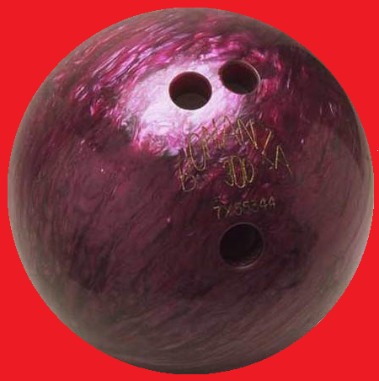
Option B: Engineering physics
B.1 – Rigid bodies and rotational dynamics
Rotational inertia I (moment of inertia)
•Consider a bowling ball on a table top:
•Neither ball is rolling, so both have a translational kinetic energy equal to zero.
•The second ball has only rotational kinetic energy.
Stationary
E_{K} = 0.
Spinning in place (perhaps on ice)
E_{K} ≠ 0.
TOP VIEW
Notes:
© 2016 by Timothy K. Lund

Slide 26
Option B: Engineering physics
B.1 – Rigid bodies and rotational dynamics
Rotational inertia I (moment of inertia)
•Even though the center of mass of the spinning bowling ball is not moving, each particle in the ball not in the center has a tangential velocity and thus has kinetic energy.
•In translation every mass particle has the same velocity.
•Not so in rotation. Each mass has a velocity that is proportional to its radius from the axis of rotation.
Notes:
© 2016 by Timothy K. Lund

Slide 27
Option B: Engineering physics
B.1 – Rigid bodies and rotational dynamics
Rotational inertia I (moment of inertia)
•In fact, if you recall that for circular motion v = r ω, we see that for each particle in a rotating extended mass
E_{K} = (1/2)mv ²
= (1/2)m(r ω)²
= (1/2) (mr ²) ω².
•Given that the ω is the same for all particles in a rigid extended body, clearly the total kinetic energy is given by
E_{K} = (1/2) I ω² with I = Σmr ².
where I is the rotational inertia
moment of inertia I
Notes:
© 2016 by Timothy K. Lund

Slide 28
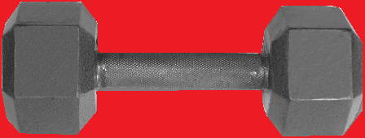
Option B: Engineering physics
B.1 – Rigid bodies and rotational dynamics
Rotational inertia I (moment of inertia)
•It turns out that the rotational inertia I has the same function in rotation as the translational inertia m has in translational motion. Later we will see that all the translational kinematic and dynamic equations can be directly translated into their rotational counterparts by simple substitutions – one of which will be I ↔ m!
PRACTICE: Find the moment of inertia of the dumbbell about its center. Each end has a mass of 15.0 kg. Assume the 30.0-cm handle is massless.
SOLUTION:
•Each mass is 0.15 m from the center of rotation. Thus
I = Σmr ² = 15(0.15)² + 15(0.15)² = 0.675 kg m².
Notes:
© 2016 by Timothy K. Lund

Slide 29
Option B: Engineering physics
B.1 – Rigid bodies and rotational dynamics
Rotational inertia I (moment of inertia)
PRACTICE: If the mass of the previous example rotates once in 2.0 seconds, what is its rotational kinetic energy?
SOLUTION:
•Use the I we just calculated and E_{K} = (1/2) I ω².
ω = θ / t = 2π rad / 2 s = 3.14 rad s⁻¹.
I = 0.675 kg m².
•Thus
E_{K} = (1/2) I ω²
= (1/2)×0.675×3.14²
= 3.3 J.
FYI
•You can verify that the unit is indeed J.
Notes:
© 2016 by Timothy K. Lund

Slide 30
Option B: Engineering physics
B.1 – Rigid bodies and rotational dynamics
Rotational inertia I (moment of inertia)
PRACTICE: If the mass of the previous example not only rotates once in 2.0 seconds, but translates at 0.25 ms⁻¹ to the left, what is its total kinetic energy?
SOLUTION:
•We just calculated that E_{K,rot} = (1/2) I ω² = 3.3 J.
•The translational kinetic energy is the usual
E_{K,trans} = (1/2)mv²
= (1/2)×(15 + 15)×0.25²
= 0.94 J.
•The total kinetic energy is just the sum:
•Then E_{K,tot} = 3.3 + 0.94 = 4.2 J.
E_{K,tot} = E_{K,rot} + E_{K,trans}
Total E_{K}
Notes:
© 2016 by Timothy K. Lund

Slide 31
Option B: Engineering physics
B.1 – Rigid bodies and rotational dynamics
Rotational inertia I (moment of inertia)
PRACTICE: Find the moment of inertia of the dumbbell about one of its ends. Each end has a mass of 15.0 kg. Assume the 30.0-cm handle is massless.
SOLUTION:
•One mass is 0.00 m from the center of rotation. The other mass is 0.30 m from the center of rotation. Thus
I = Σmr ² = 15(0.00)² + 15(0.30)² = 1.35 kg m².
FYI
•Note that the moment of inertia depends not only on the mass distribution (hence the geometry) but also on the axis of rotation. Be wary!
Notes:
© 2016 by Timothy K. Lund

Slide 32
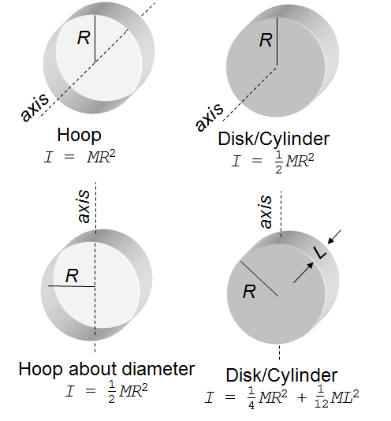
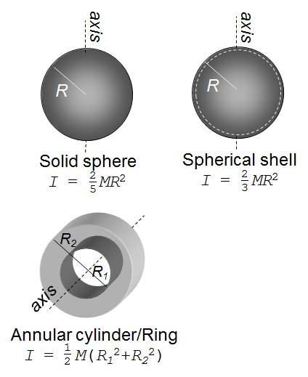
Option B: Engineering physics
B.1 – Rigid bodies and rotational dynamics
Rotational inertia I (moment of inertia) - samples
Notes:
© 2016 by Timothy K. Lund

Slide 33
Option B: Engineering physics
B.1 – Rigid bodies and rotational dynamics
Rotational inertia I (moment of inertia)
PRACTICE: Find the moment of inertia of a 7.27-kg bowling ball about its center of mass. A regulation bowling ball has a diameter of 22 cm. If it revolves twice each second, what is its rotational kinetic energy?
SOLUTION:
•Use the rotational inertia formula for a solid sphere.
I = (2/5)MR² = (2/5)×7.27×0.11²
= 0.035 kg m².
E_{K} = (1/2)Iω² = (1/2)×0.035×(2π / 0.5)²
= 2.8 J
Notes:
© 2016 by Timothy K. Lund

Slide 34
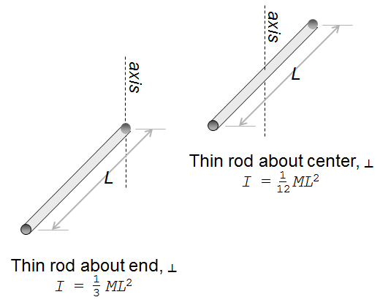
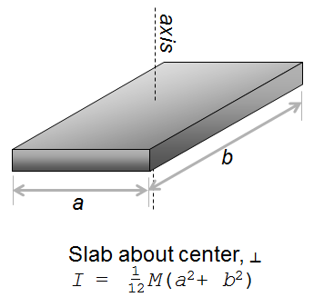
Option B: Engineering physics
B.1 – Rigid bodies and rotational dynamics
Rotational inertia I (moment of inertia) - samples
Notes:
© 2016 by Timothy K. Lund

Slide 35

Option B: Engineering physics
B.1 – Rigid bodies and rotational dynamics
Rotational inertia I (moment of inertia)
PRACTICE: Find the moment of inertia of a 125-gram meter stick about its end.
SOLUTION:
•Use the rotational inertia formula for a thin rod about its end.
I = (1/3)ML² = (1/3)×0.125×1.00²
= 0.042 kg m².
FYI
•Note that the moment of inertia about the end of the ruler is more than that about its center. Why?
•Because the mass making up the ruler is, on average, farther from the pivot point in the former case.
Notes:
© 2016 by Timothy K. Lund

Slide 36
Option B: Engineering physics
B.1 – Rigid bodies and rotational dynamics
Rotational inertia I – the parallel axis theorem
•Suppose instead of rotating the ruler about its end (for which we have a formula) or its center (for which we also have a formula), we wish to rotate it about a point one-quarter of a meter from the end (for which we don’t have a formula.
•Instead of having an infinite number of formulae for each extended mass shape, we have the parallel axis theorem, presented without proof here:
parallel axis theorem
I_{P} = I_{CM} + Md ²
FYI
•To use the PAT you need two things:
(1) I_{CM},
(2) the distance d that the new parallel axis is from the CM axis.
Notes:
© 2016 by Timothy K. Lund

Slide 37
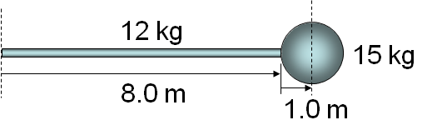
Option B: Engineering physics
B.1 – Rigid bodies and rotational dynamics
Rotational inertia I – the parallel axis theorem
parallel axis theorem
I_{P} = I_{CM} + Md ²
PRACTICE: Find the moment of inertia of a rod about its end if it has a solid sphere on the other end.
SOLUTION:
•Start with the formula for a thin rod about its end:
I_{ROD} = (1/3)ML² = (1/3)×12×8.0² = 256 kg m².
•For the solid sphere
I_{CM} = (2/5)MR² = (2/5)×15×1.0² = 6.0 kg m².
•Using the PAT for the sphere, where d = 9.0 m:
I_{P} = I_{CM} + Md ² = 6.0 + 15×9.0² = 1221 kg m².
•Finally, I_{TOT} = I_{ROD} + I_{P} = 256 + 1221 = 1500 kg m².
Notes:
© 2016 by Timothy K. Lund

Slide 38
Option B: Engineering physics
B.1 – Rigid bodies and rotational dynamics
Linear and angular displacement and velocity
•Recall from Topic 6 that arc length is given by the following simple relationship:
•Recall from Topic 2 that v = Δs / Δt and from Topic 6 that ω = Δθ / Δt. Then the following is true:
v = Δs / Δt definition of linear velocity
= Δ(r θ) / Δt substitution
= r Δθ / Δt r constant during rigid body rotation
= r ω. definition of angular velocity
linear and angular displacement
s = r θ where θ is in radians
v = r ω where ω is in radians per second
linear and angular velocity
Notes:
© 2016 by Timothy K. Lund

Slide 39
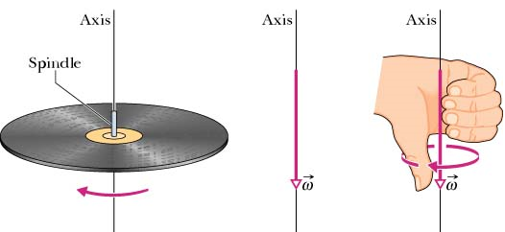
Option B: Engineering physics
B.1 – Rigid bodies and rotational dynamics
Linear and angular displacement and velocity
•Angular velocity implies a direction. It is given by yet another right hand rule:
•Grasp the axis of rotation with the right hand, with your fingers curled in the direction of rotation. Your extended thumb points in the direction of ω.
Notes:
© 2016 by Timothy K. Lund

Slide 40
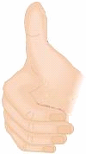


Option B: Engineering physics
B.1 – Rigid bodies and rotational dynamics
Linear and angular displacement and velocity
PRACTICE: Find the angular velocity of Earth.
SOLUTION:
•Δθ = 2π rad.
•Δt = 24 h (3600 s h⁻¹) = 86400 s.
•From ω = Δθ / Δt we see that
ω = 2π rad / 86400 s
= 7.27×10⁻⁵ rad s⁻¹.
•This small angular speed is why we can’t feel the earth spinning.
•From the right hand rule for spin we see that the angular velocity points north.
ω
Notes:
© 2016 by Timothy K. Lund

Slide 41
Option B: Engineering physics
B.1 – Rigid bodies and rotational dynamics
Linear and angular acceleration
•Recall from Topic 2 that acceleration was defined as a = Δv / Δt. In a similar manner we define angular acceleration α as
•But since v = r ω we can then write
a = Δv / Δt definition of linear acceleration
= Δ(r ω) / Δt substitution
= r Δω / Δt r constant during rigid body rotation
= r α. definition of angular acceleration
α = Δω / Δt where α is in radians per second squared
angular acceleration
a_{t} = r α where α is in radians per second squared
linear and angular acceleration
Notes:
© 2016 by Timothy K. Lund

Slide 42

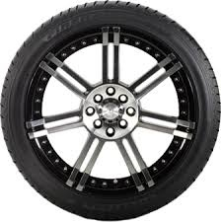
Option B: Engineering physics
B.1 – Rigid bodies and rotational dynamics
Centripetal and tangential acceleration
•Recall from Topic 6 that centripetal acceleration a_{c} was a center-pointing acceleration given by
•The formula a_{t} = r α represents the tangential acceleration.
•The tangential and centripetal accelerations are mutually perpendicular.
•The net acceleration is the vector sum of a_{c} and a_{t}.
•Note that a² = a_{c}² + a_{t}².
•Once the wheel reaches operational speed, a_{t} = 0 and only a_{c} remains.
a_{c} = v ²/ r = rω²
centripetal acceleration
a_{t}
a_{c}
a
Notes:
© 2016 by Timothy K. Lund

Slide 43
Option B: Engineering physics
B.1 – Rigid bodies and rotational dynamics
Rotational kinematics
•Recall the kinematic equations from Topic 2.1:
•And the following conversions :
•It is left as an exercise to prove the following:
s = ut + (1/2)at ²
v = u + at
v ² = u ² + 2as
kinematic equations (translational)
s = r θ
v = r ω
a = r α
translational / rotational conversions
θ_{f} = ω_{i}t + (1/2)αt ²
ω_{f} = ω_{i} + αt
ω_{f}² = ω_{i}² + 2αθ
kinematic equations (rotational)
Notes:
© 2016 by Timothy K. Lund

Slide 44
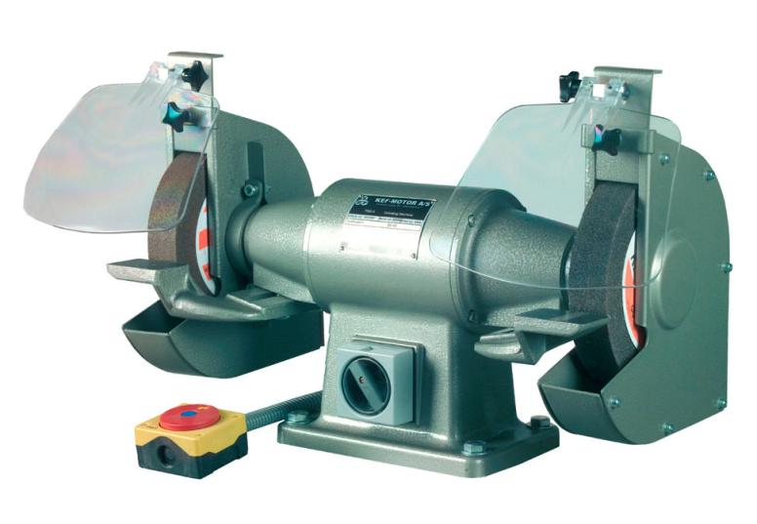
Option B: Engineering physics
B.1 – Rigid bodies and rotational dynamics
Rotational kinematics
θ_{f} = ω_{i}t + (1/2)αt ²
ω_{f} = ω_{i} + αt
ω_{f}² = ω_{i}² + 2αθ
kinematic equations (rotational)
PRACTICE: Find the angular acceleration of a bench grinder’s cutting wheel if it reaches 2500 rpm in 3.5 s.
SOLUTION:
  ω_{i} = 0.
  ω_{f} = (2500 rev min⁻¹)(2π rad rev⁻¹)(1 min / 60 s)
  = 261.8 rad s⁻¹.
  α = Δω / Δt = (262 – 0) / 3.5 = 75 rad s⁻².
Notes:
© 2016 by Timothy K. Lund

Slide 45
Option B: Engineering physics
B.1 – Rigid bodies and rotational dynamics
Rotational kinematics
θ_{f} = ω_{i}t + (1/2)αt ²
ω_{f} = ω_{i} + αt
ω_{f}² = ω_{i}² + 2αθ
kinematic equations (rotational)
PRACTICE: Find the angle through which the cutting wheel rotates during its acceleration.
SOLUTION: You can use the first or the last formula.
  θ_{f} = ω_{i}t + (1/2)αt ²
  θ_{f} = 0×3.5 + (1/2)×75 ×3.5²
  θ_{f} = 460 rad.
Notes:
© 2016 by Timothy K. Lund

Slide 46
Option B: Engineering physics
B.1 – Rigid bodies and rotational dynamics
Rotational kinematics
θ_{f} = ω_{i}t + (1/2)αt ²
ω_{f} = ω_{i} + αt
ω_{f}² = ω_{i}² + 2αθ
kinematic equations (rotational)
PRACTICE: Find the tangential acceleration of the edge of the 5.0-cm radius cutting wheel during and after acceleration.
SOLUTION: a_{t} = rα.
•During acceleration α = 75:
a_{t} = r α = 0.050×75 = 3.8 m s⁻².
•After acceleration α = 0:
a_{t} = r α = 0.050×0 = 0.0 m s⁻².
Notes:
© 2016 by Timothy K. Lund

Slide 47
Option B: Engineering physics
B.1 – Rigid bodies and rotational dynamics
a_{t}
a_{c}
a
Rotational kinematics
θ_{f} = ω_{i}t + (1/2)αt ²
ω_{f} = ω_{i} + αt
ω_{f}² = ω_{i}² + 2αθ
kinematic equations (rotational)
PRACTICE: Find the net acceleration of the edge of the 5.0-cm radius cutting wheel at t = 0.08 s.
SOLUTION: a_{t} = rα.
•During acceleration a_{t} = 3.8 m s⁻².
•At t = 0.08 s, ω_{f} = ω_{i} + αt = 0 + 76.9×0.08 = 6.2 rad s⁻¹.
a_{C} = r ω² = 0.050×6.2² = 1.9 m s⁻².
a_{NET}² = a_{C}² + a_{t}² = 1.9² + 3.8² → a_{NET} = 4.2 m s⁻².
Notes:
© 2016 by Timothy K. Lund

Slide 48
Option B: Engineering physics
B.1 – Rigid bodies and rotational dynamics
Rotational dynamics
•Recall the dynamic equations from Topic 2:
•And the following conversions:
•Clearly the dynamic equations in terms of the rotational variables become:
•Note the new symbol L representing angular momentum. The units for L are kg m² s⁻¹.
F = ma, W = Fs, Power = Fv
p = mv (linear momentum)
E_{K} = (1/2)mv ²
dynamic equations (translational)
s↔θ, v↔ω, a↔α, m↔I, F↔Γ, p↔L
conversions
Γ = Iα, W = Γ θ, Power = Γ ω
L= I ω (angular momentum)
E_{K} = (1/2) I ω ²
dynamic equations (rotational)
Notes:
© 2016 by Timothy K. Lund

Slide 49
Option B: Engineering physics
B.1 – Rigid bodies and rotational dynamics
Rotational dynamics
α
EXAMPLE: Consider a disk-like pulley of mass m and radius R. A string is connected to a block of mass M, and wrapped around the pulley. What is the acceleration of the block as it falls?
SOLUTION: We can insert the forces into our diagrams, important dimensions, and accelerations.
•Clearly the acceleration of the pulley is angular α:
•While the acceleration of the block is linear a:
•Recall the relationships between then angular and the linear variables: a = Rα or α = a / R.
•For the disk, I = (1/2)mR² so that
Γ = Iα = Ia / R = (1/2)mR²×a / R = (1/2)mRa.
m
R
T
M
T
a
Mg
Notes:
© 2016 by Timothy K. Lund

Slide 50
Option B: Engineering physics
B.1 – Rigid bodies and rotational dynamics
Rotational dynamics
α
EXAMPLE: Consider a disk-like pulley of mass m and radius R. A string is connected to a block of mass M, and wrapped around the pulley. What is the acceleration of the block as it falls?
SOLUTION:
•But Γ = RT so that
RT = (1/2)mRa → T = (1/2)ma.
•For the falling mass:
T – Mg = -Ma.
•Finally
(1/2)ma – Mg = -Ma
a = Mg / [M + m / 2].
m
R
T
T
a
M
Mg
Notes:
© 2016 by Timothy K. Lund

Slide 51

Option B: Engineering physics
B.1 – Rigid bodies and rotational dynamics
Rotational kinematics and dynamics
•How am I going to remember all of this?!?
v = u + at
s ↔ θ
v ↔ ω
a ↔ α
m ↔ I
F ↔ Γ
ω_{f} = ω_{i} + αt
s = ut + (1/2)at ²
θ = ω_{i}t + (1/2)αt ²
v ² = u ² + 2as
ω_{f}² = ω_{i}² + 2αθ
F = ma
Γ = Iα
E_{K} = (1/2)mv²
E_{K} = (1/2)Iω²
Notes:
© 2016 by Timothy K. Lund

Slide 52
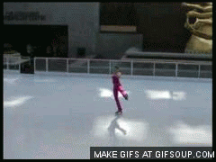
Option B: Engineering physics
B.1 – Rigid bodies and rotational dynamics
Conservation of angular momentum
•Extending linear momentum p = mv to angular momentum L = Iω, we may well ask if angular momentum, like linear momentum, is also conserved. The answer is Yes.
•How does the skater change her I with the repositioning of her body?
•Why does ω↑ as r↓?
•Just as p is conserved in the absence of a net external force, so is L in the absence of a net external torque.
Notes:
© 2016 by Timothy K. Lund

Slide 53
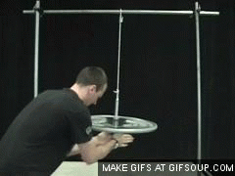
Option B: Engineering physics
B.1 – Rigid bodies and rotational dynamics
Conservation of angular momentum
PRACTICE: Explain what is happening in this video.
SOLUTION:
•An external torque (the instructor’s hands) increases the angular momentum of the wheel.
•Another external torque (the instructor, again) reorients the direction of the angular momentum.
•Upon release the angular momentum of the wheel keeps it oriented in its counterintuitive way!
Notes:
© 2016 by Timothy K. Lund

Slide 54
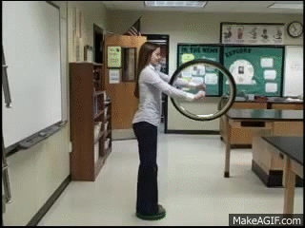
Option B: Engineering physics
B.1 – Rigid bodies and rotational dynamics
Conservation of angular momentum
PRACTICE: Explain what is happening in this video.
SOLUTION:
•The student is on a frictionless stand and is free to rotate. The wheel begins by rotating with a horizontal L.
•As the student exerts an internal torque to the wheel, reorienting its L vertically, the student’s vertical L changes in such a way as to keep the total L constant.
•She rotates opposite to the wheel!
Notes:
© 2016 by Timothy K. Lund

Slide 55
Option B: Engineering physics
B.1 – Rigid bodies and rotational dynamics
Conservation of angular momentum
PRACTICE: Use conservation of angular momentum to predict the angular speed of Earth if it became a black hole. Assume the earth is a solid homogenous sphere. M = 5.98×10²⁴ kg and R = 6.37 ×10⁶ m.
SOLUTION: Use I = (2/5)MR ², L = Iω, and L_{i} = L_{f}:
•I_{i} = (2/5)×5.98×10²⁴×(6.37×10⁶)² = 9.71×10³⁷ kg m².
•R_{s} = 2GM / c²
= 2×6.67×10⁻¹¹×5.98×10²⁴ / (3.00×10⁸)² = 0.00886 m.
•I_{f} = (2/5)×5.98×10²⁴×(0.00886)² = 1.88×10²⁰ kg m².
•L_{f} = L_{i} → I_{f} ω_{f} = I_{i} ω_{i} →
ω_{f} = (I_{i} / I_{f}) ω_{i}
= [(9.71×10³⁷)/(1.88×10²⁰)](2π/ 24×3600)
= 3.75×10¹³ rad s⁻¹.
Notes:
© 2016 by Timothy K. Lund

Slide 56
Option B: Engineering physics
B.1 – Rigid bodies and rotational dynamics
Rolling motion
•A special subset of dynamics is called rolling motion, where by “rolling” we mean “rolling without slipping.”
•A rolling wheel is shown here:
•If the wheel’s cm has traveled a distance s, so has a point on its circumference (it is not slipping).
•The speed of the wheel is given by v_{CM} = s / t.
•The speed of a point on the circumference, the tangential speed, is also given by v_{t} = s / t.
v_{t}
s
v_{CM}
s
Notes:
© 2016 by Timothy K. Lund

Slide 57
Option B: Engineering physics
B.1 – Rigid bodies and rotational dynamics
Rolling motion
•A special subset of dynamics is called rolling motion, where by “rolling” we mean “rolling without slipping.”
•A rolling wheel is shown here:
•Since v_{t} = Rω = v_{CM}, we can write:
v_{t}
s
v_{CM}
s
condition for rolling motion
v_{CM} = Rω
FYI
•This only holds for rolling without slipping.
Notes:
© 2016 by Timothy K. Lund

Slide 58
Option B: Engineering physics
B.1 – Rigid bodies and rotational dynamics
Rolling motion
•Consider the following three scenarios:
•In pure translation, all points move at v_{CM}.
•In pure rotation, all points move at v = rω. Note the velocities of top and bottom (r = R), in particular.
•In rolling motion, the two pure aspects are summed.
v = v_{CM}
v = Rω
v = 2Rω
v = v_{CM}
v = 0
v = Rω
v = v_{CM}
v = Rω
v = 0
TRANSLATIONAL MOTION
ROTATIONAL MOTION
ROLLING MOTION
Notes:
© 2016 by Timothy K. Lund

Slide 59
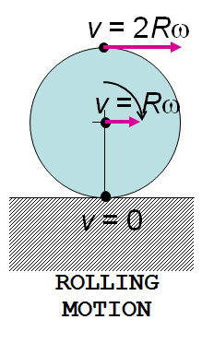

Option B: Engineering physics
B.1 – Rigid bodies and rotational dynamics
Rolling motion
EXAMPLE: A 13-cm radius hoop is rolling without slipping at a speed of 25 ms⁻¹. What are the linear speeds of the top of the wheel, the middle of the wheel, and the bottom of the wheel? If the hoop fails because of centripetal accelerations, where will it be most likely to fail first?
SOLUTION:
•The top is traveling at 2v_{CM} = 50 ms⁻¹.
•The middle is traveling at v_{CM} = 25 ms⁻¹.
•The bottom is traveling at 0 ms⁻¹.
Because a_{C} = v² / r, clearly it will fail at the top first. In fact, at the top,
a_{C} = v² / r = 50² / 0.26 = 9600 ms⁻² = 960 G!
Notes:
© 2016 by Timothy K. Lund

Slide 60
Option B: Engineering physics
B.1 – Rigid bodies and rotational dynamics
Rolling motion
EXAMPLE: A solid sphere having a mass of 0.125 kg and a radius of 1.5 cm rolls without slipping down a 30° ramp having a length of 1.00 m. What is its speed when it reaches the bottom? How does this compare to its speed if the ramp were frictionless?
SOLUTION: The change in potential energy must be shared between K_{ROT} and K_{TRAN}, thus the answer to the second question is “slower.”
•I_{SPH} = (2/5)mR² = (2/5)×0.125×0.015² = 1.125×10⁻⁵.
•K_{TRAN} + K_{ROT} = mgh = 0.125×10×1.00 sin 30° = 0.625 J
•(1/2)mv_{CM}² + (1/2)Iω² = (1/2)mv_{CM}² + (1/2)I(v_{CM}/R)²
= (1/2)×0.125 v_{CM}² + (1/2)×1.125×10⁻⁵×v_{CM}²/ 0.015²
= 0.0875v_{CM}² = 0.625 → v_{CM} = 2.7 ms⁻¹.
Notes:
© 2016 by Timothy K. Lund

