Slide 1
Topic 1: Measurement and uncertainties 1.2 – Uncertainties and errors
Essential idea:
Scientists aim towards designing experiments that can give a “true value” from their measurements, but due to the limited precision in measuring devices, they often quote their results with some form of uncertainty.
Notes:
© 2006 By Timothy K. Lund

Slide 2
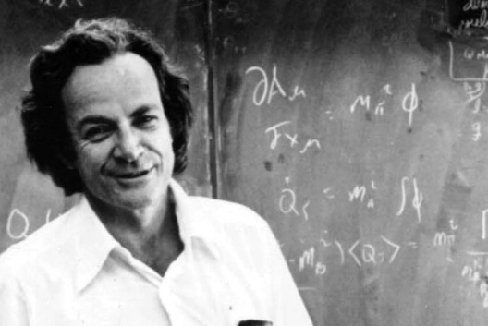
Topic 1: Measurement and uncertainties 1.2 – Uncertainties and errors
Nature of science:
Uncertainties: “All scientific knowledge is uncertain. When the scientist tells you he does not know the answer, he is an ignorant man. When he tells you he has a hunch about how it is going to work, he is uncertain about it. When he is pretty sure of how it is going to work, he still is in some doubt. And it is of paramount importance, in order to make progress, that we recognize this ignorance and this doubt. Because we have the doubt, we then propose looking in new directions for new ideas.”
– Feynman, Richard P. 1998. The Meaning of It All: Thoughts of a Citizen-Scientist. Reading, Massachusetts, USA. Perseus. P 13.
Notes:
2
© 2006 By Timothy K. Lund

Slide 3
Topic 1: Measurement and uncertainties 1.2 – Uncertainties and errors
Understandings:
• Random and systematic errors
• Absolute, fractional and percentage uncertainties
• Error bars
• Uncertainty of gradients and intercepts
Notes:
3
© 2006 By Timothy K. Lund

Slide 4
Topic 1: Measurement and uncertainties 1.2 – Uncertainties and errors
Applications and skills:
• Explaining how random and systematic errors can be identified and reduced
• Collecting data that include absolute and/or fractional uncertainties and stating these as an uncertainty range (expressed as: best estimate ± uncertainty range)
• Propagating uncertainties through calculations involving addition, subtraction, multiplication, division and raising to a power
• Determining the uncertainty in gradients and intercepts
Notes:
4
© 2006 By Timothy K. Lund

Slide 5
Topic 1: Measurement and uncertainties 1.2 – Uncertainties and errors
Guidance:
• Analysis of uncertainties will not be expected for trigonometric or logarithmic functions in examinations
Data booklet reference:
• If y = a ± b then Δy = Δa + Δb
• If y = a · b / c then Δy / y = Δa / a + Δb / b + Δc / c
• If y = a ^{n} then Δy / y = | n · Δa / a |
Notes:
5
© 2006 By Timothy K. Lund

Slide 6
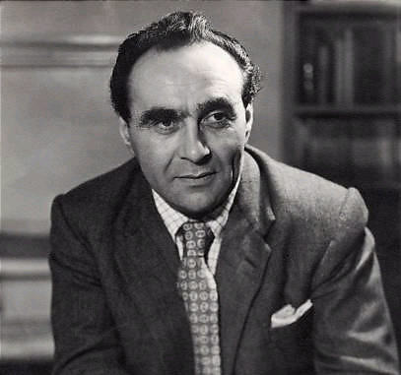
Topic 1: Measurement and uncertainties 1.2 – Uncertainties and errors
Theory of knowledge:
• “One aim of the physical sciences has been to give an exact picture of the material world. One achievement of physics in the twentieth century has been to prove that this aim is unattainable.” – Jacob Bronowski.
• Can scientists ever be truly certain of their discoveries?
Jacob Bronowski was a mathematician, biologist, historian of science, theatre author, poet and inventor. He is probably best remembered as the writer of The Ascent of Man.
Notes:
6
© 2006 By Timothy K. Lund

Slide 7
Topic 1: Measurement and uncertainties 1.2 – Uncertainties and errors
Utilization:
• Students studying more than one group 4 subject will be able to use these skills across all subjects
Aims:
• Aim 4: it is important that students see scientific errors and uncertainties not only as the range of possible answers but as an integral part of the scientific process
• Aim 9: the process of using uncertainties in classical physics can be compared to the view of uncertainties in modern (and particularly quantum) physics
Notes:
7
© 2006 By Timothy K. Lund

Slide 8
Topic 1: Measurement and uncertainties 1.2 – Uncertainties and errors
Random and systematic errors
•Error in measurement is expected because of the imperfect nature of us and our measuring devices.
•For example a typical meter stick has marks at every millimeter (10⁻³ m or 1/1000 m).
EXAMPLE: Consider the following line whose length we wish to measure. How long is it?
SOLUTION: It is closer to 1.2 cm than to 1.1 cm, so we say it measures 1.2 cm (or 12 mm or 0.012 m).
0
1
1 cm
1 mm
Notes:
© 2006 By Timothy K. Lund

Slide 9
Topic 1: Measurement and uncertainties 1.2 – Uncertainties and errors
Random and systematic errors
•Error in measurement is expected because of the imperfect nature of us and our measuring devices.
•We say the precision or uncertainty in our measurement is ± 1 mm.
EXAMPLE: Consider the following line whose length we wish to measure. How long is it?
SOLUTION: It is closer to 1.2 cm than to 1.1 cm, so we say it measures 1.2 cm (or 12 mm or 0.012 m).
0
1
1 cm
1 mm
FYI •We record L = 12 mm ± 1 mm.
Notes:
© 2006 By Timothy K. Lund

Slide 10
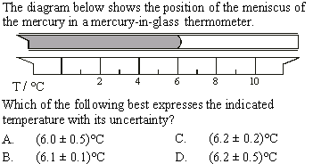
Topic 1: Measurement and uncertainties 1.2 – Uncertainties and errors
Random and systematic errors
SOLUTION:
6.2 is the nearest reading.
The uncertainty is certainly less than 0.5.
7
Notes:
10
© 2006 By Timothy K. Lund

Slide 11
Topic 1: Measurement and uncertainties 1.2 – Uncertainties and errors
Random and systematic errors
•Random error is error due to the recorder, rather than the instrument used for the measurement.
•Different people may measure the same line slightly differently. You may in fact measure the same line differently on two different occasions.
EXAMPLE: Suppose Bob measures L = 11 mm ± 1 mm and Ann measures L = 12 mm ± 1 mm.
Then Bob guarantees that the line falls between 10 mm and 12 mm.
Ann guarantees it is between 11 mm and 13 mm.
Both are absolutely correct.
0
1
Notes:
© 2006 By Timothy K. Lund

Slide 12
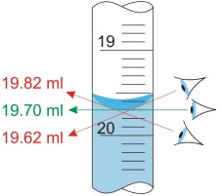
Topic 1: Measurement and uncertainties 1.2 – Uncertainties and errors
Random and systematic errors
•Random error is error due to the recorder, rather than the instrument used for the measurement.
•Different people may measure the same line slightly differently. You may in fact measure the same line differently on two different occasions.
•Perhaps the ruler wasn’t perfectly lined up.
•Perhaps your eye was viewing at an angle rather than head-on. This is called a parallax error.
FYI
•The only way to minimize random error is to take many readings of the same measurement and to average them all together.
Notes:
© 2006 By Timothy K. Lund

Slide 13
Topic 1: Measurement and uncertainties 1.2 – Uncertainties and errors
Random and systematic errors
Systematic error is error due to the instrument being “out of adjustment.”
•A voltmeter might have a zero offset error.
•A meter stick might be rounded on one end.
Now Bob measures the same line at 13 mm ± 1 mm.
Furthermore, every measurement Bob makes will be off by that same amount.
Worn off end
0
1
FYI
•Systematic errors are usually difficult to detect.
Notes:
© 2006 By Timothy K. Lund

Slide 14
Topic 1: Measurement and uncertainties 1.2 – Uncertainties and errors
Random and systematic errors
•The following game where a catapult launches darts with the goal of hitting the bull’s eye illustrates the difference between precision and accuracy.
Trial 1
RE↑SE↑
Trial 2
RE↑SE↓
Trial 3
RE↓SE↑
Trial 4
RE↓SE↓
Low Precision
Low Precision
High Precision
High Precision
•Hits not grouped
•Hits not grouped
•Hits grouped
•Hits grouped
Low Accuracy
High Accuracy
Low Accuracy
High Accuracy
•Average well below bulls eye
•Average right at bulls eye
•Average well below bulls eye
•Average right at bulls eye
Notes:
© 2006 By Timothy K. Lund

Slide 15
Topic 1: Measurement and uncertainties 1.2 – Uncertainties and errors
Random and systematic errors
PRACTICE:
SOLUTION:
This is like the rounded-end ruler. It will produce a systematic error.
Thus its error will be in accuracy, not precision.
Notes:
15
© 2006 By Timothy K. Lund

Slide 16
Topic 1: Measurement and uncertainties 1.2 – Uncertainties and errors
Absolute, fractional and percentage uncertainties
•Absolute error is the raw uncertainty or precision of your measurement.
EXAMPLE:
A student measures the length of a line with a wooden meter stick to be 11 mm ± 1 mm. What is the absolute error or uncertainty in her measurement?
SOLUTION:
The ± number is the absolute error. Thus 1 mm is the absolute error.
1 mm is also the precision.
•1 mm is also the raw uncertainty.
Notes:
© 2006 By Timothy K. Lund

Slide 17
Topic 1: Measurement and uncertainties 1.2 – Uncertainties and errors
Absolute, fractional and percentage uncertainties
•Fractional error is given by
fractional error
Absolute Error
Measured Value
Fractional Error =
EXAMPLE:
A student measures the length of a line with a wooden meter stick to be 11 mm ± 1 mm. What is the fractional error or uncertainty in her measurement?
SOLUTION:
Fractional error = 1 / 11 = 0.09.
FYI •”Fractional” errors are usually expressed as decimal numbers rather than fractions.
Notes:
© 2006 By Timothy K. Lund

Slide 18
Topic 1: Measurement and uncertainties 1.2 – Uncertainties and errors
Absolute, fractional and percentage uncertainties
•Percentage error is given by
percentage error
Absolute Error
Measured Value
Percentage Error =
· 100%
EXAMPLE:
A student measures the length of a line with a wooden meter stick to be 11 mm ± 1 mm. What is the percentage error or uncertainty in her measurement?
SOLUTION:
Percentage error = (1 / 11) ·100% = 9%
FYI •Don’t forget to include the percent sign.
Notes:
© 2006 By Timothy K. Lund

Slide 19
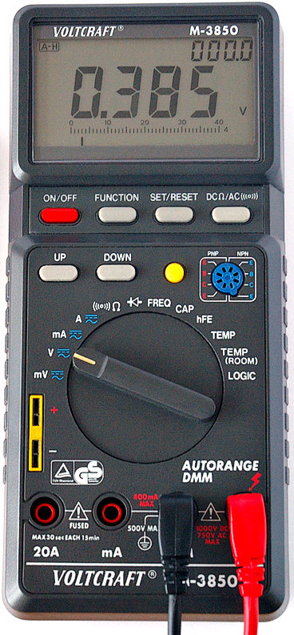
Topic 1: Measurement and uncertainties 1.2 – Uncertainties and errors
Absolute, fractional and percentage uncertainties
PRACTICE:
A student measures the voltage shown. What are the absolute, fractional and percentage uncertainties of his measurement? Find the precision and the raw uncertainty.
SOLUTION:
Absolute uncertainty = 0.001 V.
Fractional uncertainty = 0.001/0.385 = 0.0026.
Percentage uncertainty = 0.0026(100%) = 0.26%.
Precision is 0.001 V.
Raw uncertainty is 0.001 V.
Notes:
© 2006 By Timothy K. Lund

Slide 20
Topic 1: Measurement and uncertainties 1.2 – Uncertainties and errors
Absolute, fractional and percentage uncertainties
PRACTICE:
SOLUTION:
Find the average of the two measurements:
(49.8 + 50.2) / 2 = 50.0.
Find the range / 2 of the two measurements:
(50.2 – 49.8) / 2 = 0.2.
The measurement is 50.0 ± 0.2 cm.
Notes:
20
© 2006 By Timothy K. Lund

Slide 21
Topic 1: Measurement and uncertainties 1.2 – Uncertainties and errors
Propagating uncertainties through calculations
•To find the uncertainty in a sum or difference you just add the uncertainties of all the ingredients.
•In formula form we have
uncertainty in sums and differences
If y = a ± b then ∆y = ∆a + ∆b
FYI
•Note that whether or not the calculation has a + or a -,
the uncertainties are ADDED.
•Uncertainties NEVER REDUCE ONE ANOTHER.
Notes:
© 2006 By Timothy K. Lund

Slide 22
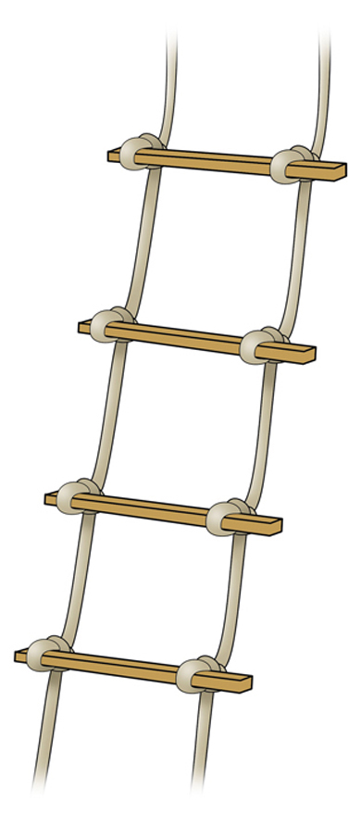
Topic 1: Measurement and uncertainties 1.2 – Uncertainties and errors
Propagating uncertainties through calculations
•To find the uncertainty in a sum or difference you just add the uncertainties of all the ingredients.
EXAMPLE:
A 9.51 ± 0.15 meter rope ladder is hung from a roof that is 12.56 ± 0.07 meters above the ground. How far is the bottom of the ladder from the ground?
SOLUTION:
y = a – b = 12.56 - 9.51 = 3.05 m
∆y = ∆a + ∆b = 0.15 + 0.07 = 0.22 m
•Thus the bottom is 3.05 ± 0.22 m from the ground.
Notes:
© 2006 By Timothy K. Lund

Slide 23
Topic 1: Measurement and uncertainties 1.2 – Uncertainties and errors
Propagating uncertainties through calculations
•To find the uncertainty in a product or quotient you just add the percentage or fractional uncertainties of all the ingredients.
•In formula form we have
uncertainty in products and quotients
If y = a · b / c then ∆y / y = ∆a / a + ∆b / b + ∆c / c
FYI
•Whether or not the calculation has a × or a ÷,
the uncertainties are ADDED.
•You can’t add numbers having different units, so we use fractional uncertainties for products and quotients.
Notes:
© 2006 By Timothy K. Lund

Slide 24
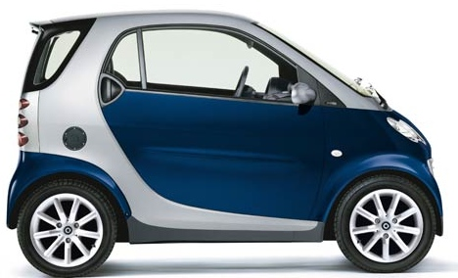
Topic 1: Measurement and uncertainties 1.2 – Uncertainties and errors
Propagating uncertainties through calculations
•To find the uncertainty in a product or quotient you just add the percentage or fractional uncertainties of all the ingredients.
EXAMPLE: A car travels 64.7 ± 0.5 meters in 8.65 ± 0.05 seconds. What is its speed?
SOLUTION: Use rate = distance divided by time.
r = d / t = 64.7 / 8.65 = 7.48 m s⁻¹
∆r / r = ∆d / d + ∆t / t = .5 / 64.7 + .05 / 8.65 = 0.0135
•∆r / 7.48 = 0.0135 so that
•∆r = 7.48( 0.0135 ) = 0.10 m s⁻¹.
•Thus, the car is traveling at 7.48 ± 0.10 m s⁻¹.
Notes:
© 2006 By Timothy K. Lund

Slide 25
Topic 1: Measurement and uncertainties 1.2 – Uncertainties and errors
Propagating uncertainties through calculations
PRACTICE:
SOLUTION:
∆P / P = ∆I / I + ∆I / I + ∆R / R
∆P / P = 2% + 2% + 10% = 14%.
Notes:
25
© 2006 By Timothy K. Lund

Slide 26
Topic 1: Measurement and uncertainties 1.2 – Uncertainties and errors
Propagating uncertainties through calculations
PRACTICE:
SOLUTION:
∆F / F = 0.2 / 10 = 0.02 = 2%.
∆m / m = 0.1 / 2 = 0.05 = 5%.
∆a / a = ∆F / F + ∆m / m = 2% + 5% = 7%.
Notes:
26
© 2006 By Timothy K. Lund

Slide 27
Topic 1: Measurement and uncertainties 1.2 – Uncertainties and errors
Propagating uncertainties through calculations
PRACTICE:
SOLUTION:
∆r / r = 0.5 / 10 = 0.05 = 5%.
A = πr².
Then ∆A / A = ∆r / r + ∆r / r = 5% + 5% = 10%.
Notes:
27
© 2006 By Timothy K. Lund

Slide 28
Topic 1: Measurement and uncertainties 1.2 – Uncertainties and errors
Uncertainty of gradient and intercepts
•IB has a requirement that when you conduct an experiment of your own design, you must have five variations in your independent variable.
•And for each variation of your independent variable you must conduct three trials to gather the values of the dependent variable.
•The three values for each dependent variable will then be averaged.
Notes:
© 2006 By Timothy K. Lund

Slide 29
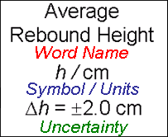
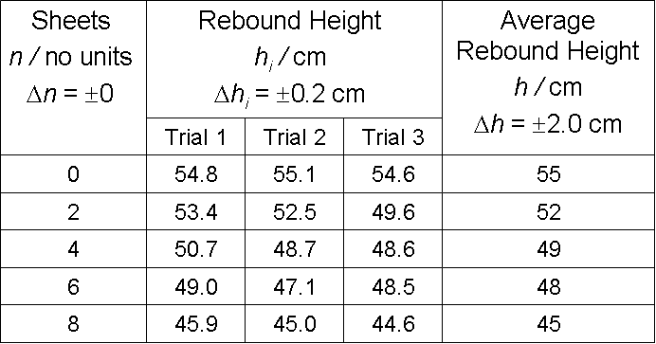
Topic 1: Measurement and uncertainties 1.2 – Uncertainties and errors
The “good” header
Uncertainty of gradient and intercepts
•This is a well designed table containing all of the information and data points required by IB:
3 Trials
Dependent
( responding )
Independent
( manipulated )
Notes:
© 2006 By Timothy K. Lund

Slide 30
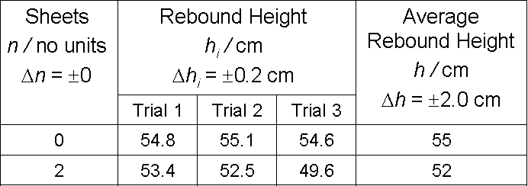
Topic 1: Measurement and uncertainties 1.2 – Uncertainties and errors
Uncertainty of gradient and intercepts
•In order to determine the uncertainty in the dependent variable we reproduce the first two rows of the previous table:
•The uncertainty in the average height h was taken to be half the largest range in the trial data, which is in the row for n = 2 sheets:
53.4 - 49.6
2
= 2.0.
Notes:
© 2006 By Timothy K. Lund

Slide 31
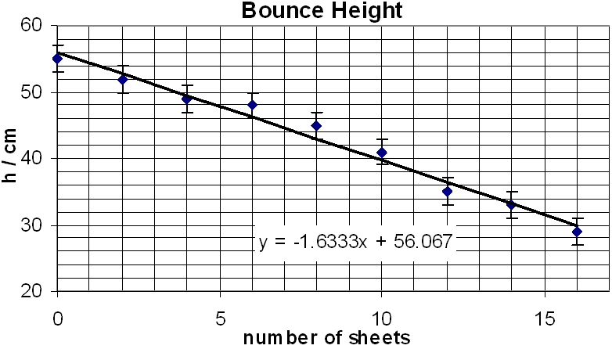
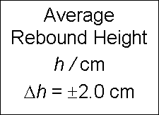
Topic 1: Measurement and uncertainties 1.2 – Uncertainties and errors
Uncertainty of gradient and intercepts
•The size of the error bar in the graph is then up two and down two at each point in the graph:
Error bars go up 2 and down 2 at each point.
Notes:
© 2006 By Timothy K. Lund

Slide 32
Topic 1: Measurement and uncertainties 1.2 – Uncertainties and errors
Uncertainty of gradient and intercepts
•To determine the uncertainty in the gradient and intercepts of a best fit line we look only at the first and last error bars, as illustrated here:
m_{max}
m_{best}
intercept
b_{min}
m_{min}
slope
b_{best}
Recall: y = mx + b
b_{max}
m_{max} - m_{min}
2
slope & uncertainty
m_{best} ± Δm = m_{best} ±
b_{max} - b_{min}
2
intercept & uncertainty
b_{best} ± Δb = b_{best} ±
Notes:
© 2006 By Timothy K. Lund

Slide 33
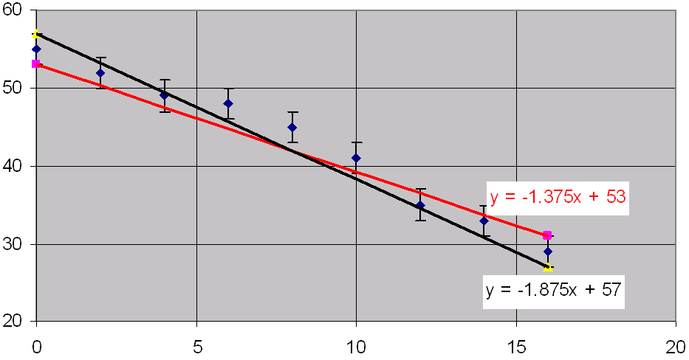
Topic 1: Measurement and uncertainties 1.2 – Uncertainties and errors
Uncertainty of gradient and intercepts
•The slope uncertainty calculation is shown here:
m_{max} - m_{min}
Δm =
2
⁻1.375 - ⁻1.875
2
Δm =
Δm = ± 0.25
Notes:
33
© 2006 By Timothy K. Lund

Slide 34
Topic 1: Measurement and uncertainties 1.2 – Uncertainties and errors
Uncertainty of gradient and intercepts
•The intercept uncertainty calculation is shown here:
b_{max} - b_{min}
Δb =
2
53 - 57
2
Δb =
Δb = ± 2
Notes:
34
© 2006 By Timothy K. Lund

Slide 35
Topic 1: Measurement and uncertainties 1.2 – Uncertainties and errors
Uncertainty of gradient and intercepts
•Finally, the finished graph:
m = -1.6 ± 0.3 cm sheet ⁻¹
b = 56 ± 2 cm
Notes:
35
© 2006 By Timothy K. Lund

Slide 36
Topic 1: Measurement and uncertainties 1.2 – Uncertainties and errors
Uncertainty of gradient and intercepts
EXAMPLE:
SOLUTION:
Look for the line to lie within all horizontal and vertical error bars.
Only graph B satisfies this requirement.
Notes:
36
© 2006 By Timothy K. Lund

