Slide 1
Topic 11: Electromagnetic induction - AHL 11.2 – Power generation and transmission
Topic 11.2 is an extension of Topics 5.1, 5.4, 8.1 and 10.2.
Essential idea: Generation and transmission of alternating current (ac) electricity has transformed the world.
Nature of science: Bias: In the late 19th century Edison was a proponent of direct current electrical energy transmission while Westinghouse and Tesla favored alternating current transmission. The so called “battle of currents” had a significant impact on today’s society.
Notes:
© 2015 by Timothy K. Lund

Slide 2
Topic 11: Electromagnetic induction - AHL 11.2 – Power generation and transmission
Understandings:
• Alternating current (ac) generators
• Average power and root mean square (rms) values of current and voltage
• Transformers
• Diode bridges
• Half-wave and full-wave rectification
Notes:
2
© 2015 by Timothy K. Lund

Slide 3
Topic 11: Electromagnetic induction - AHL 11.2 – Power generation and transmission
Applications and skills:
• Explaining the operation of a basic ac generator, including the effect of changing the generator frequency
• Solving problems involving the average power in an ac circuit
• Solving problems involving step-up and step-down transformers
• Describing the use of transformers in ac electrical power distribution
• Investigating a diode bridge rectification circuit experimentally
• Qualitatively describing the effect of adding a capacitor to a diode bridge rectification circuit
Notes:
3
© 2015 by Timothy K. Lund

Slide 4
Topic 11: Electromagnetic induction - AHL 11.2 – Power generation and transmission
Guidance:
• Calculations will be restricted to ideal transformers but students should be aware of some of the reasons why real transformers are not ideal (for example: flux leakage, joule heating, eddy current heating, magnetic hysteresis)
• Proof of the relationship between the peak and rms values will not be expected
Data booklet reference:
• I_{rms} = I₀ / 2
• V_{rms} = V₀ / 2
• R = V₀ / I₀ = V_{rms} / I_{rms}
• P_{max} = I₀V₀
• P = (1/2) I₀V₀
• ε_{p} / ε_{s} = N_{p} / N_{s} = I_{s} / I_{p}
Notes:
4
© 2015 by Timothy K. Lund

Slide 5
Topic 11: Electromagnetic induction - AHL 11.2 – Power generation and transmission
International-mindedness:
• The ability to maintain a reliable power grid has been the aim of all governments since the widespread use of electricity started
Theory of knowledge:
• There is continued debate of the effect of electromagnetic waves on the health of humans, especially children. Is it justifiable to make use of scientific advances even if we do not know what their long-term consequences may be?
Aims:
• Aim 6: experiments could include: construction of a basic ac generator; investigation of variation of input and output coils on a transformer; observing Wheatstone and Wien bridge circuits
Notes:
5
© 2015 by Timothy K. Lund

Slide 6
Topic 11: Electromagnetic induction - AHL 11.2 – Power generation and transmission
Aims:
• Aim 7: construction and observation of the adjustments made in very large electricity distribution systems is best carried out using computer-modeling software and websites
• Aim 9: power transmission is modeled using perfectly efficient systems but no such system truly exists. Although the model is imperfect, it renders the maximum power transmission. Recognition and ac-counting for the differences between the “perfect” system and the practical system is one of the main functions of professional scientists
Notes:
6
© 2015 by Timothy K. Lund

Slide 7
Topic 11: Electromagnetic induction - AHL 11.2 – Power generation and transmission
Alternating current (ac) generators
•Recall Faraday’s law:
•From the formula we see that there are three ways to increase the induced emf of a rotating coil:
(1) Increase the number of turns N in coil.
(2) Increase the flux change ΔΦ.
(3) Decrease the time Δt over which the flux changes.
ε = – N ΔΦ / Δt
Faraday’s law
FYI
•Recall that Φ = BA cos θ. Given the uniform magnetic field and rotating coil, B and A are constant. Thus the flux change ΔΦ will be due only to the change in the angle Δθ.
Notes:
© 2015 by Timothy K. Lund

Slide 8
Topic 11: Electromagnetic induction - AHL 11.2 – Power generation and transmission
Alternating current (ac) generators
PRACTICE:
What is the effect of increasing the frequency of the generator on the induced emf?
SOLUTION:
•From the previous slide (Point 3) we noted that if we decrease Δt then we will increase the induced emf.
•But if we decrease Δt then we decreaseT the period of rotation (time for each revolution).
•Recalling that frequency f = 1 / T, we see that as T decreases, f increases.
•Thus increasing the frequency of a generator increases the induced emf.
Notes:
© 2015 by Timothy K. Lund

Slide 9
Topic 11: Electromagnetic induction - AHL 11.2 – Power generation and transmission
Alternating current (ac) generators
•Consider the rectangular loop of wire made to rotate in the fixed magnetic field shown:
•At this instant
Φ = BA cos 0º = ⁺BA.
•A bit later θ has changed:
Φ = BA cos 45º = ⁺0.7BA.
•When θ = 90º:
Φ = BA cos 90º = 0.
•As θ continues to increase, the flux Φ becomes negative.
•A sinusoidal pattern emerges.
B
B
B
A
θ
θ
A
A
BA
Φ/ Wb
t / s
⁻BA
Notes:
© 2015 by Timothy K. Lund

Slide 10
Topic 11: Electromagnetic induction - AHL 11.2 – Power generation and transmission
Alternating current (ac) generators
•Since ε = -ΔΦ / Δt we see that the induced emf ε is the inverse slope of the flux.
•Since the slope of the cosine plot is proportional to the sine graph we see that ε ∝ BA sin θ.
•In Topic 9.1 we learned that the constant of proportionality is the angular frequency ω (measured in radians per second). For a coil of N loops rotating in a constant magnetic field we thus have the induced emf
BA
Φ/ Wb
t / s
⁻BA
ε₀
ε / V
t / s
⁻ε₀
ε = NBAω sin ωt
induced emf (rotating coil, N loops, constant B-field)
(ω = angular frequency)
Notes:
© 2015 by Timothy K. Lund

Slide 11
Topic 11: Electromagnetic induction - AHL 11.2 – Power generation and transmission
Alternating current (ac) generators
ε = NBAω sin ωt
induced emf (rotating coil, N loops, constant B-field)
(ω = angular frequency)
EXAMPLE: A 250-turn coil of wire has dimensions 2.5 cm by 3.2 cm. It is rotating at a frequency of 60 Hz in a constant magnetic field having a strength of 1.5 T.
(a) What is its peak voltage ε₀?
(b) What is the time dependence of its emf?
SOLUTION: Recall that ω = 2πf = 2π(60) = 120π.
(a) A = (0.025)(0.032) = 0.00080 m². Then
ε₀ = NBAω = 250(1.5)(0.00080)120π = 110 V.
(b) ε = NBAω sin ωt = 110 sin (120πt).
Notes:
© 2015 by Timothy K. Lund

Slide 12
Topic 11: Electromagnetic induction - AHL 11.2 – Power generation and transmission
Alternating current (ac) generators
EXAMPLE: Rewrite the generator induced emf formula in terms of frequency f, rather than angular frequency ω.
SOLUTION: Since ω = 2πf we have
ε = NBAω sin ωt
ε = 2πfNBA sin 2πft
ε = ε₀ sin 2πft
ε = NBAω sin ωt
induced emf (rotating coil, N loops, constant B-field)
ε = 2πfNBA sin 2πft
ε = ε₀ sin 2πft
ε₀ = 2πfNBA
FYI
•ε₀ = 2πfNBA clearly shows that increasing the frequency increases the induced emf of the coil.
Notes:
© 2015 by Timothy K. Lund

Slide 13
Topic 11: Electromagnetic induction - AHL 11.2 – Power generation and transmission
Alternating current (ac) generators
EXAMPLE: Here is a simplified one-loop generator:
•Some mechanical means makes the coil rotate (say a steam turbine or paddle wheels).
•The alternating current is picked up by brushes riding on two conducting rings that each touch only one end of the coil, as shown.
Output voltage
N
S
FYI •The schematic representation of an AC voltage supply or generator is .
Notes:
© 2015 by Timothy K. Lund

Slide 14
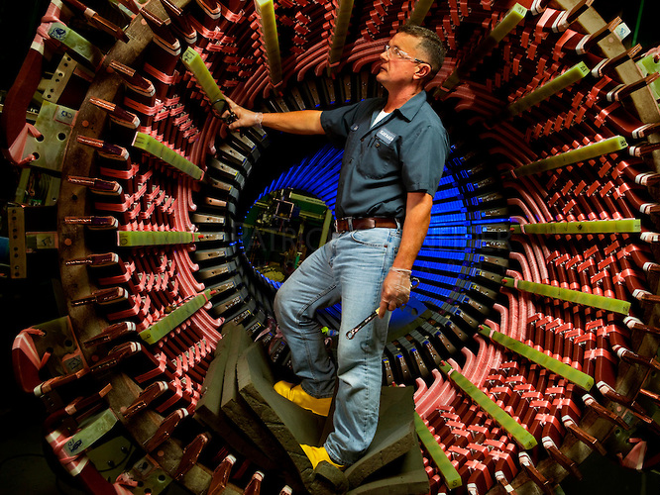
Massive windings for a nuclear power plant generator.
Notes:
© 2015 by Timothy K. Lund

Slide 15
Topic 11: Electromagnetic induction - AHL 11.2 – Power generation and transmission
Root mean square (rms) values of current and voltage
•The voltage produced by American power plants is marketed as 120 V AC, but if you were to record the voltage over time you would discover that it varies between -170 V and +170 V.
•The value that is marketed is essentially sort of an “average” voltage value.
•The problem with finding the usual average of a sinusoidal function is that it is zero!
170
ε / V
y / s
⁻170
(+) and (-) areas cancel.
170
(+)
(+)
ε / V
t / s
(-)
(-)
⁻170
Notes:
© 2015 by Timothy K. Lund

Slide 16
Topic 11: Electromagnetic induction - AHL 11.2 – Power generation and transmission
Root mean square (rms) values of current and voltage
•The way to find the average of a regularly alternating voltage is called the root mean square.
•What we do is find the area under the squared value of the sinusoidal voltage so that no cancellation occurs!
•Consider the dashed line located at ε₀²/ 2:
•Visualize the lobes above the dashed line filling in the troughs below.
ε₀
ε / V
t / s
⁻ε₀
ε₀²
ε₀²
2
0
t / s
Notes:
© 2015 by Timothy K. Lund

Slide 17
Topic 11: Electromagnetic induction - AHL 11.2 – Power generation and transmission
Root mean square (rms) values of current and voltage
•The AC rms values are equivalent to the constant DC values that would dissipate the same power.
V
EXAMPLE: Find the rms voltage for the “triangular” wave shown:
SOLUTION: There are equal (+) and (-) areas and the straight- forward average is zero. So use the rms for a single period T:
•Find the area under the squared graph [ A = (1/2)bh ]:
•A = 2(1/2)(T / 4)(V₀²) + (1/2)(T / 2)(V₀²) = (1/2)TV₀².
•The mean height is thus A / T = (1/2)V₀² = V₀²/ 2.
•Thus V_{rms} = V₀ / 2.
V₀
t
-V₀
V²
T
V₀²
T
0
t
T / 4
T / 2
T / 4
Notes:
© 2015 by Timothy K. Lund

Slide 18
Topic 11: Electromagnetic induction - AHL 11.2 – Power generation and transmission
Root mean square (rms) values of current and voltage
•The AC rms values are equivalent to the constant DC values that would dissipate the same power.
•We then define the root mean square value of an alternating voltage V_{rms} as
•A current that is set up by an alternating voltage will likewise be alternating. Similarly, we define the root mean square value of an alternating current I_{rms} as
•Think of rms values as the AC equivalent of a DC circuit in regards to power dissipation.
V_{rms} = V₀ / 2
root mean square (rms) of an alternating voltage
(V₀ = peak voltage)
I_{rms} = I₀ / 2
root mean square (rms) of an alternating current
(I₀ = peak current)
Notes:
© 2015 by Timothy K. Lund

Slide 19
Topic 11: Electromagnetic induction - AHL 11.2 – Power generation and transmission
Root mean square (rms) values of current and voltage
PRACTICE: “Mains” (outlet) electricity in the UK is rated at 220 V. This is an rms value. Find the peak voltage from a UK outlet.
SOLUTION: Use V_{rms} = V₀ / 2
•Thus
V₀ = 2 V_{rms}
= 2 (220)
= 310 V.
FYI
•Travelers bring voltage converters along for their personal appliances.
Notes:
© 2015 by Timothy K. Lund

Slide 20
Topic 11: Electromagnetic induction - AHL 11.2 – Power generation and transmission
Root mean square (rms) values of current and voltage
•Recall the power formulas for DC (shown here):
•The whole reason for using the rms values for AC current and voltage is this:
-Power consumption doesn’t depend on the peak voltage (and peak current); rather, it depends on the rms values, since they are an average.
P = VI = I ²R = V ²/ R
electrical power (DC)
P = V_{rms}I_{rms} = I_{rms}²R = V_{rms}²/ R
electrical power (AC)
PRACTICE: Show that for an AC circuit P = (1/2)V₀I₀.
SOLUTION:
P = V_{rms}I_{rms}
= (V₀ / 2)(I₀ / 2) = (1/2)V₀I₀.
Notes:
© 2015 by Timothy K. Lund

Slide 21
Topic 11: Electromagnetic induction - AHL 11.2 – Power generation and transmission
Root mean square (rms) values of current and voltage
•Power consumption is given by P = V_{rms}I_{rms} which we just showed to be (1/2)V₀I₀.
Notes:
© 2015 by Timothy K. Lund

Slide 22
Topic 11: Electromagnetic induction - AHL 11.2 – Power generation and transmission
Root mean square (rms) values of current and voltage
•This is a straight-forward definition of rms current.
Notes:
© 2015 by Timothy K. Lund

Slide 23
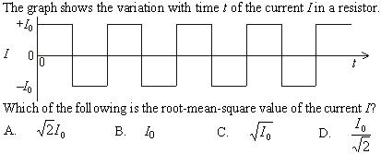
Topic 11: Electromagnetic induction - AHL 11.2 – Power generation and transmission
Root mean square (rms) values of current and voltage
I₀²
I₀²
T
2
T
2
•First we square the values over one period T:
•We then find the squared area: I₀²T/ 2 + I₀²T/ 2 = I₀²T.
•Then we find the mean height: A / T = I₀²T / T = I₀².
•Then we take the square root: I = I₀.
Notes:
© 2015 by Timothy K. Lund

Slide 24
Topic 11: Electromagnetic induction - AHL 11.2 – Power generation and transmission
Alternating current (ac) generators
ε = NBAω sin ωt
induced emf (rotating coil, N loops, constant B-field)
ε = 2πfNBA sin 2πft
ε = ε₀ sin 2πft
ε₀ = 2πfNBA
•Note from the second formula that if f’ = 2f, then V’ = 2V where V and V’ are peak values.
•Then V_{rms} = V’ / 2 = 2V / 2 = 2 V.
Notes:
© 2015 by Timothy K. Lund

Slide 25
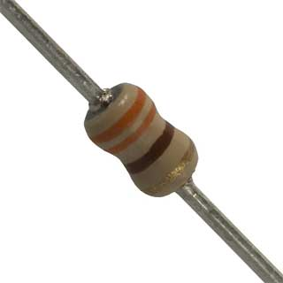
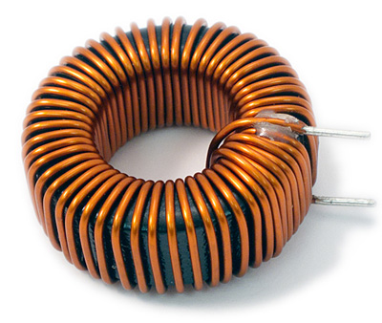
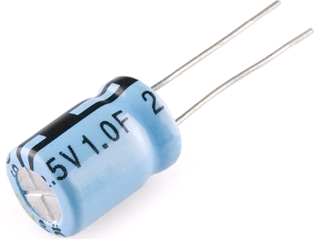
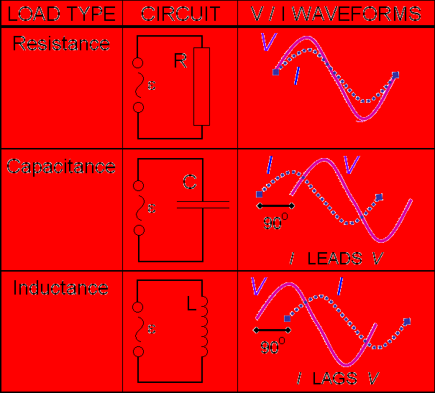
Topic 11: Electromagnetic induction - AHL 11.2 – Power generation and transmission
Solve AC circuit problems for ohmic resistors
•If a resistor is connected to an AC supply, the following relationship holds:
•This relationship shows that I andV are proportional to each other and in phase.
•This may seem an obvious relationship but in AC circuits there are components called capacitors and inductors which change the phase relationship between I and V.
V_{rms} = I_{rms}R V₀ = I₀R
ac circuits and resistors
consumes energy
stores E-field
stores B-field
Notes:
© 2015 by Timothy K. Lund

Slide 26
Topic 11: Electromagnetic induction - AHL 11.2 – Power generation and transmission
Solve AC circuit problems for ohmic resistors
•Power dissipation depends of rms values – that is why we use them after all.
•Thus P = I_{rms}²R = I₀²R / 2 (since I_{rms} = I₀ / 2).
•If I₀’ = 2I₀ then
P’ = I₀’²R / 2
P’ = (2I₀)²R / 2
P’ = 4I₀²R / 2
P’ = 2I₀²R.
Notes:
© 2015 by Timothy K. Lund

Slide 27
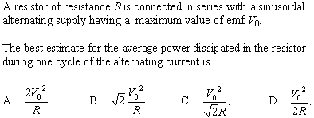
Topic 11: Electromagnetic induction - AHL 11.2 – Power generation and transmission
Solve AC circuit problems for ohmic resistors
P = V_{rms}I_{rms} = I_{rms}²R = V_{rms}²/ R
electrical power (AC)
•Since V_{rms} = V₀ / 2 then
P = V_{rms}²/ R = (V₀ / 2)²/ R = V₀²/ (2R).
Notes:
© 2015 by Timothy K. Lund

Slide 28
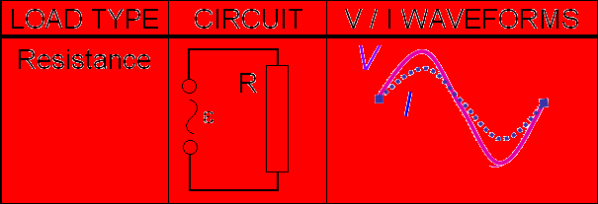
Topic 11: Electromagnetic induction - AHL 11.2 – Power generation and transmission
Solve AC circuit problems for ohmic resistors
EXAMPLE: A 60-Hz generator which produces an induced emf having a maximum value of ε₀ = 140 V is connected to a resistor of 28 Ω as shown. Find the equation of the current I as a function of time.
SOLUTION: For a resistance circuit, I and V are in phase.
•FromV₀ = I₀R we have
V₀ = I₀R → 140 = I₀(28) → I₀ = 5.0 A.
•From I = I₀ sin 2πft we have
I = 5.0 sin 2π60t
= 5.0 sin 120πt.
Notes:
© 2015 by Timothy K. Lund

Slide 29
Topic 11: Electromagnetic induction - AHL 11.2 – Power generation and transmission
Transformers
•A transformer is a device that changes a higher AC voltage to a lower one (called a step down transformer) or from a lower AC voltage to a higher one (called a step up transformer).
•Here is how it works: The input coil, called the primary winding, is wrapped around a soft iron core as shown:
•Then the output coil, called the secondary winding, is wrapped around the same soft iron core, but with a different number of loops.
•Observe loop ratios to determine the transformer type.
INPUT
OUTPUT
primary
secondary
step down transformer
primary
secondary
step up transformer
Notes:
© 2015 by Timothy K. Lund

Slide 30
Topic 11: Electromagnetic induction - AHL 11.2 – Power generation and transmission
Transformers
•In an ideal transformer there is no power loss in going from the primary side to the secondary side. Thus
I_{p}V_{p} = I_{s}V_{s} → I_{s} / I_{p} = V_{p} / V_{s}.
•Because of flux linkage we know that for each winding the voltage is proportional to the number N of loops.
•Therefore V_{p} ∝ N_{p} and V_{s} ∝ N_{s} and we see that
V_{p} / V_{s} = N_{p} / N_{s}.
•Putting it all together we get the following:
I_{s} / I_{p} = V_{p} / V_{s} = N_{p} / N_{s}
ideal transformer
FYI
•The schematic representation of an ideal transformer is shown here:
Notes:
© 2015 by Timothy K. Lund

Slide 31
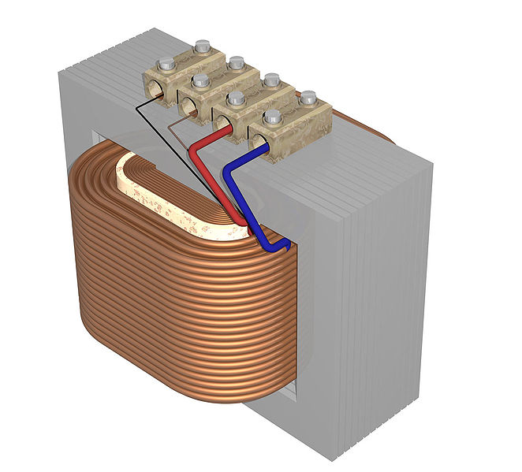
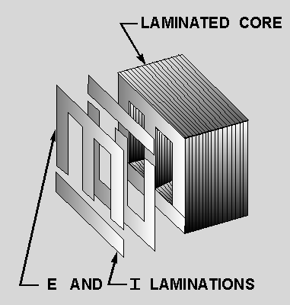
Topic 11: Electromagnetic induction - AHL 11.2 – Power generation and transmission
Transformers – real
EXAMPLE:
•To enhance the flux linkage between the primary and secondary coils, transformers are constructed using an iron core.
•The primary and secondary coils are often concentric:
•The iron core of a transformer is laminated (layered and insulated from other layers) to reduce the eddy current and hysteresis current energy losses.
COIL 1
COIL 2
Notes:
© 2015 by Timothy K. Lund

Slide 32
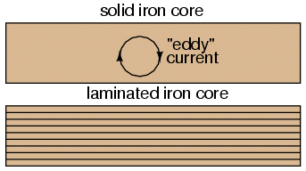
Topic 11: Electromagnetic induction - AHL 11.2 – Power generation and transmission
Transformers – real
•For real transformers there are eddy currents and hysteresis currents, both of which are created by Faraday’s law due to the magnetic flux change that is naturally a part of AC circuits. Both of these currents produce P = I ²R heat loss.
•Hysteresis losses (I_{hyst} ∝ f ) are less significant than eddy losses (I_{eddy} ∝ f ² ).
•Eddy currents can be minimized by lamination of the transformer core.
•The laminations are insulated from one another, thereby eliminating any complete loops to make a circuit.
•Furthermore, each layer has E and I laminations.
Notes:
© 2015 by Timothy K. Lund

Slide 33
Topic 11: Electromagnetic induction - AHL 11.2 – Power generation and transmission
Solve problems involving ideal transformers
•For an ideal transformer there is no power loss between primary and secondary coils.
•Thus V_{p}I_{p} = V_{s}I_{s}.
Notes:
© 2015 by Timothy K. Lund

Slide 34
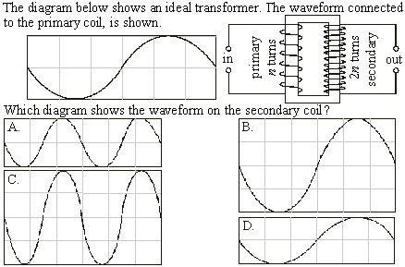
Topic 11: Electromagnetic induction - AHL 11.2 – Power generation and transmission
Solve problems involving ideal transformers
•V ∝ N → V_{s} = 2V_{p}.
•f is not changed in a trans- former.
Notes:
© 2015 by Timothy K. Lund

Slide 35
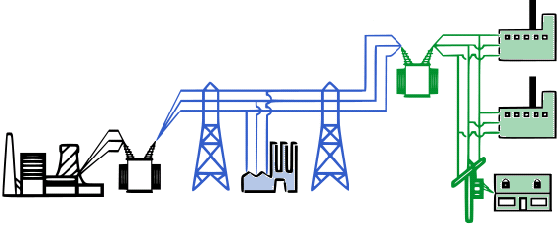
Topic 11: Electromagnetic induction - AHL 11.2 – Power generation and transmission
Transformers in AC electrical power distribution
•Observe the simplified electrical grid:
FYI
•Power is lost as heat during transformer step-up and -down of the voltage due to eddy currents (I_{eddy} ∝ f ²).
•Power is lost as heat in the lines during the current transmission due to internal resistance (P = I ²R).
Notes:
© 2015 by Timothy K. Lund

Slide 36
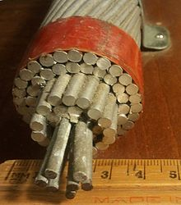
Topic 11: Electromagnetic induction - AHL 11.2 – Power generation and transmission
Solve problems involving power transmission
•For transmission lines, the gauge of wire is determined in a trade-off between the cost of large-diameter (low resistance) wire, and the cost of power lost due to low-diameter (high resistance) wire.
EXAMPLE: Many transmission lines are made of aluminum (having a resistivity of 5.2×10⁻⁸ Ω m) reinforced with steel (see picture).
(a) What is the cross-sectional area of the cable?
SOLUTION: The diameter is
d = (4 in )(2.54 cm in⁻¹) = 10 cm = 0.1 m.
•The area is then
A = πd ² / 4 = π(0.1)² / 4 = 0.008 m².
Notes:
© 2015 by Timothy K. Lund

Slide 37
Topic 11: Electromagnetic induction - AHL 11.2 – Power generation and transmission
Solve problems involving power transmission
•For transmission lines, the gauge of wire is determined in a trade-off between the cost of large-diameter (low resistance) wire, and the cost of power lost due to low-diameter (high resistance) wire.
EXAMPLE: Many transmission lines are made of aluminum (having a resistivity of 5.2×10⁻⁸ Ω m) reinforced with steel (see picture).
(b) Assuming the cable is all aluminum, find the resistance of a 150 km section.
SOLUTION: Use R = ρL / A:
R = ρL / A
= (5.2×10⁻⁸)150000 / 0.008 = 1 Ω.
Notes:
© 2015 by Timothy K. Lund

Slide 38
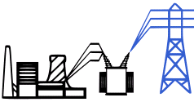
Topic 11: Electromagnetic induction - AHL 11.2 – Power generation and transmission
Solve problems involving power transmission
•Recall that heat loss is determined by P = I ²R.
•Since the resistance R of the transmission cable is fixed once its diameter has been chosen, the only other way to reduce power loss is to reduce the current I going through the cable.
•Since P = VI, if we want to minimize I we can do so if we increase V, thus maintaining the power P that is to be delivered.
•This is the idea behind the use of the step-up transformer at the generation side of the power grid.
Notes:
© 2015 by Timothy K. Lund

Slide 39
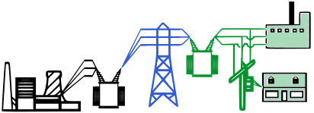
Topic 11: Electromagnetic induction - AHL 11.2 – Power generation and transmission
Solve problems involving power transmission
•Since the high voltage used for transmission is very dangerous, at the end of the transmission it is brought back down to a safer level through the use of a step-down transformer.
Notes:
© 2015 by Timothy K. Lund

Slide 40
Topic 11: Electromagnetic induction - AHL 11.2 – Power generation and transmission
Solve problems involving power transmission
PRACTICE: The 150 km cable whose resistance was calculated previously to be 1 Ω is designed to deliver 270 MW to a community.
(a) If the transmission occurs at 138 kV, what is the current and what is the heat loss?
SOLUTION:
•Use P = VI ( or I = P / V ) and P = I ²R.
(a) I = P / V = 270×10⁶ / 138×10³ = 2000 A (1957 A).
P = I ²R = 1957²(1) = 3.8×10⁶ W = 4 MW.
This is a 4 / 270 = 0.01 = 1% heat loss.
Notes:
© 2015 by Timothy K. Lund

Slide 41
Topic 11: Electromagnetic induction - AHL 11.2 – Power generation and transmission
Solve problems involving power transmission
PRACTICE: The 150 km cable whose resistance was calculated previously to be 1 Ω is designed to deliver 270 MW to a community.
(b) If the transmission occurs at 765 kV, what is the current and what is the heat loss?
SOLUTION:
•Use P = VI ( or I = P / V ) and P = I ²R.
(b) I = P / V = 270×10⁶ / 765×10³ = 350 A (353 A).
P = I ²R = 353²(1) = 1.2×10⁵ W = 0.1 MW.
This is 0.1 / 270 = 0.0004 = 0.04% heat loss.
Notes:
© 2015 by Timothy K. Lund

Slide 42
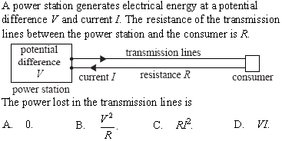
Topic 11: Electromagnetic induction - AHL 11.2 – Power generation and transmission
Solve problems involving power transmission
Notes:
© 2015 by Timothy K. Lund

Slide 43
Topic 11: Electromagnetic induction - AHL 11.2 – Power generation and transmission
The effect of electromagnetic waves on human health
•The frequency of transmitted and home-used power is about 60 Hz, which is considered to be an extremely low frequency (ELF).
•The photons emitted by such ELF radiation are not energetic enough to ionize living cells, and thus cannot harm cells via ionization in the ways that alpha, beta and gamma rays can.
•The alternating field, however, can set up small alternating currents in the body. This is because there are both ions and polarized molecules in cellular structures which can respond to alternating electromagnetic fields according to Faraday’s law.
Notes:
© 2015 by Timothy K. Lund

Slide 44
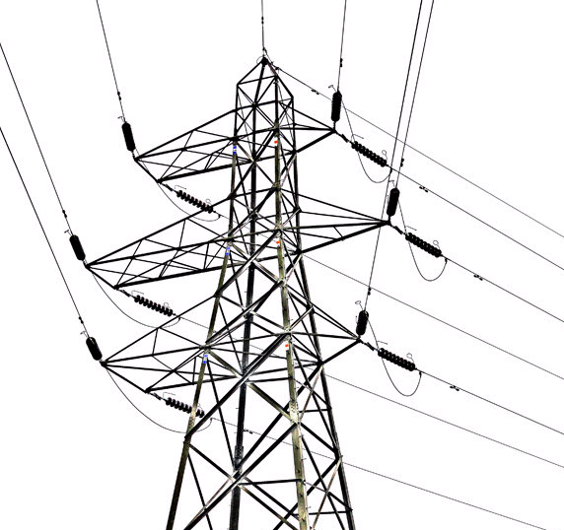
Topic 11: Electromagnetic induction - AHL 11.2 – Power generation and transmission
The effect of electromagnetic waves on human health
•Many studies have shown that ELF fields do not harm genetic material.
•Studies on the effect of ELF-induced currents in living cells are inconclusive, however.
•Read the article Power lines link to cancer to see evidence that induced currents do increase the incidence of childhood leukemia.
•Another obvious risk is danger of electrocution.
Notes:
© 2015 by Timothy K. Lund

Slide 45
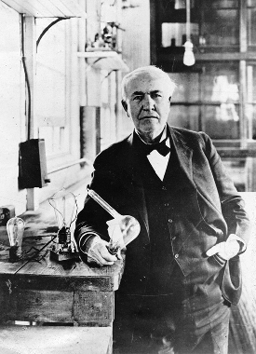
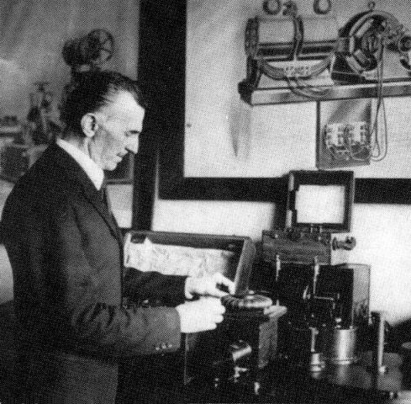
Topic 11: Electromagnetic induction - AHL 11.2 – Power generation and transmission
The AC vs. DC argument
•When electricity became available for distribution to households, various arguments as to which form it should be transmitted in were put forth by Edison (DC), Westinghouse (AC), and Tesla (AC).
•Power transmission today is exclusively AC.
•Given that AC can be stepped up and down via transformers (and DC can’t), we can see why it is preferable to DC for transmission.
•It is also easier to produce AC in quantity.
•However, most of the electronic devices we use today are of the DC variety. Thus there must be a means to convert AC to DC within these devices.
Notes:
© 2015 by Timothy K. Lund

Slide 46
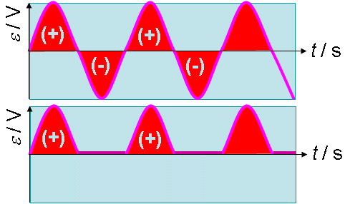
Topic 11: Electromagnetic induction - AHL 11.2 – Power generation and transmission
The diode bridge rectifier
•A diode is a semiconductor that allows current to flow only one-way. Its schematic symbol shows the direction of the conventional (+) current flow.
•Thus, if we supply an AC input to the diode, only the positive lobes of the alternating input will be allowed to pass through.
•The conversion from AC to DC is called rectification.
•This particular example is called a half-wave rectifier because we only “harvest” half the electrical energy.
AC INPUT
DC OUTPUT
Notes:
© 2015 by Timothy K. Lund

Slide 47
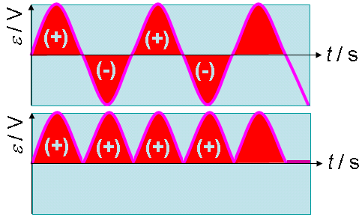
Topic 11: Electromagnetic induction - AHL 11.2 – Power generation and transmission
The diode bridge rectifier
•If we are clever, we can construct a full-wave bridge rectifier using four diodes and a resistor, as shown:
•Now if we supply an AC input to the diode “bridge” there will always be a path for a lobe to make it through and produce a DC voltage drop across the load resistor.
DC OUTPUT
AC INPUT
DC OUTPUT
Notes:
© 2015 by Timothy K. Lund

Slide 48
Topic 11: Electromagnetic induction - AHL 11.2 – Power generation and transmission
(+)
The diode bridge rectifier
•Here is how it works:
•At the instant shown, let us say that the left terminal of the AC supply is (+) and the right terminal is (–).
•The (+) flows with the diode arrow, and the (–) flows against the diode arrow:
•Now suppose the polarity switches at the supply terminals:
•Note that no matter what the polarity of the supply terminals, the top output will be (+) and the bottom output will be (–). Thus we have DC at the output.
DC OUTPUT
(–)
Notes:
© 2015 by Timothy K. Lund

Slide 49
Topic 11: Electromagnetic induction - AHL 11.2 – Power generation and transmission
(+)
The diode bridge rectifier
•Because the full-wave rectifier simply converts negative lobes to positive ones, the voltage is not very constant.
•Note that although it is DC, it varies from 0 to V₀ twice each period.
•This fluctuation is too great for most electronic devices.
•Luckily, this problem can be corrected simply by adding a large-valued capacitor across the output. Its storage capacity “smooths” out the resulting waveform.
(–)
Notes:
© 2015 by Timothy K. Lund

