Slide 1
Topic 5: Electricity and magnetism 5.4 – Magnetic effects of electric currents
Essential idea: The effect scientists call magnetism arises when one charge moves in the vicinity of another moving charge.
Nature of science: Models and visualization: Magnetic field lines provide a powerful visualization of a magnetic field. Historically, the field lines helped scientists and engineers to understand a link that begins with the influence of one moving charge on another and leads onto relativity.
Notes:
© 2014 By Timothy K. Lund

Slide 2
Topic 5: Electricity and magnetism 5.4 – Magnetic effects of electric currents
Understandings:
• Magnetic fields
• Magnetic force
Applications and skills:
• Determining the direction of force on a charge moving in a magnetic field
• Determining the direction of force on a current-carrying conductor in a magnetic field
• Sketching and interpreting magnetic field patterns
• Determining the direction of the magnetic field based on current direction
• Solving problems involving magnetic forces, fields, current and charges
Notes:
© 2014 By Timothy K. Lund

Slide 3
Topic 5: Electricity and magnetism 5.4 – Magnetic effects of electric currents
Guidance:
• Magnetic field patterns will be restricted to long straight conductors, solenoids, and bar magnets
Data booklet reference:
• F = qvB sin θ
• F = BIL sin θ
International-mindedness:
• The investigation of magnetism is one of the oldest studies by man and was used extensively by voyagers in the Mediterranean and beyond thousands of years ago
Notes:
© 2014 By Timothy K. Lund

Slide 4
Topic 5: Electricity and magnetism 5.4 – Magnetic effects of electric currents
Theory of knowledge:
• Field patterns provide a visualization of a complex phenomenon, essential to an understanding of this topic. Why might it be useful to regard knowledge in a similar way, using the metaphor of knowledge as a map – a simplified representation of reality?
Notes:
© 2014 By Timothy K. Lund

Slide 5
Topic 5: Electricity and magnetism 5.4 – Magnetic effects of electric currents
Utilization:
• Only comparatively recently has the magnetic compass been superseded by different technologies after hundreds of years of our dependence on it
• Modern medical scanners rely heavily on the strong, uniform magnetic fields produced by devices that utilize superconductors
• Particle accelerators such as the Large Hadron Collider at CERN rely on a variety of precise magnets for aligning the particle beams
Notes:
© 2014 By Timothy K. Lund

Slide 6
Topic 5: Electricity and magnetism 5.4 – Magnetic effects of electric currents
Aims:
• Aim 2 and 9: visualizations frequently provide us with insights into the action of magnetic fields, however the visualizations themselves have their own limitations
• Aim 7: computer-based simulations enable the visualization of electro-magnetic fields in three-dimensional space
Notes:
© 2014 By Timothy K. Lund

Slide 7
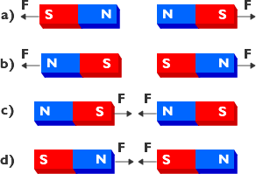
Topic 5: Electricity and magnetism 5.4 – Magnetic effects of electric currents
Magnetic force
•The magnetic force can be demonstrated using two bar magnets, which are metallic bars that have north and south poles:
•From a) and b) we see that like poles repel.
•From c) and d) we see that unlike poles attract.
•Both statements together are called the pole law.
•Note the similarity with the charge law.
Notes:
© 2014 By Timothy K. Lund

Slide 8
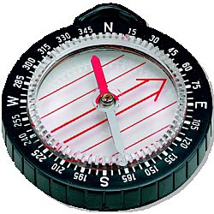
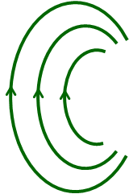
Topic 5: Electricity and magnetism 5.4 – Magnetic effects of electric currents
Magnetic field
•Because of their historical use for navigation, magnetic poles of detection devices are defined like this:
•The pole labeled "North" is really the north-seeking pole.
•The pole labeled "South" is really the south-seeking pole.
N
From the pole law we see that the north geographic pole is actually a south magnetic pole!
S
Notes:
© 2014 By Timothy K. Lund

Slide 9
Topic 5: Electricity and magnetism 5.4 – Magnetic effects of electric currents
Magnetic field
•When we say "north-seeking" we mean that the north pole of a hanging, balanced magnet will tend to point toward the north geographic pole of the earth.
•We call the lines along which the magnets align themselves the magnetic field lines.
•The symbol B is used to represent the magnetic flux density and is measured in Tesla (T).
•Note that B is a vector since it has direction.
Magnetic field lines
N
S
Notes:
© 2014 By Timothy K. Lund

Slide 10
Topic 5: Electricity and magnetism 5.4 – Magnetic effects of electric currents
Magnetic field
•By convention, the direction of the magnetic field lines is the direction a north-seeking pole would point if placed within the field:
•Just as in any field, the strength of the B-field is proportional to the density of the field lines.
•At either pole of the earth the B-field is thus the greatest.
N
S
Notes:
© 2014 By Timothy K. Lund

Slide 11
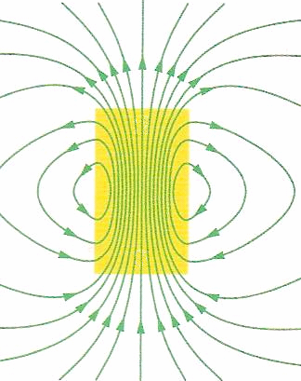
Topic 5: Electricity and magnetism 5.4 – Magnetic effects of electric currents
Sketching and interpreting magnetic field patterns
EXAMPLE: A bar magnet is a piece of ferrous metal which has a north and a south pole. Looking at the B-field about such a magnet, determine the north and the south poles.
SOLUTION:
•By convention, the direction of the magnetic field lines is the direction a north-seeking pole would point if placed within the field.
•The poles are as shown. Why?
•By the pole law (S) is attracted to (N), and (N) is attracted to (S).
N
S
N
N
S
S
N
S
Notes:
© 2014 By Timothy K. Lund

Slide 12
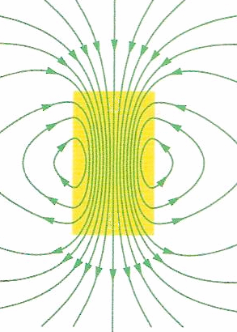
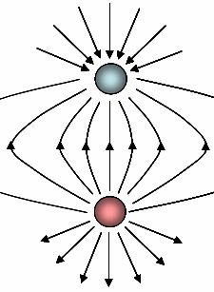
Topic 5: Electricity and magnetism 5.4 – Magnetic effects of electric currents
Sketching and interpreting magnetic field patterns
•A bar magnet is a magnetic dipole because it has two poles, N and S.
•Compare the field lines of the magnetic dipole with the electric dipole, which also has two poles, (+) and (-).
•Externally, they are identical. How do they differ internally?
magnetic dipole
electric dipole
Notes:
© 2014 By Timothy K. Lund

Slide 13
Topic 5: Electricity and magnetism 5.4 – Magnetic effects of electric currents
Sketching and interpreting magnetic field patterns
•We can take an electric dipole and split it into its constituent monopoles:
(-) MONOPOLE
(+) MONOPOLE
FYI
•An electric monopole is a charge.
DIPOLE
Notes:
© 2014 By Timothy K. Lund

Slide 14
Topic 5: Electricity and magnetism 5.4 – Magnetic effects of electric currents
Sketching and interpreting magnetic field patterns
•Now we ask, can we do the same thing to a magnetic dipole?
Can we split a magnet and isolate the poles?
S
N
S
N
S
N
S
N
S
N
S
N
S
N
S
N
S
N
S
N
S
N
S
N
S
N
S
N
S
N
FYI
•The answer is: No.
•To date no one has succeeded in isolating a magnetic monopole.
•Become rich and famous: Discover or create one!
Notes:
© 2014 By Timothy K. Lund

Slide 15
Topic 5: Electricity and magnetism 5.4 – Magnetic effects of electric currents
Magnetic field caused by a current
•Consider a current-carrying wire as shown.
•If we place compasses around the wire we discover that a magnetic field is produced which is tangent to a circle surrounding the wire.
•This is a strange phenomenon: Namely, the magnetic field lines do not originate on the wire. They encircle it. They have no beginning, and no end.
•Furthermore, if we reverse the direction of the current, the magnetic field lines will also reverse their directions.
I
Notes:
© 2014 By Timothy K. Lund

Slide 16
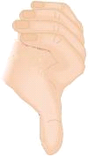
Topic 5: Electricity and magnetism 5.4 – Magnetic effects of electric currents
Determining magnetic field direction – straight wire
•There is a “right hand rule” for a current carrying wire which helps us remember the direction of the B-field.
•Imagine grasping the wire with your right hand in such a way that your extended thumb points in the direction of the current.
•Then your fingers will wrap around the wire in the same direction as the B-field lines.
I
Notes:
© 2014 By Timothy K. Lund

Slide 17
Topic 5: Electricity and magnetism 5.4 – Magnetic effects of electric currents
Determining magnetic field direction – straight wire
•There are sketching conventions for drawing B-fields. They are as follows…
OR
View from head of B-field
B
View from tail of B-field
OR
Notes:
© 2014 By Timothy K. Lund

Slide 18
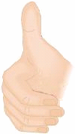
Topic 5: Electricity and magnetism 5.4 – Magnetic effects of electric currents
Determining magnetic field direction – straight wire
EXAMPLE: Using the drawing conventions just shown, sketch in the B-field for the current-carrying wire shown here.
SOLUTION:
•Use the right hand rule to determine the direction, then sketch in the field symbols.
•Note that on right the side of the wire the B-field enters the slide.
•On the left side the B-field exits the slide.
I
FYI
•The field gets weaker the farther you are from the wire. How can you tell from the picture?
Notes:
© 2014 By Timothy K. Lund

Slide 19
Topic 5: Electricity and magnetism 5.4 – Magnetic effects of electric currents
Sketching and interpreting magnetic field patterns
•Observe what happens if we bend a straight current-carrying wire into a loop:
weak B-field
I
I
FYI
•The B-field inside a loop is stronger than outside.
strong B-field
Notes:
© 2014 By Timothy K. Lund

Slide 20
Topic 5: Electricity and magnetism 5.4 – Magnetic effects of electric currents
Solving problems involving magnetic fields
•This level of physics does not require you to derive the following two formulas. They are presented to show how the B-field strength increases for a loop.
B = μ₀I / (2πd)
Magnetic field strength a distance d from a current-carrying wire
B = μ₀I / (2R)
Magnetic field strength in the center of a current-carrying loop of radius R
I
FYI •μ₀ = 4π×10⁻⁷ T m A⁻¹ is the permeability of free space.
•ε₀ = 8.85×10⁻¹² C² N⁻¹ m⁻² is the permittivity of free space.
d
R
B
I
B
Notes:
© 2014 By Timothy K. Lund

Slide 21
Topic 5: Electricity and magnetism 5.4 – Magnetic effects of electric currents
Solving problems involving magnetic fields
PRACTICE: Find the magnetic flux density 1.0 cm from a straight wire carrying a current of 25 A.
SOLUTION: Magnetic flux density is just B.
•Use B = μ₀I / (2πd) where d = 1.0 cm = 0.010 m.
B = 4π×10⁻⁷×25 / [2π×0.010] = 5.0×10⁻⁴ T.
PRACTICE: Find the B-field strength at the center of a 1.0 cm radius loop of wire carrying a current of 25 A.
SOLUTION:
•Use B = μ₀I / (2R) where R = 1.0 cm = 0.010 m.
B = 4π×10⁻⁷×25 / [2×0.010] = 1.6×10⁻³ T.
π times stronger!
Notes:
© 2014 By Timothy K. Lund

Slide 22
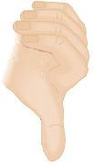
Topic 5: Electricity and magnetism 5.4 – Magnetic effects of electric currents
Determining magnetic field direction – wire loop
•There is a “right hand rule” for a current carrying loop which helps us remember the direction of the B-field.
•Imagine placing the heel of your right hand on the loop in such a way that your fingers curl in the direction of the current.
•Then your extended thumb points in the direction of the B-field.
•Of course, you could just use the straight-wire RHR and grasp the loop itself, if you like.
I
B
Notes:
© 2014 By Timothy K. Lund

Slide 23
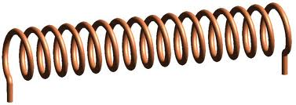
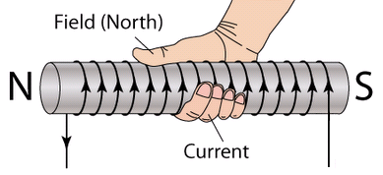
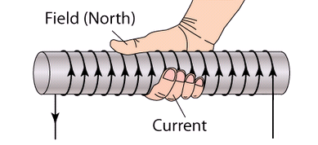
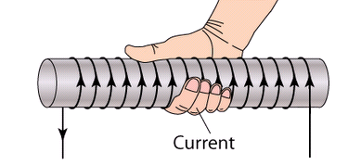
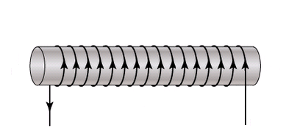
Topic 5: Electricity and magnetism 5.4 – Magnetic effects of electric currents
Determining magnetic field direction – solenoid
•A solenoid is just a series of loops stretched out as shown.
•There is a RHR for solenoids.
•With your right hand, grasp the solenoid in such a way that your fingers curl around it in the direction of the current-carrying loops.
•Then your extended thumb points in the direction of the B-field.
•Of course, you could just use the loop RHR and grasp the end loop itself, if you like.
•Quit the laughing.
I
Notes:
© 2014 By Timothy K. Lund

Slide 24
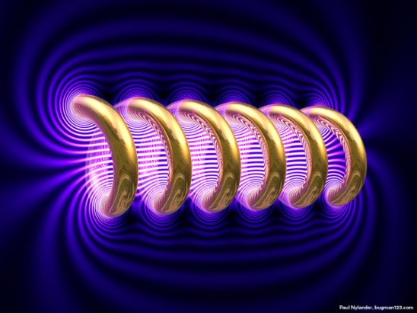
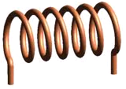
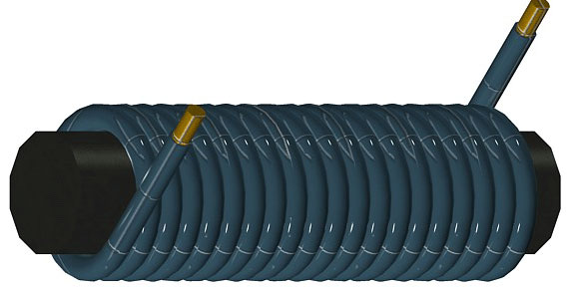
Topic 5: Electricity and magnetism 5.4 – Magnetic effects of electric currents
Sketching and interpreting magnetic field patterns
•The B-field looks like this around a solenoid:
•Note the concentration of the B-field lines inside the solenoid, and the micro-loops close to the wires.
•If we place an iron core inside the solenoid we have what is called an electromagnet.
•The ferrous core enhances the strength of the B-field.
N
S
I
Notes:
© 2014 By Timothy K. Lund

Slide 25
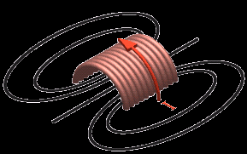
Topic 5: Electricity and magnetism 5.4 – Magnetic effects of electric currents
Solving problems involving magnetic fields
PRACTICE: In the solenoid shown label the north and south poles.
SOLUTION: Use the RHR for solenoids.
•Grasp the solenoid with your right hand in such a way that your fingers curl in the direction of the current.
•Your extended thumb points in the direction of the B-field which points the same way a north pole does.
Notes:
© 2014 By Timothy K. Lund

Slide 26
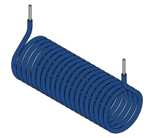
Topic 5: Electricity and magnetism 5.4 – Magnetic effects of electric currents
Solving problems involving magnetic fields
PRACTICE: The north and south poles are labeled in the solenoid. Sketch in the current, both entering and leaving the solenoid.
SOLUTION: Use the RHR for solenoids.
•Grasp the solenoid with your right hand in such a way that your extended thumb points in the direction of the north pole.
•Your curled fingers point in the direction of the current through the loops of the solenoid.
I
I
Notes:
© 2014 By Timothy K. Lund

Slide 27
Topic 5: Electricity and magnetism 5.4 – Magnetic effects of electric currents
Determining the force on a charge moving in a B-field
•Since a moving charge produces a magnetic field it should come as no surprise that a moving charge placed in an external magnetic field will feel a magnetic force. (Because of the pole law).
•Furthermore, a stationary charge in a magnetic field will feel no magnetic force because the charge will not have its own magnetic field.
•In fact, the force F felt by a charge q traveling at velocity v through a B-field of strength B is given by
F = qvB sin θ
where θ is the angle between v and B
Force on q due to presence of B
Notes:
© 2014 By Timothy K. Lund

Slide 28
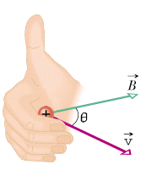
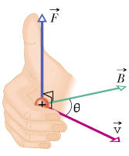
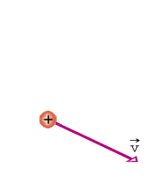
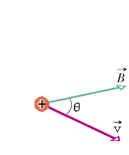
Topic 5: Electricity and magnetism 5.4 – Magnetic effects of electric currents
Determining the force on a charge moving in a B-field
•The direction of F is given by another right hand rule.
•Place the heel of your right hand in the plane containing v and B so that your curled fingertips touch v first:
•Your extended thumb points in the direction of the force on a (+) charge.
FYI
•F is perpendicular to v and B and is thus perpendicular to the plane of v and B.
•F is in the opposite direction for a (-) charge.
Notes:
© 2014 By Timothy K. Lund

Slide 29
Topic 5: Electricity and magnetism 5.4 – Magnetic effects of electric currents
Solving problems involving magnetic fields and forces
PRACTICE: A 25 μC charge traveling at 150 m s⁻¹ to the north enters a uniform B-field having a strength of 0.050 T and pointing to the west.
(a) What will be the magnitude of the magnetic force acting on the charge?
(b) Which way will the charge be deflected?
SOLUTION: How about making a sketch:
(a) F = qvB sin θ (where in this case θ = 90°)
F = (25×10⁻⁶)(150)(0.050) sin 90°
F = 1.9×10⁻⁴ N.
(b) Use the RHR for charges. Note q will deflect upward. upward.
UP
F
N
v
B
W
E
q
S
DOWN
Notes:
© 2014 By Timothy K. Lund

Slide 30
Topic 5: Electricity and magnetism 5.4 – Magnetic effects of electric currents
Solving problems involving magnetic fields and forces
PRACTICE: A 25 μC charge traveling at 150 m s⁻¹ to the north enters a uniform B-field having a strength of 0.050 T and pointing to the west.
(c) Explain why the magnetic force can not change the magnitude of the velocity of the charge while it is being deflected.
SOLUTION:
•Since F is perpendicular to v only v’s direction will change, not its magnitude.
UP
F
N
v
B
W
E
q
S
DOWN
Notes:
© 2014 By Timothy K. Lund

Slide 31
Topic 5: Electricity and magnetism 5.4 – Magnetic effects of electric currents
Solving problems involving magnetic fields and forces
PRACTICE: A 25 μC charge traveling at 150 m s⁻¹ to the north enters a uniform B-field having a strength of 0.050 T and pointing to the west.
(d) How do you know that the charge will be in uniform circular motion?
SOLUTION:
•As stated in the last problem v is constant.
•Since q and v and B are constant, so is F.
•Since F is constant, so is a.
•A constant acceleration perpendicular to the charge’s velocity is the definition of UCM. We will learn about UCM in detail in Topic 6.
UP
F
N
v
B
W
E
q
S
DOWN
Notes:
© 2014 By Timothy K. Lund

Slide 32
Topic 5: Electricity and magnetism 5.4 – Magnetic effects of electric currents
Solving problems involving magnetic fields and forces
PRACTICE: A 25 μC charge traveling at 150 m s⁻¹ to the north enters a uniform B-field having a strength of 0.050 T and pointing to the west.
(e) If the charge has a mass of 2.5×10⁻⁵ kg, what will be the radius of its circular motion?
SOLUTION:
•In (a) we found that F = 1.9×10⁻⁴ N.
•Then a = F / m = 1.9×10⁻⁴ / 2.5×10⁻⁵ = 7.6 m s⁻².
•From (d) we know the charge is in UCM.
•Thus a = v² / r so that
r = v² / a = 150² / 7.6 = 3000 m. (2961)
UP
F
N
v
B
W
E
q
S
DOWN
Notes:
© 2014 By Timothy K. Lund

Slide 33
Topic 5: Electricity and magnetism 5.4 – Magnetic effects of electric currents
Solving problems involving magnetic fields and forces
•
•
•
•
•
•
•
•
•
PRACTICE: Consider a charge q traveling at velocity v in the magnetic field B shown here. Show that r = mv / qB.
SOLUTION: •Since v is in the blue plane and B points out toward you, v⊥B and sin 90° = 1.
•Thus F = qvB.
•But F = ma so that qvB = ma.
•Since the charge is in UCM then a = v² / r.
•Thus qvB = mv² / r.
•Finally r = mv² / qvB = mv / qB.
B
•
•
•
•
•
•
•
•
•
•
•
•
•
•
•
•
•
•
r
•
•
•
•
•
•
•
•
•
•
•
•
•
•
•
•
•
•
•
•
•
•
•
•
•
•
•
•
•
•
•
•
•
•
•
•
•
•
•
•
•
•
•
•
•
•
•
•
•
•
•
•
•
•
Notes:
© 2014 By Timothy K. Lund

Slide 34
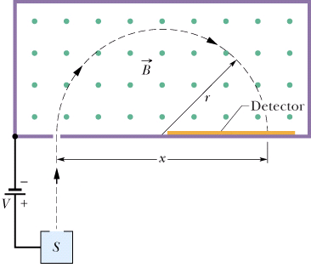
Topic 5: Electricity and magnetism 5.4 – Magnetic effects of electric currents
Solving problems involving magnetic fields and forces
EXAMPLE: The tendency of a moving charge to follow a curved trajectory in a magnetic field is used in a mass spectrometer.
•An unknown element is ionized, and accelerated by an applied voltage in the chamber S.
•It strikes a phosphorescent screen and flashes.
•By measuring x, one can determine the mass of the ion, and hence the unknown element.
Notes:
© 2014 By Timothy K. Lund

Slide 35
Topic 5: Electricity and magnetism 5.4 – Magnetic effects of electric currents
Solving problems involving magnetic fields and forces
EXAMPLE: The tendency of a moving charge to follow a curved trajectory in a magnetic field is used in a mass spectrometer.
Show that m = xqB / 2v.
SOLUTION:
•From the previous slide r = mv / qB.
•Thus m = rqB / v.
•But from the picture we see that r = x / 2.
•Thus m = rqB / v = xqB / 2v.
v
q
Notes:
© 2014 By Timothy K. Lund

Slide 36
Topic 5: Electricity and magnetism 5.4 – Magnetic effects of electric currents
Force on a current-carrying conductor in a B-field
•We already know the effect of a magnetic field on a moving charge.
•It stands to reason that a wire carrying a current in a magnetic field will also feel a force, because current is moving charge.
•A wire with no current feels no magnetic force:
•But a wire with a current will be deflected by a magnetic force as shown:
•Knowing the RHR for a charge is all you need to determine the direction of the force in the wire.
v
F_{B}
B
Notes:
© 2014 By Timothy K. Lund

Slide 37
Topic 5: Electricity and magnetism 5.4 – Magnetic effects of electric currents
Force on a current-carrying conductor in a B-field
•We now know the direction of the magnetic force acting on a current-carrying wire if it is in a magnetic field.
•The magnitude of the magnetic force F acting on a wire of length L and carrying a current of I in a magnetic field B is given by this formula:
F = BIL sin θ
where θ is the angle between I and B
Force on wire of length L due to B
FYI
•Note that the direction of I is also the direction of q as it flows through the wire.
Notes:
© 2014 By Timothy K. Lund

Slide 38
Topic 5: Electricity and magnetism 5.4 – Magnetic effects of electric currents
Solving problems involving magnetic fields and forces
EXAMPLE: Beginning with the formula F = qvB sin θ show that F = BIL sin θ.
SOLUTION:
F = qvB sin θ ( given )
F = q(L / t)B sin θ ( v = distance / time )
F = (q / t)LB sin θ ( just move the t )
F = ILB sin θ ( I = charge / time )
F = BIL sin θ ( commutative property )
Notes:
© 2014 By Timothy K. Lund

Slide 39
Topic 5: Electricity and magnetism 5.4 – Magnetic effects of electric currents
Solving problems involving magnetic fields and forces
PRACTICE: A 25-m long piece of wire carrying a 15 A current to the north is immersed in a magnetic flux density of 0.076 T which points downward.
Find the magnitude and direction of the magnetic force acting on the wire.
SOLUTION: A sketch helps…
•F = BIL sin θ.
•The angle between I and B is θ = 90°.
•F = (0.076)(15)(25) sin 90° = 29 N.
•The direction comes from the RHR for charges:
•The direction is WEST.
UP
N
v
F
W
E
B
S
DOWN
Notes:
© 2014 By Timothy K. Lund

Slide 40
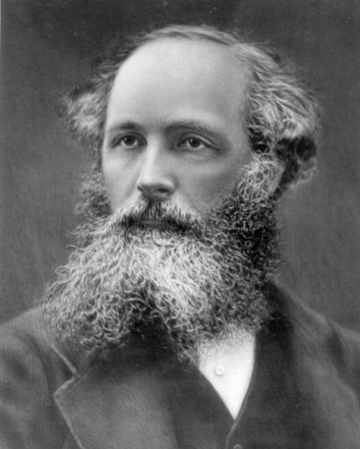
Topic 5: Electricity and magnetism 5.4 – Magnetic effects of electric currents
Solving problems involving magnetic fields and forces
EXAMPLE: James Clerk Maxwell developed the theory that showed that the electric field and the magnetic field were manifestations of a single force called the electromagnetic force. Both the electromagnetic force and the gravitational force travel as waves through space at the speed of light. Compare and contrast the two waves.
SOLUTION:
•The effect of an electromagnetic disturbance on an object is to move it around in time with the wave, as shown:
Notes:
© 2014 By Timothy K. Lund

Slide 41
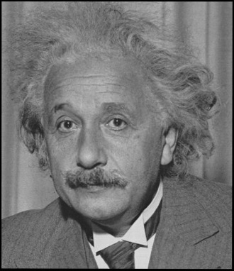
Topic 5: Electricity and magnetism 5.4 – Magnetic effects of electric currents
Solving problems involving magnetic fields and forces
EXAMPLE: James Clerk Maxwell developed the theory that showed that the electric field and the magnetic field were manifestations of a single force called the electromagnetic force. Both the electromagnetic force and the gravitational force travel as waves through space at the speed of light. Compare and contrast the two waves.
SOLUTION:
•The effect of a gravitational disturbance on an object is to stretch and shrink it in time with the wave.
Notes:
© 2014 By Timothy K. Lund

Slide 42
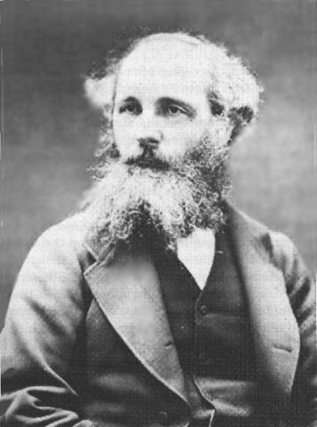
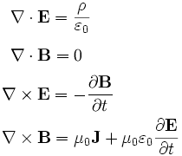
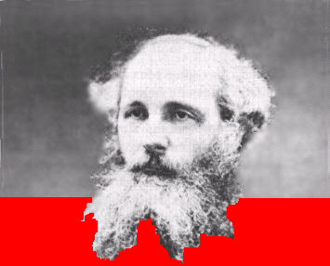
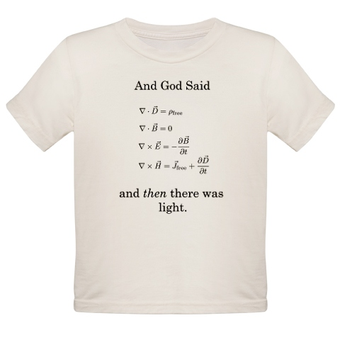
Topic 5: Electricity and magnetism 5.4 – Magnetic effects of electric currents
Solving problems involving magnetic fields and forces
EXAMPLE: Find the value of 1 / ε₀μ₀ .
SOLUTION:
•The permittivity of free space is ε₀ = 8.85×10 ⁻¹².
•The permeability of free space is μ₀ = 4π×10 ⁻⁷.
•Then
1 / ε₀μ₀ = 1 / 8.85×10 ⁻¹²×4π×10 ⁻⁷
= 2.9986×10⁸ ms⁻¹.
Typical college nerd tee-shirt!
FYI
•Thus c = 1 / ε₀μ₀ .
Notes:
42
© 2014 By Timothy K. Lund

Slide 43
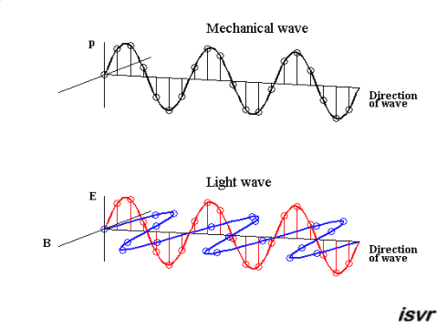
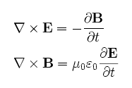
Topic 5: Electricity and magnetism 5.4 – Magnetic effects of electric currents
Solving problems involving magnetic fields and forces
EXAMPLE: How are the electric field and the magnetic field related in electromagnetic radiation (light)?
SOLUTION: Observe the animation:
•They are perpendicular, and they are in phase.
Notes:
43
© 2014 By Timothy K. Lund

Slide 44
Topic 5: Electricity and magnetism 5.4 – Magnetic effects of electric currents
Solving problems involving magnetic fields and forces
EXAMPLE: Explain the colors of the Aurora Borealis, or northern lights.
SOLUTION:
•The aurora borealis is caused by the interaction of charged particles from space with the earth's magnetic field, and their subsequent collisions with N₂ and O₂ molecules in the upper atmosphere.
•Nitrogen glows violet and oxygen glows green during the de-ionization process.
•We’ll learn about ionization in Topic 7…
Notes:
© 2014 By Timothy K. Lund

Slide 45
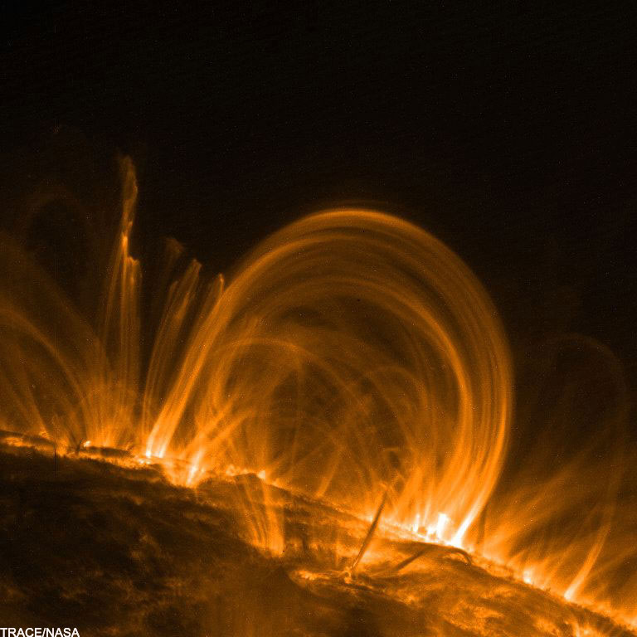
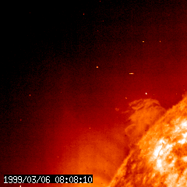
Topic 5: Electricity and magnetism 5.4 – Magnetic effects of electric currents
Solving problems involving magnetic fields and forces
EXAMPLE: Explain the source of the charged particles causing the Aurora Borealis.
SOLUTION:
•Solar flares send a flux of charged particles as far as Earth.
•These particles are funneled into the atmosphere by Earth’s magnetic field.
Notes:
© 2014 By Timothy K. Lund

Slide 46
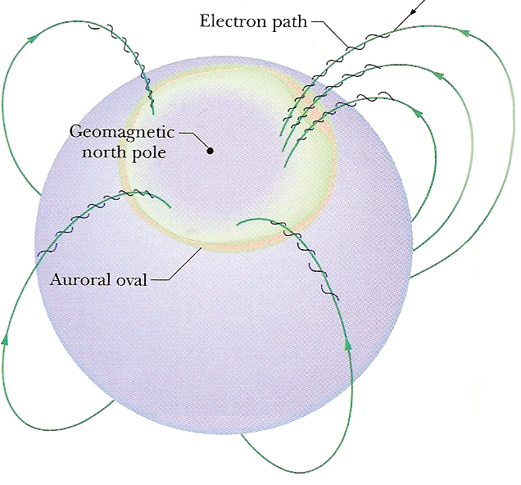
Topic 5: Electricity and magnetism 5.4 – Magnetic effects of electric currents
Solving problems involving magnetic fields and forces
EXAMPLE: Explain why the Aurora Borealis occurs near the north pole.
SOLUTION:
•Because the charged particles are moving, the earth's magnetic field causes a force on them that brings them spiraling into the upper atmosphere where they ionize oxygen and nitrogen molecules.
Notes:
© 2014 By Timothy K. Lund

Slide 47
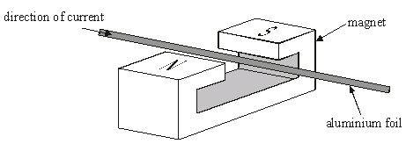
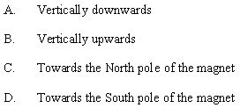
Topic 5: Electricity and magnetism 5.4 – Magnetic effects of electric currents
Solving problems involving magnetic fields and forces
PRACTICE: A piece of aluminum foil is held between the two poles of a strong magnet as shown.
When a current passes through the foil in the direction shown, which way will the foil be deflected?
SOLUTION:
•Sketch in B and v:
•Use the RHR for a moving charge in a B-field.
F
B
v
Notes:
© 2014 By Timothy K. Lund

Slide 48
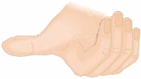
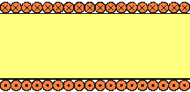
Topic 5: Electricity and magnetism 5.4 – Magnetic effects of electric currents
Solving problems involving magnetic fields and forces
PRACTICE: The diagram shows a cross-section of a current-carrying solenoid. The current enters the paper at the top of the solenoid, and leaves it at the bottom.
(a) Sketch in the magnetic field lines inside and just outside of each end of the solenoid.
SOLUTION:
•Using the RHR for solenoids, grasp it with the right hand so your fingers point in the direction of the current.
•Extended thumb gives direction of B-field.
Notes:
© 2014 By Timothy K. Lund

Slide 49
Topic 5: Electricity and magnetism 5.4 – Magnetic effects of electric currents
Solving problems involving magnetic fields and forces
PRACTICE: The diagram shows a cross-section of a current-carrying solenoid. The current enters the paper at the top of the solenoid, and leaves it at the bottom.
(b) A positive charge enters the inside of the vacuum-filled solenoid from the left as shown. Find the direction of the magnetic force acting on the charge.
SOLUTION:
•From the picture we see that θ = 180°.
•Then F = qvB sin θ = qvB sin 180° = 0 N.
v
Notes:
© 2014 By Timothy K. Lund

Slide 50
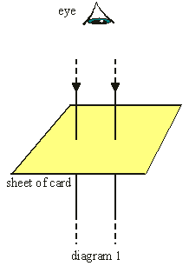
You can also use Newton’s 3rd law for the second force.
Topic 5: Electricity and magnetism 5.4 – Magnetic effects of electric currents
Solving problems involving magnetic fields and forces
PRACTICE: Two current-carrying parallel wires are kept in position by a card with two holes in it as shown.
(a) In diagram 1, sketch in the force acting on each wire.
SOLUTION: •From the RHR for wires, the magnetic field from the right wire looks like this:
•The velocity of the charges in the left wire looks like this:
•Thus the force on the left wire looks like this:
•Repeat for the force on the right wire:
B
F
v
Notes:
© 2014 By Timothy K. Lund

Slide 51
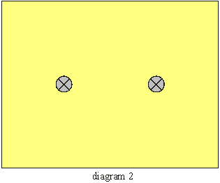
Why are the circles not equally spaced about each wire?
Topic 5: Electricity and magnetism 5.4 – Magnetic effects of electric currents
Solving problems involving magnetic fields and forces
PRACTICE: Two current-carrying parallel wires are kept in position by a card with two holes in it as shown.
(b) In diagram 2, sketch the magnetic field lines in the card produced by the two wires.
SOLUTION:
•From the RHR the field lines look like this (as seen on the previous problem):
FYI •Sometimes it might help to look ahead on a problem. This diagram could certainly assist you in solving part (a).
Notes:
© 2014 By Timothy K. Lund

Slide 52
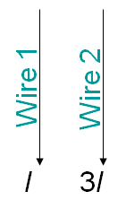
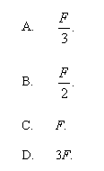
Topic 5: Electricity and magnetism 5.4 – Magnetic effects of electric currents
Solving problems involving magnetic fields and forces
PRACTICE: Two parallel wires are shown with the given currents in the given directions. The force on Wire 2 due to the current in Wire 1 is F. Find the force in Wire 1 due to the current in Wire 2 in terms of F.
SOLUTION:
•Recall Newton’s 3rd law.
•The force on Wire 1 and the force on Wire 2 are an action-reaction pair.
•But action-reaction pairs have equal magnitude (and opposite direction).
•Thus Wire 1 feels the exact same force F!
Notes:
© 2014 By Timothy K. Lund

Slide 53
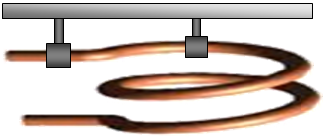
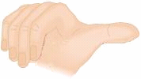
Topic 5: Electricity and magnetism 5.4 – Magnetic effects of electric currents
Solving problems involving magnetic fields and forces
PRACTICE: A very flexible wire is formed into exactly two loops. The top loop is firmly anchored to a support, and cannot move.
Explain why, when a current is passed through the wire, the loops get closer together.
SOLUTION: Use the RHR for straight wire.
•Assume the current enters at the bottom.
•Use RHR on bottom loop to get B for top loop:
•But v of the charge in top loop is as shown:
•Then F on the top loop is as shown:
v
B
F
Notes:
© 2014 By Timothy K. Lund

Slide 54
Topic 5: Electricity and magnetism 5.4 – Magnetic effects of electric currents
Solving problems involving magnetic fields and forces
PRACTICE: A very flexible wire is formed into exactly two loops. The top loop is firmly anchored to a support, and cannot move.
Explain why, when a current is passed through the wire, the loops get closer together.
SOLUTION: Use the RHR for straight wire.
•Use the RHR on the top loop for B at the bottom loop:
•But v of the charge in bottom loop is as shown:
•Then F on the bottom loop is as shown:
•Both F’s cause the loop separation to decrease.
F
B
v
Notes:
© 2014 By Timothy K. Lund

