Slide 1
Topic 7: Atomic, nuclear and particle physics
7.1 – Discrete energy and radioactivity
Essential idea: In the microscopic world energy is discrete.
Nature of science: Accidental discovery: Radioactivity was discovered by accident when Becquerel developed photographic film that had accidentally been exposed to radiation from radioactive rocks. The marks on the photographic film seen by Becquerel probably would not lead to anything further for most people. What Becquerel did was to correlate the presence of the marks with the presence of the radioactive rocks and investigate the situation further.
Notes:
© 2006 By Timothy K. Lund

Slide 2
Topic 7: Atomic, nuclear and particle physics
7.1 – Discrete energy and radioactivity
Understandings:
• Discrete energy and discrete energy levels
• Transitions between energy levels
• Radioactive decay
• Fundamental forces and their properties
• Alpha particles, beta particles and gamma rays
• Half-life
• Absorption characteristics of decay particles
• Isotopes
• Background radiation
Notes:
2
© 2006 By Timothy K. Lund

Slide 3
Topic 7: Atomic, nuclear and particle physics
7.1 – Discrete energy and radioactivity
Applications and skills:
• Describing the emission and absorption spectrum of common gases
• Solving problems involving atomic spectra, including calculating the wavelength of photons emitted during atomic transitions
• Completing decay equations for alpha and beta decay
• Determining the half-life of a nuclide from a decay curve
• Investigating half-life experimentally (or by simulation)
Notes:
3
© 2006 By Timothy K. Lund

Slide 4
Topic 7: Atomic, nuclear and particle physics
7.1 – Discrete energy and radioactivity
Guidance:
• Students will be required to solve problems on radioactive decay involving only integral numbers of half-lives
• Students will be expected to include the neutrino and antineutrino in beta decay equations
Data booklet reference:
• E = hf
• λ = hc / E
Notes:
4
© 2006 By Timothy K. Lund

Slide 5
Topic 7: Atomic, nuclear and particle physics
7.1 – Discrete energy and radioactivity
International-mindedness:
• The geopolitics of the past 60+ years have been greatly influenced by the existence of nuclear weapons
Theory of knowledge:
• The role of luck/serendipity in successful scientific discovery is almost inevitably accompanied by a scientifically curious mind that will pursue the outcome of the “lucky” event. To what extent might scientific discoveries that have been described as being the result of luck actually be better described as being the result of reason or intuition?
Notes:
5
© 2006 By Timothy K. Lund

Slide 6
Topic 7: Atomic, nuclear and particle physics
7.1 – Discrete energy and radioactivity
Utilization:
• Knowledge of radioactivity, radioactive substances and the radioactive decay law are crucial in modern nuclear medicine
• How to deal with the radioactive output of nuclear decay is important in the debate over nuclear power stations (see Physics sub-topic 8.1)
• Carbon dating is used in providing evidence for evolution (see Biology sub-topic 5.1)
• Exponential functions (see Mathematical studies SL sub-topic 6.4; Mathematics HL sub-topic 2.4)
Notes:
6
© 2006 By Timothy K. Lund

Slide 7
Topic 7: Atomic, nuclear and particle physics
7.1 – Discrete energy and radioactivity
Aims:
• Aim 8: the use of radioactive materials poses environmental dangers that must be addressed at all stages of research
• Aim 9: the use of radioactive materials requires the development of safe experimental practices and methods for handling radioactive materials
Notes:
7
© 2006 By Timothy K. Lund

Slide 8
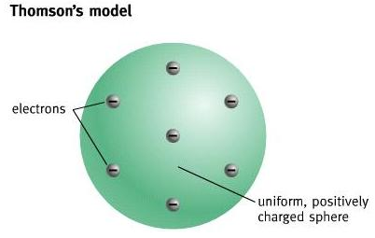
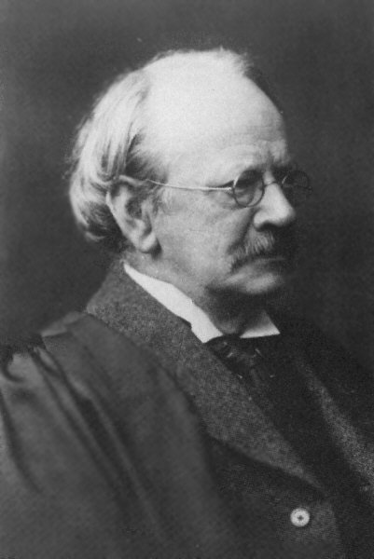
Topic 7: Atomic, nuclear and particle physics
7.1 – Discrete energy and radioactivity
Describing the emission and absorption spectrum of common gases
•In 1897 British physicist J.J. Thomson discovered the electron, and went on to propose a "plum pudding" model of the atom in which all of the electrons were embedded in a spherical positive charge the size of the atom.
The “Plum pudding” model of the atom
atomic diameter (≈ 10⁻¹⁰ m)
+7
- 7
Notes:
© 2006 By Timothy K. Lund

Slide 9

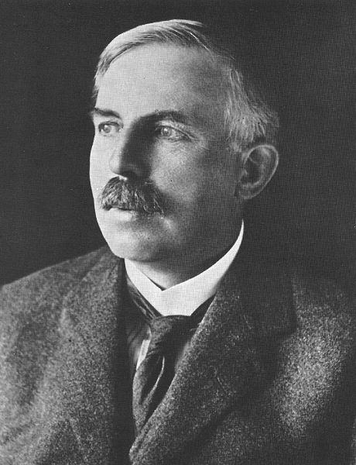
Topic 7: Atomic, nuclear and particle physics
7.1 – Discrete energy and radioactivity
Describing the emission and absorption spectrum of common gases
•In 1911 British physicist Ernest Rutherford conducted experiments on the structure of the atom by sending alpha particles (which we will study later) through gold leaf.
•Gold leaf is like tin foil, but it can be made much thinner so that the alpha particles only travel through a thin layer of atoms.
FYI
•An alpha (α) particle is a doubly-positive charged particle emitted by radioactive materials.
Notes:
© 2006 By Timothy K. Lund

Slide 10
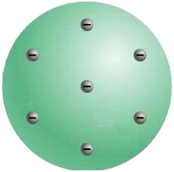
Topic 7: Atomic, nuclear and particle physics
7.1 – Discrete energy and radioactivity
Describing the emission and absorption spectrum of common gases
•Rutherford proposed that alpha particles would travel more or less straight through the atom without deflection if Thomson’s “Plum pudding” model was correct:
scintillation screen
α
α
α
FYI
•Instead of observing minimal scattering as in the Plum Pudding model, Rutherford observed the scattering as shown on the next slide:
Notes:
© 2006 By Timothy K. Lund

Slide 11
Topic 7: Atomic, nuclear and particle physics
7.1 – Discrete energy and radioactivity
Describing the emission and absorption spectrum of common gases
•Here we see that the deflections are much more scattered...
•Rutherford proposed that the positive charge of the atom was located in the center, and he coined the term nucleus.
The Rutherford Model
nucleus
The atom
Notes:
© 2006 By Timothy K. Lund

Slide 12
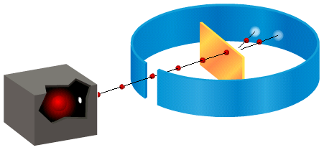
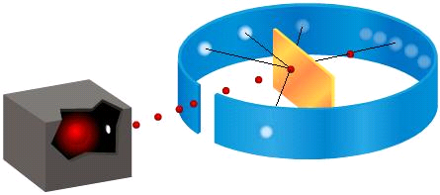
Topic 7: Atomic, nuclear and particle physics
7.1 – Discrete energy and radioactivity
Describing the emission and absorption spectrum of common gases
Expected Results
Actual Results
FYI
•This experiment is called the Geiger-Marsden scattering experiment.

Slide 13
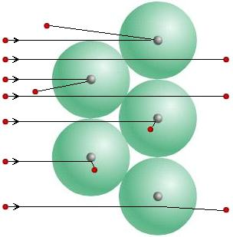
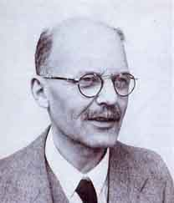
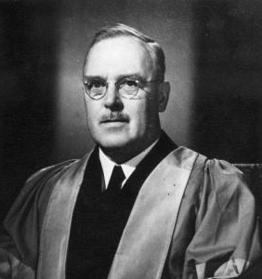
Topic 7: Atomic, nuclear and particle physics
7.1 – Discrete energy and radioactivity
Describing the emission and absorption spectrum of common gases
•Only by assuming a concentration of positive charge at the center of the atom, as opposed to “spread out” as in the Plum Pudding model, could Rutherford’s team explain the results of the experiment.
Geiger
Marsden

Slide 14
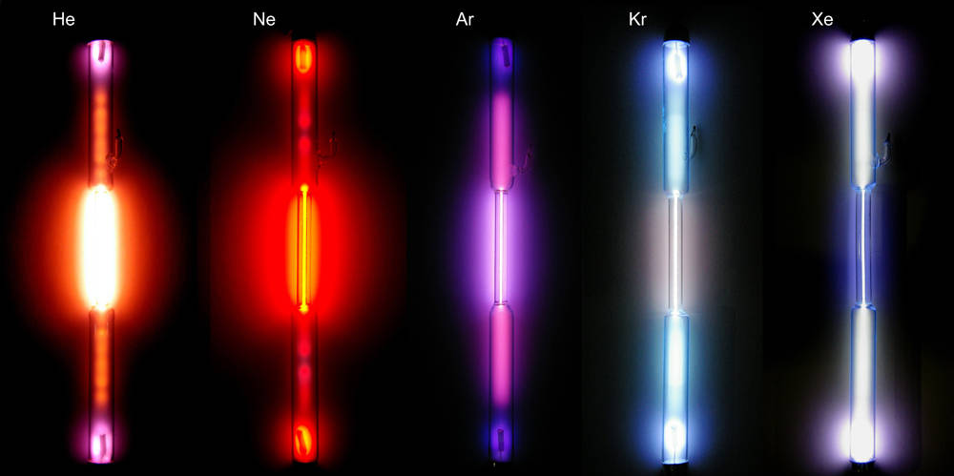
Topic 7: Atomic, nuclear and particle physics
7.1 – Discrete energy and radioactivity
Describing the emission and absorption spectrum of common gases
•When a gas in a tube is subjected to a voltage, the gas ionizes, and emits light.
Notes:
© 2006 By Timothy K. Lund

Slide 15

Topic 7: Atomic, nuclear and particle physics
7.1 – Discrete energy and radioactivity
Describing the emission and absorption spectrum of common gases
•We can analyze that light by looking at it through a spectroscope.
•A spectroscope acts similar to a prism, in that it separates the incident light into its constituent wavelengths.
•For example, heated barium gas will produce an emission spectrum that looks like this:
•An emission spectrum is an elemental fingerprint.
400 450 500 550 600 650 700 750
λ / ×10⁻⁹ m (λ / nm)
Notes:
© 2006 By Timothy K. Lund

Slide 16



Topic 7: Atomic, nuclear and particle physics
7.1 – Discrete energy and radioactivity
Describing the emission and absorption spectrum of common gases
•Each element also has an absorption spectrum, caused by cool gases between a source of light and the scope.
continuous spectrum
light source
absorption spectrum
light source
cool gas X
emission spectrum
hot gas X
compare…
Same fingerprint!
Notes:
© 2006 By Timothy K. Lund

Slide 17

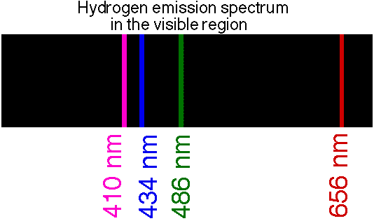
Topic 7: Atomic, nuclear and particle physics
7.1 – Discrete energy and radioactivity
Transitions between energy levels
•In the late 1800s a Swedish physicist by the name of J.J. Balmer observed the spectrum of hydrogen – the simplest of all the elements:
•His observations gave us clues as to the way the negative charges were distributed about the nucleus.
Notes:
© 2006 By Timothy K. Lund

Slide 18
Topic 7: Atomic, nuclear and particle physics
7.1 – Discrete energy and radioactivity
Transitions between energy levels
•In reality, there are many additional natural groupings for the hydrogen spectrum, two of which are shown here:
•These groupings led scientists to imagine that the hydrogen’s single electron could occupy many different energy levels, as shown in the next slide:
0 200 400 600 800 1000 1200 1400 1600 1800 2000
Lyman Series
(UV)
Balmer Series (Visible)
λ / nm
Paschen Series
(IR)
Notes:
© 2006 By Timothy K. Lund

Slide 19
Topic 7: Atomic, nuclear and particle physics
7.1 – Discrete energy and radioactivity
Transitions between energy levels
•The first 7 energy levels for hydrogen are shown here:
•The energy levels are labeled from the lowest to the highest as n = 1 to n = 7 in the picture.
•n is called the principal quantum number and goes all the way up to infinity (∞)!
•In its ground state or unexcited state, hydrogen’s single electron is in the 1st energy level (n = 1):
7
6
5
4
3
2
1
Notes:
© 2006 By Timothy K. Lund

Slide 20
Topic 7: Atomic, nuclear and particle physics
7.1 – Discrete energy and radioactivity
Transitions between energy levels
•As we will see later, light energy is carried by a particle called a photon.
•If a photon of just the right energy strikes a hydrogen atom, it is absorbed by the atom and stored by virtue of the electron jumping to a new energy level:
•The electron jumped from the n = 1 state to the n = 3 state.
•We say the atom is excited.
7
6
5
4
3
2
1
Notes:
© 2006 By Timothy K. Lund

Slide 21
Topic 7: Atomic, nuclear and particle physics
7.1 – Discrete energy and radioactivity
Transitions between energy levels
•When the atom de-excites the electron jumps back down to a lower energy level.
•When it does, it emits a photon of just the right energy to account for the atom’s energy loss during the electron’s orbital drop.
•The electron jumped from the n = 3 state to the n = 2 state.
•We say the atom is de-excited, but not quite in its ground state.
7
6
5
4
3
2
1
Notes:
© 2006 By Timothy K. Lund

Slide 22
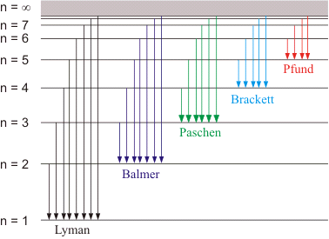
Topic 7: Atomic, nuclear and particle physics
7.1 – Discrete energy and radioactivity
Transitions between energy levels
•The graphic shown here accounts for many of the observed hydrogen emission spectra.
•The excitation illustrated looked like this:
•The de- excitation looked like this:
Infrared
Visible
Ultraviolet
Notes:
© 2006 By Timothy K. Lund

Slide 23
Topic 7: Atomic, nuclear and particle physics
7.1 – Discrete energy and radioactivity
Transitions between energy levels
•The human eye is only sensitive to the Balmer series of photon energies (or wavelengths):
Infrared
Visible
Ultraviolet
Notes:
© 2006 By Timothy K. Lund

Slide 24
Topic 7: Atomic, nuclear and particle physics
7.1 – Discrete energy and radioactivity
Transitions between energy levels
•The previous energy level diagram was NOT to scale. This one is. Note that none of the energy drops of the other series overlap those of the Balmer series, and thus we cannot see any of them.
•But we can still sense them!
n = ∞
0.00 eV
Second Excited State →
n = 5
-0.544 eV
n = 4
-0.850 eV
n = 3
-1.51 eV
First Excited → State
Paschen Series (IR)
n = 2
[ HEAT ]
-3.40 eV
Balmer Series (Visible)
Ground State →
n = 1
-13.6 eV
Lyman Series (UV)
[ SUNBURN ]
FYI •Transition energy is measured in eV because of the tiny amounts involved.
Notes:
© 2006 By Timothy K. Lund

Slide 25
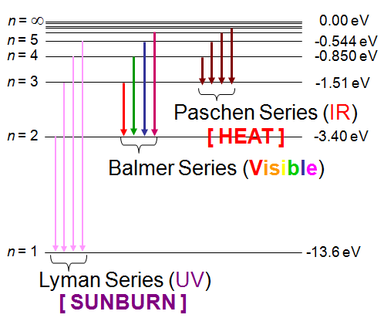
Topic 7: Atomic, nuclear and particle physics
7.1 – Discrete energy and radioactivity
Transitions between energy levels
•Because of wave-particle duality, we have discovered that light not only acts like a wave, having a wavelength λ and a frequency f, but it acts like a particle (called a photon) having an energy E given by
Where h = 6.63×10 ⁻³⁴ Js and is called Planck’s constant.
energy E of a photon having frequency f
E = hf
Notes:
© 2006 By Timothy K. Lund

Slide 26
Topic 7: Atomic, nuclear and particle physics
7.1 – Discrete energy and radioactivity
Transitions between energy levels
EXAMPLE:
An electron jumps from energy level n = 3 to energy level n = 2 in the hydrogen atom.
(a) What series is this de-excitation in?
SOLUTION:
•Find it on the diagram:
•This jump is contained in the Balmer Series, and produces a visible photon.
Notes:
© 2006 By Timothy K. Lund

Slide 27
Topic 7: Atomic, nuclear and particle physics
7.1 – Discrete energy and radioactivity
Transitions between energy levels
EXAMPLE:
An electron jumps from energy level n = 3 to energy level n = 2 in the hydrogen atom.
(b) Find the atom’s change in energy in eV and in J.
SOLUTION:
•ΔE = E_{f} – E₀
= ⁻3.40 - ⁻1.51 = ⁻1.89 eV.
•ΔE = (⁻1.89 eV)(1.60×10⁻¹⁹ J / eV)
= ⁻3.02×10⁻¹⁹ J.
Notes:
© 2006 By Timothy K. Lund

Slide 28
Topic 7: Atomic, nuclear and particle physics
7.1 – Discrete energy and radioactivity
Transitions between energy levels
EXAMPLE:
An electron jumps from energy level n = 3 to energy level n = 2 in the hydrogen atom.
(c) Find the energy (in J) of the emitted photon.
SOLUTION:
•The hydrogen atom lost 3.02×10⁻¹⁹ J of energy.
•From conservation of energy a photon was created having E = 3.02×10⁻¹⁹ J.
Notes:
© 2006 By Timothy K. Lund

Slide 29
Topic 7: Atomic, nuclear and particle physics
7.1 – Discrete energy and radioactivity
Transitions between energy levels
EXAMPLE:
An electron jumps from energy level n = 3 to energy level n = 2 in the hydrogen atom.
(d) Find the frequency of the emitted photon.
SOLUTION:
•From E = hf we have
3.02×10⁻¹⁹ = (6.63×10⁻³⁴)f, or
f = 3.02×10⁻¹⁹ / 6.63×10⁻³⁴
f = 4.56×10¹⁴ Hz.
FYI •When finding f, be sure E is in Joules, not eV.
Notes:
© 2006 By Timothy K. Lund

Slide 30
Topic 7: Atomic, nuclear and particle physics
7.1 – Discrete energy and radioactivity
Transitions between energy levels
EXAMPLE:
An electron jumps from energy level n = 3 to energy level n = 2 in the hydrogen atom.
(e) Find the wavelength (in nm) of the emitted photon.
SOLUTION:
•From v = λf where v = c we have 3.00×10⁸ = λ(4.56×10¹⁴), or λ = 6.58×10⁻⁷ m.
•Then λ = 6.58×10⁻⁷ m
= 658×10⁻⁹ m = 658 nm.
Notes:
© 2006 By Timothy K. Lund

Slide 31
Topic 7: Atomic, nuclear and particle physics
7.1 – Discrete energy and radioactivity
Discrete energy and discrete energy levels
•Discrete means discontinuous, or separated.
PRACTICE: Which one of the following provides direct evidence for the existence of discrete energy levels in an atom?
A. The continuous spectrum of the light emitted by a white hot metal.
B. The line emission spectrum of a gas at low pressure.
C. The emission of gamma radiation from radioactive atoms.
D. The ionization of gas atoms when bombarded by alpha particles.
SOLUTION:
•Just pay attention!
Notes:
© 2006 By Timothy K. Lund

Slide 32
Topic 7: Atomic, nuclear and particle physics
7.1 – Discrete energy and radioactivity
Solving problems involving atomic spectra
PRACTICE: A spectroscopic examination of glowing hydrogen shows the presence of a 434 nm blue emission line.
(a) What is its frequency?
SOLUTION:
•Use c = λf
where c = 3.00×10⁸ m s⁻¹ and λ = 434 ×10⁻⁹ m:
• 3.00×10⁸ = (434×10⁻⁹)f
f = 3.00×10⁸ / 434×10⁻⁹
= 6.91×10¹⁴ Hz.
Notes:
© 2006 By Timothy K. Lund

Slide 33
Topic 7: Atomic, nuclear and particle physics
7.1 – Discrete energy and radioactivity
Solving problems involving atomic spectra
PRACTICE: A spectroscopic examination of glowing hydrogen shows the presence of a 434 nm blue emission line.
(b) What is the energy (in J and eV) of each of its blue- light photons?
SOLUTION: Use E = hf:
• E = (6.63×10⁻³⁴)(6.91×10¹⁴)
E = 4.58×10⁻¹⁹ J.
E = (4.58×10⁻¹⁹ J)(1 eV/ 1.60×10⁻¹⁹ J )
E = 2.86 eV.
Notes:
© 2006 By Timothy K. Lund

Slide 34
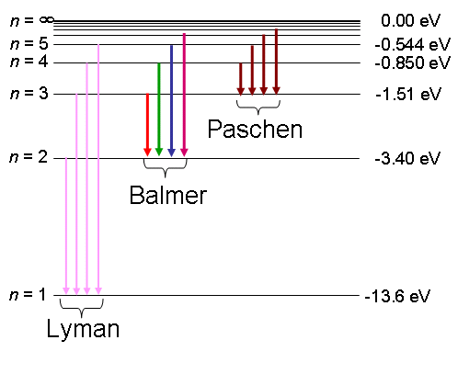
Topic 7: Atomic, nuclear and particle physics
7.1 – Discrete energy and radioactivity
Solving problems involving atomic spectra
PRACTICE: A spectroscopic examination of glowing hydrogen shows the presence of a 434 nm blue emission line.
(c) What are the energy levels associated with this photon?
SOLUTION:
•Because it is visible use the Balmer Series with ∆E = -2.86 eV.
•Note that E₂ – E₅ = -3.40 – -0.544 = -2.86 eV.
•Thus the electron jumped from n = 5 to n = 2.
Notes:
© 2006 By Timothy K. Lund

Slide 35
Topic 7: Atomic, nuclear and particle physics
7.1 – Discrete energy and radioactivity
Solving problems involving atomic spectra
PRACTICE: The element helium was first identified by the absorption spectrum of the sun.
(a) Explain what is meant by the term absorption spectrum.
SOLUTION:
•An absorption spectrum is produced when a cool gas is between a source having a continuous spectrum and an observer with a spectroscope.
•The cool gases absorb their signature wavelengths from the continuous spectrum.
•Where the wavelengths have been absorbed by the gas there will be black lines.
continuous spectrum
absorption spectrum
emission spectrum
Notes:
© 2006 By Timothy K. Lund

Slide 36
Topic 7: Atomic, nuclear and particle physics
7.1 – Discrete energy and radioactivity
Solving problems involving atomic spectra
PRACTICE:
One of the wavelengths of the absorption spectrum for helium occurs at 588 nm.
(b) Show that the energy of a photon having a wavelength of 588 nm is 3.38×10⁻¹⁹ J.
SOLUTION: This formula can be used directly:
•From E = hc / λ we see that
E = (6.63×10⁻³⁴)(3.00×10⁸) / 588×10⁻⁹)
E = 3.38×10⁻¹⁹ J.
Where h = 6.63×10 ⁻³⁴ Js and is called Planck’s constant.
E = hc / λ
energy E of a photon having wavelength λ
Notes:
© 2006 By Timothy K. Lund

Slide 37
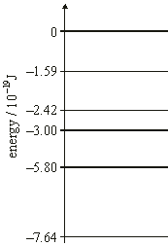
Topic 7: Atomic, nuclear and particle physics
7.1 – Discrete energy and radioactivity
Solving problems involving atomic spectra
PRACTICE: The diagram represents some energy levels of the helium atom.
(c) Use the information in the diagram to explain how absorption at 588 nm arises.
SOLUTION: We need the difference in energies between two levels to be 3.38×10⁻¹⁹ J.
•Note that 5.80 – 2.42 = 3.38.
•Since it is an absorption the atom stored the energy by jumping an electron from the -5.80×10⁻¹⁹ J level to the -2.42×10⁻¹⁹ J level, as illustrated.
Notes:
© 2006 By Timothy K. Lund

Slide 38
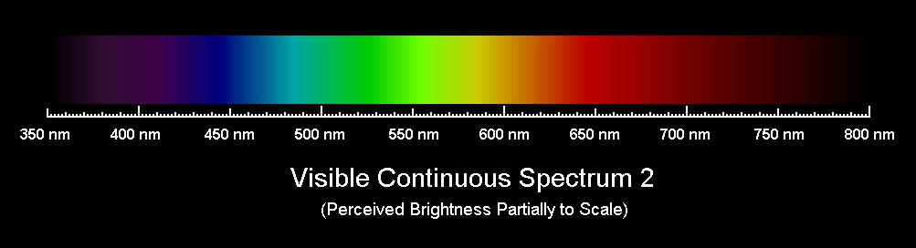
Topic 7: Atomic, nuclear and particle physics
7.1 – Discrete energy and radioactivity
Solving problems involving atomic spectra
•In a later lecture we will discover that the most intense light reaching us from the sun is between 500 nm and 650 nm in wavelength.
•Evolutionarily our eyes have developed in such a way that they are most sensitive to that range of wavelengths, as shown in the following graphic:
Notes:
© 2006 By Timothy K. Lund

Slide 39
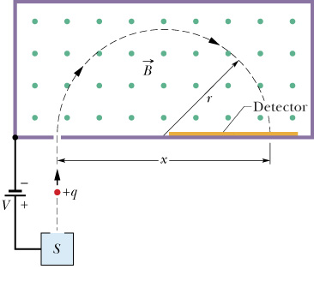
Topic 7: Atomic, nuclear and particle physics
7.1 – Discrete energy and radioactivity
Isotopes
•Recall the mass spectrometer, in which an atom is stripped of its electrons and accelerated through a voltage into a magnetic field.
•Scientists discovered that hydrogen nuclei had three different masses:
•Since the charge of the hydrogen nucleus is e, scientists postulated the existence of a neutral particle called the neutron, which added mass without charge.
Notes:
© 2006 By Timothy K. Lund

Slide 40
Topic 7: Atomic, nuclear and particle physics
7.1 – Discrete energy and radioactivity
Isotopes
•The proton and neutron are called nucleons.
•For the element hydrogen, it was found that its nucleus existed in three forms:
•A set of nuclei for a single element having different numbers of neutrons are called isotopes.
•A particular isotope of an element is called a species or a nuclide.
Proton [ Charge = 1e or just +1 ]
Nucleons
Neutron [ Charge = 0e or just 0 ]
Isotopes
Hydrogen
Deuterium
Tritium
Notes:
© 2006 By Timothy K. Lund

Slide 41
Topic 7: Atomic, nuclear and particle physics
7.1 – Discrete energy and radioactivity
Isotopes
•An element’s chemistry is determined by the number of electrons surrounding it.
•The number of electrons an element has is determined by the number of protons in that element’s nucleus.
•Therefore it follows that isotopes of an element have the same chemical properties.
•For example there is water, made of hydrogen H and oxygen O, with the molecular structure H₂O.
•But there is also heavy water, made of deuterium D and oxygen O, with the molecular formula D₂O.
•Both have exactly the same chemical properties.
•But heavy water is slightly denser than water.
Notes:
© 2006 By Timothy K. Lund

Slide 42
Topic 7: Atomic, nuclear and particle physics
7.1 – Discrete energy and radioactivity
Isotopes
•A species or nuclide of an element is described by three integers:
•The nucleon number A is the total number of protons and neutrons in the nucleus.
•The proton number Z is the number of protons in the nucleus. It is also known as the atomic number.
•The neutron number N is the number of neutrons in the nucleus.
•It follows that the relationship between all three numbers is just
A = Z + N
nucleon relationship
Notes:
© 2006 By Timothy K. Lund

Slide 43
Topic 7: Atomic, nuclear and particle physics
7.1 – Discrete energy and radioactivity
Isotopes
•In nuclear physics you need to be able to distinguish the different isotopes.
CHEMISTRY
NUCLEAR PHYSICS
Mass Number = A
H
H
Protons = Z
N = Neutrons
1
H
2
H
3
H
1
0
1
1
1
2
hydrogen
deuterium
tritium
hydrogen-1
hydrogen-2
hydrogen-3
FYI
•Since A = Z + N, we need not show N.
•And Z can be found on any periodic table.
Notes:
© 2006 By Timothy K. Lund

Slide 44
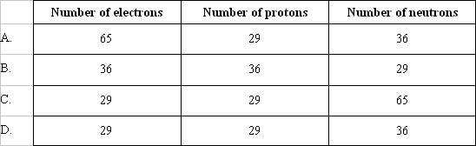
Topic 7: Atomic, nuclear and particle physics
7.1 – Discrete energy and radioactivity
Isotopes
PRACTICE: Which of the following gives the correct number of electrons, protons and neutrons in the neutral atom ⁶⁵₂₉Cu?
SOLUTION:
•A = 65, Z = 29, so N = A – Z = 65 – 29 = 36.
•Since it is neutral, the number of electrons equals the number of protons = Z = 29.
Notes:
© 2006 By Timothy K. Lund

Slide 45
Topic 7: Atomic, nuclear and particle physics
7.1 – Discrete energy and radioactivity
Isotopes
PRACTICE: Ag-102, Ag-103 and Ag-104 are all isotopes of the element silver. Which one of the following is a true statement about the nuclei of these isotopes?
A. All have the same mass.
B. All have the same number of nucleons.
C. All have the same number of neutrons.
D. All have the same number of protons.
SOLUTION: Isotopes of an element have different masses and nucleon totals.
•Isotopes of an element have the same number of protons, and by extension, electrons. This is why their chemical properties are identical.
Notes:
© 2006 By Timothy K. Lund

Slide 46
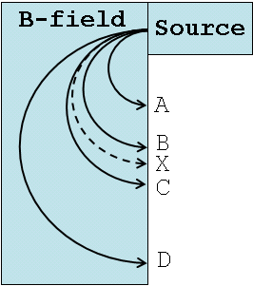
Topic 7: Atomic, nuclear and particle physics
7.1 – Discrete energy and radioactivity
Isotopes
PRACTICE:
Track X shows the deflection of a singly-charged carbon-12 ion in the deflection chamber of a mass spectrometer. Which path best shows the deflection of a singly- charged carbon-14 ion? Assume both ions travel at the same speed.
SOLUTION:
•Since carbon-14 is heavier, it will have a bigger radius than carbon-12.
•Since its mass is NOT twice the mass of carbon-12, it will NOT have twice the radius.
Notes:
© 2006 By Timothy K. Lund

Slide 47
Topic 7: Atomic, nuclear and particle physics
7.1 – Discrete energy and radioactivity
Fundamental forces and their properties
•Given that a nucleus is roughly 10⁻¹⁵ m in diameter it should be clear that the Coulomb repulsion between protons within the nucleus must be enormous.
•Given that most nuclei do NOT spew out their protons, there must be a nucleon force that acts within the confines of the nucleus to overcome the Coulomb force.
•We call this nucleon force the strong force.
•In a nutshell, the strong force…
counters the Coulomb force to prevent nuclear decay and therefore must be very strong.
is very short-range, since protons located far enough apart do, indeed, repel.
Notes:
© 2006 By Timothy K. Lund

Slide 48
Topic 7: Atomic, nuclear and particle physics
7.1 – Discrete energy and radioactivity
Fundamental forces and their properties
PRACTICE:
The nucleus of an atom contains protons. The protons are prevented from flying apart by
A. The presence of orbiting electrons.
B. The presence of gravitational forces.
C. The presence of strong attractive nuclear forces.
D. The absence of Coulomb repulsive forces at nuclear distances.
SOLUTION:
•It is the presence of the strong force within the nucleus.
Notes:
© 2006 By Timothy K. Lund

Slide 49
Topic 7: Atomic, nuclear and particle physics
7.1 – Discrete energy and radioactivity
Fundamental forces and their properties
PRACTICE: Use Coulomb’s law to find the repulsive force between two protons in a helium nucleus. Assume the nucleus is 1.00×10⁻¹⁵ m in diameter and that the protons are as far apart as they can get.
SOLUTION:
•From Coulomb’s law the repulsive force is
•F = ke² / r² = 9×10⁹(1.6×10⁻¹⁹)² / (1.00×10⁻¹⁵)²
•F = 230 N.
FYI
•From chemistry we know that atoms can be separated from each other and moved easily.
•This tells us that at the range of about 10⁻¹⁰ m (the atomic diameter), the strong force is zero.
Notes:
© 2006 By Timothy K. Lund

Slide 50
Topic 7: Atomic, nuclear and particle physics
7.1 – Discrete energy and radioactivity
Fundamental forces and their properties
ELECTRO-WEAK
GRAVITY
STRONG
ELECTROMAGNETIC
WEAK
+
+
nuclear
force
light, heat and charge
radioactivity
freefall
STRONGEST
WEAKEST
Range:
Extremely Short
Range:
∞
Range:
Short
Range:
∞
Force Carrier:
Gluon
Force Carrier:
Photon
Force Carrier:
Graviton
Notes:
© 2006 By Timothy K. Lund

Slide 51
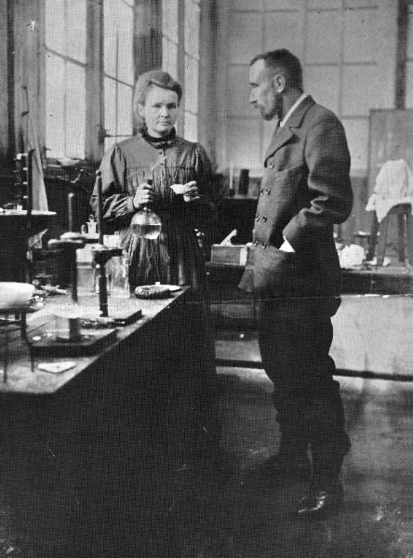

Topic 7: Atomic, nuclear and particle physics
7.1 – Discrete energy and radioactivity
Radioactive decay
•In 1893, Pierre and Marie Curie announced the discovery of two radioactive elements, radium and polonium.
•When these elements were placed by a radio receiver, that receiver picked up some sort of activity coming from the elements.
FYI
•Studies showed this radioactivity was not affected by normal physical and chemical processes.
Notes:
© 2006 By Timothy K. Lund

Slide 52
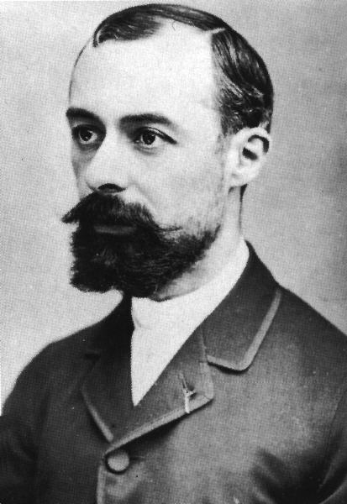


Topic 7: Atomic, nuclear and particle physics
7.1 – Discrete energy and radioactivity
Radioactive decay
•In 1896, while studying a uranium compound, French scientist Henri Becquerel discovered that a nearby photographic plate had somehow been exposed to some source of "light" even though it had not been uncovered.
•Apparently the darkening of the film was caused by some new type of radiation being emitted by the uranium compound.
•This radiation had sufficient energy to pass through the cardboard storage box and the glass of the photographic plates.
Notes:
© 2006 By Timothy K. Lund

Slide 53
Topic 7: Atomic, nuclear and particle physics
7.1 – Discrete energy and radioactivity
Alpha particles, beta particles and gamma rays
•Studies showed that there were three types of radioactive particles.
•If a radioactive substance is placed in a lead chamber and its emitted particles passed through a magnetic field, as shown, the three different types of radioactivity can be distinguished.
•Alpha particles (α) are two protons (+) and two neutrons (0). This is identical to a helium nucleus ⁴He.
•Beta particles (β) are electrons (-) that come from the nucleus.
•Gamma rays (γ) are photons and have no charge.
heavy
+2
α
0
γ
-1
β⁻
light
Notes:
© 2006 By Timothy K. Lund

Slide 54
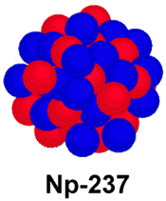
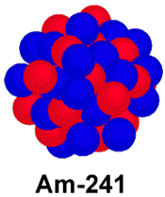

Topic 7: Atomic, nuclear and particle physics
7.1 – Discrete energy and radioactivity
Alpha particles, beta particles and gamma rays
•When a nucleus emits an alpha particle (α) it loses two protons and two neutrons.
•All alpha particles consistently have an energy of about 5 MeV.
•The decay just shown has the form
²⁴¹Am → ²³⁷Np + ⁴He.
•Since the energy needed to knock electrons off of atoms is just about 10 eV, one alpha particle can ionize a lot of atoms.
•It is just this ionization process that harms living tissue, and is much like burning at the cell level.
α
Notes:
© 2006 By Timothy K. Lund

Slide 55
Topic 7: Atomic, nuclear and particle physics
7.1 – Discrete energy and radioactivity
Alpha particles, beta particles and gamma rays
•It turns out that the total energy of the americium nucleus will equal the total energy of the neptunium nucleus plus the total energy of the alpha particle.
²⁴¹Am → ²³⁷Np + ⁴He
•According to E = mc² each portion has energy due to mass itself. It turns out that the right hand side is short by about 5 MeV (considering mass only), so the alpha particle must make up for the mass defect by having 5 MeV of kinetic energy.
E_{K} = 5 MeV
Mass defect of 5 MeV
Notes:
© 2006 By Timothy K. Lund

Slide 56
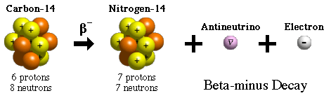
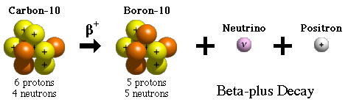
Topic 7: Atomic, nuclear and particle physics
7.1 – Discrete energy and radioactivity
Alpha particles, beta particles and gamma rays
•In β⁻ decay, a neutron becomes a proton and an electron is emitted from the nucleus.
¹⁴C → ¹⁴N + ν + e⁻
•In β⁺ decay, a proton becomes a neutron and a positron is emitted from the nucleus.
¹⁰C → ¹⁰B + ν + e⁺
•In short, a beta particle is either an electron or it is an anti-electron.
β⁻
β⁺
Notes:
© 2006 By Timothy K. Lund

Slide 57


Topic 7: Atomic, nuclear and particle physics
7.1 – Discrete energy and radioactivity
Alpha particles, beta particles and gamma rays
•In contrast to the alpha particle, it was discovered that beta particles could have a large variety of kinetic energies.
•In order to conserve energy it was postulated that another particle called a neutrino ν was created to carry the additional E_{K} needed to balance the energy.
•Beta (+) decay produces neutrinos ν, while beta (-) decay produces anti-neutrinos ν.
Same total energy
Medium
Slow
Medium
Fast
Notes:
© 2006 By Timothy K. Lund

Slide 58
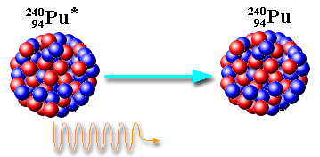


Topic 7: Atomic, nuclear and particle physics
7.1 – Discrete energy and radioactivity
Alpha particles, beta particles and gamma rays
•Recall that electrons in an atom moving from an excited state to a de-excited state release a photon.
•Nuclei can also have excited states.
•When a nucleus de-excites, it also releases a photon. This process is called gamma (γ) decay.
²³⁴Pu* → ²³⁴Pu + γ
Notes:
© 2006 By Timothy K. Lund

Slide 59


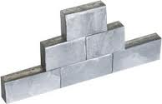
Topic 7: Atomic, nuclear and particle physics
7.1 – Discrete energy and radioactivity
Absorption characteristics of decay particles
•Since alpha particles are charged +2 and are relatively heavy, they are stopped within a few centimeters of air, or even a sheet of paper.
•The beta particles are charged -1 and are smaller and lighter. They can travel a few meters in air, or a few millimeters in aluminum.
•The gamma rays are uncharged and very high energy. They can travel a few centimeters in lead, or a very long distance through air.
•Neutrinos can go through miles of lead!
Notes:
© 2006 By Timothy K. Lund

Slide 60

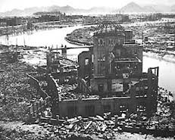
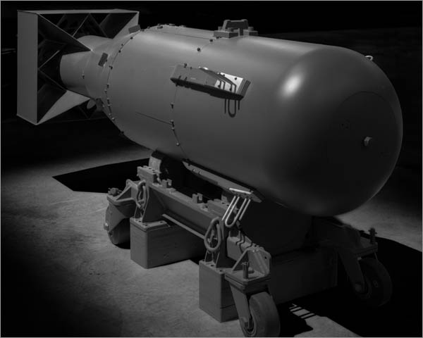
Topic 7: Atomic, nuclear and particle physics
7.1 – Discrete energy and radioactivity
Absorption characteristics of decay particles
•In living organisms, radiation causes its damage mainly by ionization in the living cells.
•All three particles energize atoms in living tissue to the point that they lose electrons and become ionized.
Notes:
© 2006 By Timothy K. Lund

Slide 61
Topic 7: Atomic, nuclear and particle physics
7.1 – Discrete energy and radioactivity
Background radiation
•Background radiation is the ionizing radiation that people are exposed to in everyday life, including natural and artificial sources.
Average annual human exposure to ionizing radiation in millisieverts (mSv)
Natural radiation source | World | USA | Japan | Remark
Inhalation of air | 1.26 | 2.28 | 0.4 | mainly from radon, depends on indoor accumulation
Ingestion of food & water | 0.29 | 0.28 | 0.4 | K-40, C-14, etc.
Terrestrial radiation from ground | 0.48 | 0.21 | 0.4 | depends on soil and building material.
Cosmic radiation from space | 0.39 | 0.33 | 0.3 | depends on altitude
sub total (natural) | 2.4 | 3.1 | 1.5
Notes:
© 2006 By Timothy K. Lund

Slide 62
Topic 7: Atomic, nuclear and particle physics
7.1 – Discrete energy and radioactivity
Background radiation
Average annual human exposure to ionizing radiation in millisieverts (mSv)
Artificial radiation source | World | USA | Japan | Remark
Medical | 0.6 | 3 | 2.3 | CT scans excludes radiotherapy
Consumer items | - | 0.13 |  | cigarettes, air travel, building materials, etc.
Atmospheric nuclear testing | 0.005 | - | 0.01 | peak of 0.11 mSv in 1963 and declining since
Occupational exposure | 0.005 | 0.005 | 0.01 | radon in mines, medical and aviation workers
Nuclear fuel cycle | 0.0002 |  | 0.001 | up to 0.02 mSv near sites; excludes occupational
Other | - | 0.003 |  | Industrial, security, medical, educational, and research
sub total (artificial) | 0.61 | 3.14 | 2.33
Notes:
© 2006 By Timothy K. Lund

Slide 63
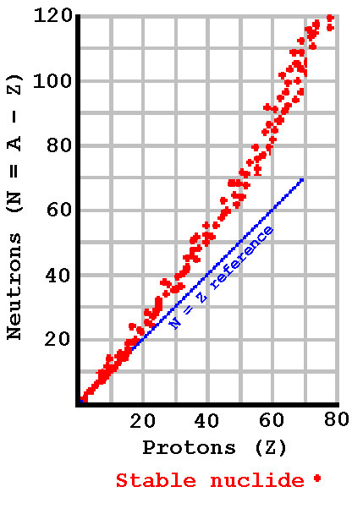
²⁰²Hg(1.53:1)
₈₀
Topic 7: Atomic, nuclear and particle physics
7.1 – Discrete energy and radioactivity
Radioactive decay
•Stable isotopes exist for elements having atomic numbers Z = 1 to 83.
•Up to Z = 20, the neutron-to- proton ratio is close to 1.
•Beyond Z = 20, the neutron-to- proton ratio is bigger than 1, and grows with atomic number.
•The extra neutrons counteract the repulsive Coulomb force between protons by increasing the strong force but not contributing to the Coulomb force.
Unstable region
Too many neutrons
(β⁻ decay)
¹¹⁰ Cd(1.29:1)
₄₈
Unstable region
Too many protons
(β⁺ decay)
⁶Li(1.00:1)
Unstable nuclides
₃
Notes:
© 2006 By Timothy K. Lund

Slide 64
DECAY SERIES for ²³⁸U
147
146
145
144
143
142
141
140
139
138
137
136
135
134
133
132
131
130
129
128
127
126
125
124
123
²³⁸U
²³⁴Th
α
β
²³⁴Pa
β
²³⁴U
²³⁰Th
α
β
²²⁶Ra
α
²²²Rn
α
Question: What type of beta decay is represented in this decay series?
Neutron Number (N)
²¹⁸Po
α
²¹⁴Pb
α
β
²¹⁸At
Answer: Since Z increases and N decreases, it must be β⁻ decay.
α
β
²¹⁴Bi
²¹⁰Tl
α
β
²¹⁴Po
α
Question: What would β⁺ decay look like? (N increases and Z decreases.)
β
²¹⁰Pb
β
²¹⁰Bi
²⁰⁶Tl
α
β
²¹⁰Po
Answer: The arrow would point LEFT and UP one unit each.
β
α
²⁰⁶Pb (STABLE)
80 81 82 83 84 85 86 87 88 89 90 91 92 93 94 95
Proton Number (Z)
Notes:
© 2006 By Timothy K. Lund

Slide 65
Topic 7: Atomic, nuclear and particle physics
7.1 – Discrete energy and radioactivity
Half-life
•As we have seen, some nuclides are unstable.
•What this means is that an unstable nucleus may spontaneously decay into another nucleus (which may or may not be stable).
•Given many identical unstable nuclides, which precise ones will decay in any particular time is impossible to predict.
•In other words, the decay process is random.
•But random though the process is, if there is a large enough population of an unstable nuclide, the probability that a certain proportion will decay in a certain time is well defined.
Notes:
© 2006 By Timothy K. Lund

Slide 66
Topic 7: Atomic, nuclear and particle physics
7.1 – Discrete energy and radioactivity
Half-life
EXAMPLE: Here we have a collection of unstable Americium-241 nuclides.
•We do not know which particular nucleus will decay next.
•All we can say is that a certain proportion will decay in a certain amount of time.
Notes:
© 2006 By Timothy K. Lund

Slide 67
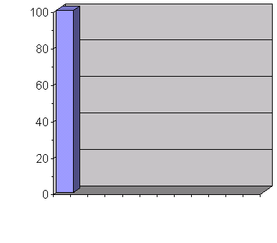
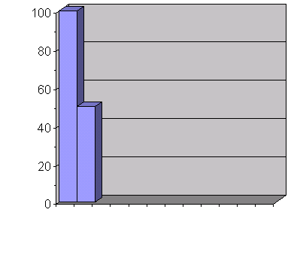
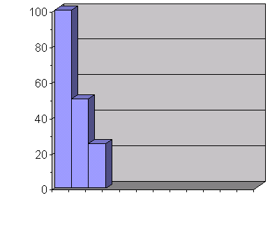
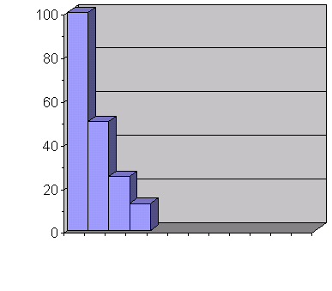
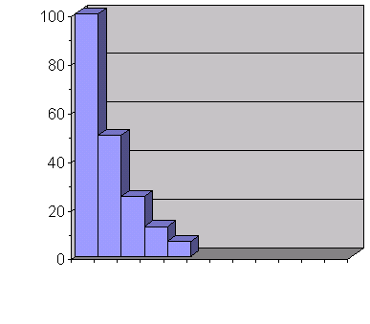
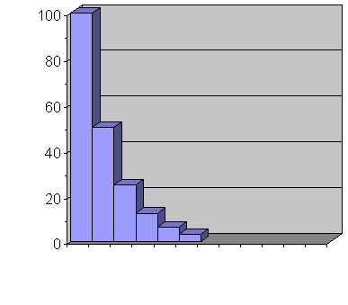


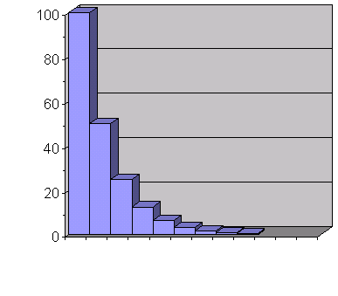

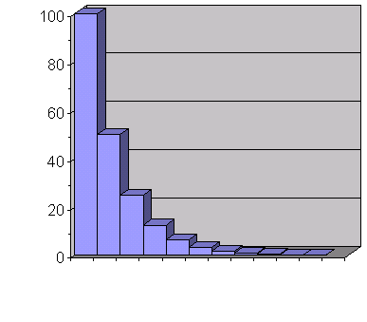

Topic 7: Atomic, nuclear and particle physics
7.1 – Discrete energy and radioactivity
Half-life
•Obviously the higher the population of Americium-241 there is to begin with, the more decays there will be in a time interval.
•But each decay decreases the remaining population.
•Hence the decay rate decreases over time for a fixed sample.
•It is an exponential decrease in decay rate.
²⁴¹Am remaining
Time axis
Notes:
© 2006 By Timothy K. Lund

Slide 68
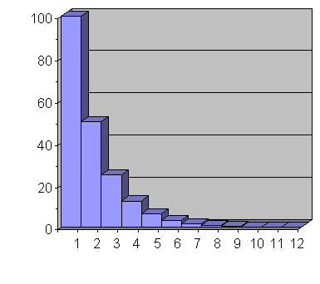
Topic 7: Atomic, nuclear and particle physics
7.1 – Discrete energy and radioactivity
Half-life
•Thus the previous graph had the time axis in increments of half-life.
•From the graph we see that half of the original 100 nuclei have decayed after 1 half-life.
•Thus after 1 half-life, only 50 of the original population of 100 have retained their original form.
•And the process continues…
N (population)
Time (half-lives)
Notes:
© 2006 By Timothy K. Lund

Slide 69
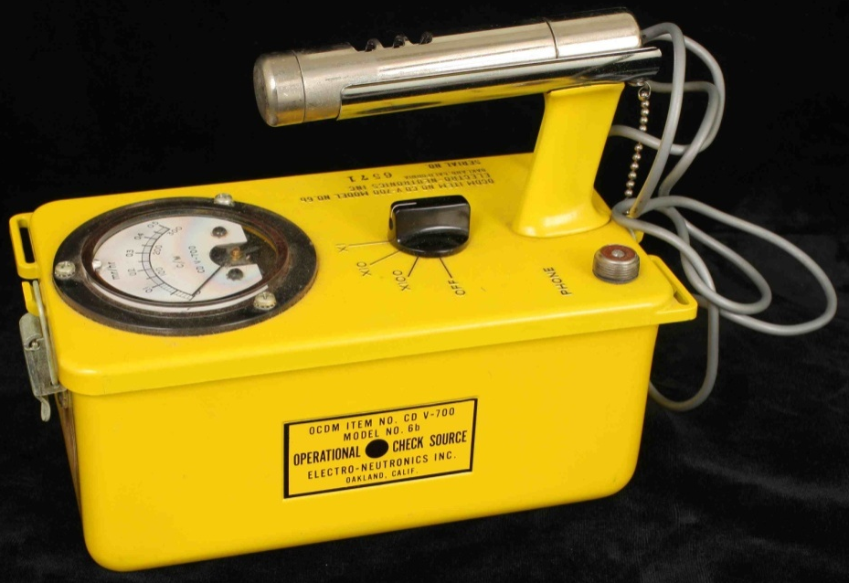
Topic 7: Atomic, nuclear and particle physics
7.1 – Discrete energy and radioactivity
Half-life
•Rather than measuring the amount of remaining radioactive nuclide there is in a sample (which is extremely hard to do) we measure instead the decay rate (which is much easier).
•Decay rates are measured using various devices, most commonly the Geiger-Mueller counter.
•Decay rates are measured in Becquerels (Bq).
1 Bq ≡ 1 decay / second
Becquerel definition
Notes:
© 2006 By Timothy K. Lund

Slide 70
Topic 7: Atomic, nuclear and particle physics
7.1 – Discrete energy and radioactivity
Solving problems involving integral numbers of half-lives
•The decay rate or activity A is proportional to the population of the radioactive nuclide N₀ in the sample.
•Thus if the population has decreased to half its original number, the activity will be halved.
A ∝ N₀
activity A
EXAMPLE: Suppose the activity of a radioactive sample decreases from X Bq to X / 16 Bq in 80 minutes. What is the half-life of the substance?
SOLUTION: Since A is proportional to N₀ we have
N₀→(1/2)N₀ →(1/4)N₀ →(1/8)N₀ →(1/16)N₀
•so that 4 half-lives = 80 min and t_{half} = 20 min.
t_{half}
t_{half}
t_{half}
t_{half}
Notes:
© 2006 By Timothy K. Lund

Slide 71
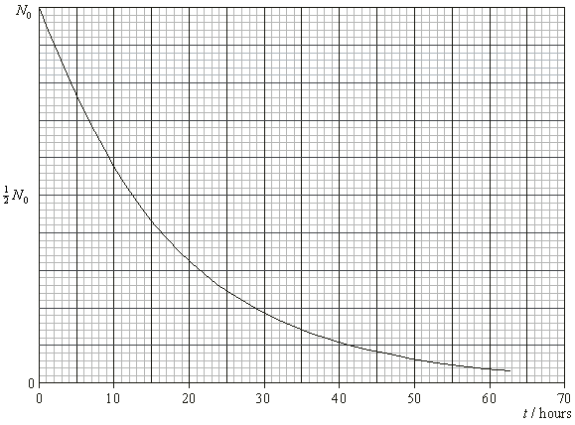
Topic 7: Atomic, nuclear and particle physics
7.1 – Discrete energy and radioactivity
Determining the half-life of a nuclide from a decay curve
EXAMPLE: Find the half-life of the radioactive nuclide shown here. N₀ is the starting population of the nuclides.
SOLUTION:
•Find the time at which the population has halved…
•The half-life is about 12.5 hours.
Notes:
© 2006 By Timothy K. Lund

Slide 72
Topic 7: Atomic, nuclear and particle physics
7.1 – Discrete energy and radioactivity
Some typical half-lives
Nuclide
Primary Decay
Half-Life
Rubidium-87
β-
4.7×10¹⁰ y
Uranium-238
α
4.5×10⁹ y
Plutonium-239
α
2.4×10⁴ y
Carbon-14
β-
5730 y
Radium-226
α
1600 y
Strontium-90
β-
28 y
Cobalt-60
β-
5.3 y
Radon-222
α
3.82 d
Iodine-123
EC
13.3 h
Polonium-218
α , β-
3.05 min
Oxygen-19
β-
27 s
Polonium-213
α
4×10⁻¹⁶ s
Notes:
© 2006 By Timothy K. Lund

Slide 73
Topic 7: Atomic, nuclear and particle physics
7.1 – Discrete energy and radioactivity
Solving problems involving integral numbers of half-lives
EXAMPLE: Suppose you have 64 grams of a radioactive material which decays into 1 gram of radioactive material in 10 hours. What is the half-life of this material?
SOLUTION:
•The easiest way to solve this problem is to keep cutting the original amount in half...
•Note that there are 6 half-lives in 10 h = 600 min. Thus t_{half} = 100 min.
64
32
16
8
4
2
1
t_{half}
t_{half}
t_{half}
t_{half}
t_{half}
t_{half}
Notes:
© 2006 By Timothy K. Lund

Slide 74
Topic 7: Atomic, nuclear and particle physics
7.1 – Discrete energy and radioactivity
Solving problems involving integral numbers of half-lives
EXAMPLE: A nuclide X has a half-life of 10 s. On decay a stable nuclide Y is formed. Initially, a sample contains only the nuclide X. After what time will 87.5% of the sample have decayed into Y?
A. 9.0 s B. 30 s C. 80 s D. 90 s
SOLUTION:
•We want only 12.5% of X to remain.
•Thus t = 3t_{half} = 3(10) = 30 s.
100%
50%
25%
12.5%
t_{half}
t_{half}
t_{half}
Notes:
© 2006 By Timothy K. Lund

Slide 75

Topic 7: Atomic, nuclear and particle physics
7.1 – Discrete energy and radioactivity
Solving problems involving integral numbers of half-lives
PRACTICE: A sample of radioactive carbon-14 decays into a stable isotope of nitrogen. As the carbon-14 decays, the rate at which nitrogen is produced
A. decreases linearly with time.
B. increases linearly with time.
C. decreases exponentially with time.
D. increases exponentially with time.
SOLUTION: •The key here is that the total sample mass remains constant. The nuclides are just changing in their proportions.
•Note that the slope (rate) of the red graph is decreasing exponentially with time.
Nitrogen
Carbon
Notes:
© 2006 By Timothy K. Lund

Slide 76
Topic 7: Atomic, nuclear and particle physics
7.1 – Discrete energy and radioactivity
Solving problems involving integral numbers of half-lives
PRACTICE: An isotope of radium has a half-life of 4 days. A freshly prepared sample of this isotope contains N atoms. The time taken for 7N/8 of the atoms of this isotope to decay is
A. 32 days.
B. 16 days.
C. 12 days.
D. 8 days.
SOLUTION: Read the problem carefully. If 7N / 8 has decayed, only 1N / 8 atoms of the isotope remain.
N→(1/2)N →(1/4)N →(1/8)N is 3 half-lives.
That would be 12 days since each half-life is 4 days.
Notes:
© 2006 By Timothy K. Lund

Slide 77
Topic 7: Atomic, nuclear and particle physics
7.1 – Discrete energy and radioactivity
Solving problems involving integral numbers of half-lives
PRACTICE:
Radioactive decay is a random process. This means that
A. a radioactive sample will decay continuously.
B. some nuclei will decay faster than others.
C. it cannot be predicted how much energy will be released.
D. it cannot be predicted when a particular nucleus will decay.
SOLUTION:
Just know this!
Notes:
© 2006 By Timothy K. Lund

Slide 78


Topic 7: Atomic, nuclear and particle physics
7.1 – Discrete energy and radioactivity
Solving problems involving integral numbers of half-lives
PRACTICE:
•Isotopes of an element have the same
number of protons and electrons, but
differing numbers of neutrons.
Notes:
© 2006 By Timothy K. Lund

Slide 79

Topic 7: Atomic, nuclear and particle physics
7.1 – Discrete energy and radioactivity
Solving problems involving integral numbers of half-lives
PRACTICE:
SOLUTION:
•The lower left number in the symbol is the number of protons.
•Since protons are positive, the new atom has one more positive value than the old.
•Thus a neutron decayed into a proton and an electron (β⁻) decay.
•And the number of nucleons remains the same…
42
β⁻
Notes:
© 2006 By Timothy K. Lund

Slide 80

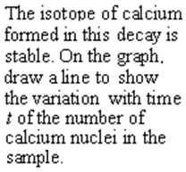

Topic 7: Atomic, nuclear and particle physics
7.1 – Discrete energy and radioactivity
Solving problems involving integral numbers of half-lives
PRACTICE:
SOLUTION:
•Flip the original curve so the amounts always total N₀.
Notes:
© 2006 By Timothy K. Lund

Slide 81

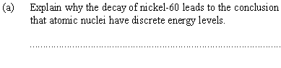
Topic 7: Atomic, nuclear and particle physics
7.1 – Discrete energy and radioactivity
Solving problems involving integral numbers of half-lives
•It is the gamma decay that leads us to the conclusion that excited nuclei, just like excited atoms, release photons of discrete energy, implying discrete energy levels.
FYI
•Recall that γ-ray decay happens when the nucleus goes from an excited state to a de-excited state.
Notes:
© 2006 By Timothy K. Lund

Slide 82
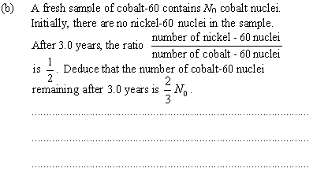
Topic 7: Atomic, nuclear and particle physics
7.1 – Discrete energy and radioactivity
Solving problems involving integral numbers of half-lives
•Since the ratio is 1/2, for each nickel atom there are 2 cobalt atoms.
•Thus, out of every three atoms, 1 is nickel and 2 are cobalt.
•Therefore, the remaining cobalt is (2/3)N₀.
Notes:
© 2006 By Timothy K. Lund

Slide 83
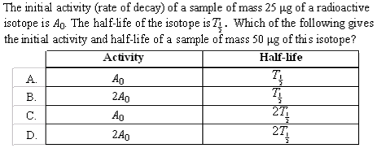
Topic 7: Atomic, nuclear and particle physics
7.1 – Discrete energy and radioactivity
Solving problems involving integral numbers of half-lives
SOLUTION: Recall that the activity is proportional to the number radioactive atoms.
•But the half-life is the same for any amount of the atoms…
N doubled, so A did too.
Notes:
© 2006 By Timothy K. Lund

Slide 84
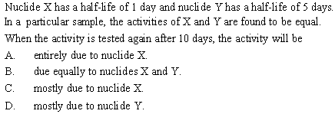
Topic 7: Atomic, nuclear and particle physics
7.1 – Discrete energy and radioactivity
Solving problems involving integral numbers of half-lives
SOLUTION: Activity is proportional to the number radioactive atoms remaining in the sample.
•Since X’s half-life is shorter than Y’s, less activity will be due to X, and more to Y at any later date…
Notes:
© 2006 By Timothy K. Lund

Slide 85
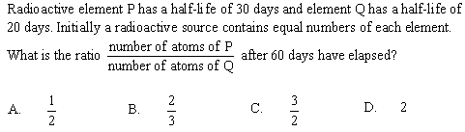
Topic 7: Atomic, nuclear and particle physics
7.1 – Discrete energy and radioactivity
Solving problems involving integral numbers of half-lives
SOLUTION:
•60 days is 2 half-lives for P so N_{P} is 1/4 of what it started out as.
•60 days is 3 half-lives for Q so N_{Q} is 1/8 of what it started out as.
•Thus N_{P} / N_{Q} = (1/4) / (1/8) = (1/4)×(8/1) = 8/4 = 2.
Notes:
© 2006 By Timothy K. Lund

