Slide 1
Topic 7: Atomic, nuclear and particle physics 7.2 – Nuclear reactions
Essential idea: Energy can be released in nuclear decays and reactions as a result of the relationship between mass and energy.
Nature of science: Patterns, trends and discrepancies: Graphs of binding energy per nucleon and of neutron number versus proton number reveal unmistakable patterns. This allows scientists to make predictions of isotope characteristics based on these graphs.
Notes:
© 2006 By Timothy K. Lund

Slide 2
Topic 7: Atomic, nuclear and particle physics 7.2 – Nuclear reactions
Understandings:
• The unified atomic mass unit
• Mass defect and nuclear binding energy
• Nuclear fission and nuclear fusion
Applications and skills:
• Solving problems involving mass defect and binding energy
• Solving problems involving the energy released in radioactive decay, nuclear fission and fusion
• Sketching and interpreting the general shape of the curve of average binding energy per nucleon against nucleon number
Notes:
© 2006 By Timothy K. Lund

Slide 3
Topic 7: Atomic, nuclear and particle physics 7.2 – Nuclear reactions
Guidance:
• Students must be able to calculate changes in terms of mass or binding energy
• Binding energy may be defined in terms of energy required to completely separate the nucleons or the energy released when a nucleus is formed from its nucleons
Data booklet reference:
• ΔE = Δm c²
Notes:
© 2006 By Timothy K. Lund

Slide 4
Topic 7: Atomic, nuclear and particle physics 7.2 – Nuclear reactions
Theory of knowledge:
• The acceptance that mass and energy are equivalent was a major paradigm shift in physics. How have other paradigm shifts changed the direction of science? Have there been similar paradigm shifts in other areas of knowledge?
Utilization:
• Our understanding of the energetics of the nucleus has led to ways to produce electricity from nuclei but also to the development of very destructive weapons
• The chemistry of nuclear reactions (see Chemistry option sub-topics C.3 and C.7)
Notes:
© 2006 By Timothy K. Lund

Slide 5
Topic 7: Atomic, nuclear and particle physics 7.2 – Nuclear reactions
Aims:
• Aim 5: some of the issues raised by the use of nuclear power transcend national boundaries and require the collaboration of scientists from many different nations
• Aim 8: the development of nuclear power and nuclear weapons raises very serious moral and ethical questions: who should be allowed to possess nuclear power and nuclear weapons and who should make these decisions? There are also serious environmental issues associated with the nuclear waste of nuclear power plants.
Notes:
© 2006 By Timothy K. Lund

Slide 6
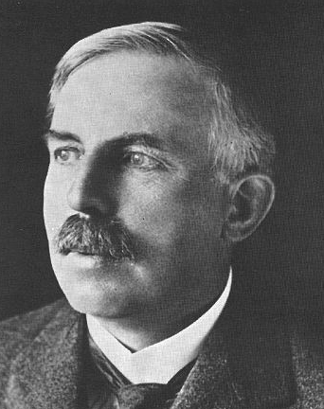
Topic 7: Atomic, nuclear and particle physics 7.2 – Nuclear reactions
Nuclear reactions
•The first induced nuclear reaction was accomplished by none other than Australian physicist Ernest Rutherford, the same guy who bombarded atoms with alpha particles and discovered the nuclear structure of the atom.
•From his experience with alpha emitters, Rutherford thought that alpha particles might just be energetic enough to breach the nuclear boundary.
Notes:
© 2006 By Timothy K. Lund

Slide 7
Topic 7: Atomic, nuclear and particle physics 7.2 – Nuclear reactions
Nuclear reactions
•In fact, he did just that in the following nuclear reaction:
nitrogen alpha oxygen proton particle
+
→
+
¹⁴N + ⁴He → ¹⁷O + ¹H
⁷ ² ⁸ ¹
FYI
•The nuclear reaction above is an example of an artificial (induced) transmutation - where one element is transmuted into another through artificial means. It is alchemy!
Notes:
© 2006 By Timothy K. Lund

Slide 8
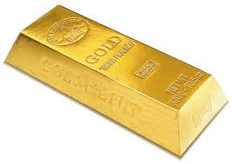
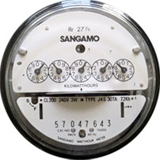
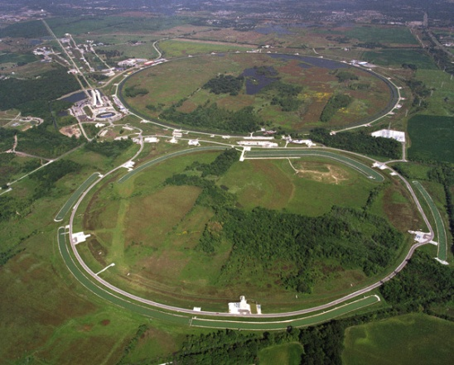
Topic 7: Atomic, nuclear and particle physics 7.2 – Nuclear reactions
Nuclear reactions
•Here is another induced transmutation that has been successfully accomplished:
mercury proton gold α
²⁰⁰Hg + ¹H → ¹⁹⁷Au + ⁴He
⁸⁰ ¹ ⁷⁹ ²
FYI •At last man’s striving in the studies of alchemy have come to fruition! Recall what a driving force this was in chemistry and physics…
•Particle accelerators are required.
•But don’t go home asking mom for one so you can make your own bootleg gold.
•Both accelerators and energy costs far outweigh the return in gold!
Notes:
© 2006 By Timothy K. Lund

Slide 9
Topic 7: Atomic, nuclear and particle physics 7.2 – Nuclear reactions
Nuclear reactions
•Here is an example of a nuclear equation:
•There are two conservation laws used to balance a nuclear equation:
(1) The conservation of nucleons tells us that the top numbers must tally on each side of the reaction.
(2) The conservation of charge tells us that the bottom numbers must tally on each side of the reaction.
214
210
4
Nucleons = A
Po
→
Pb
+
He
X
84
82
2
Protons = Z
polonium
lead
α
N = Neutrons
A = Z + N
nucleon relationship
Notes:
© 2006 By Timothy K. Lund

Slide 10
Topic 7: Atomic, nuclear and particle physics 7.2 – Nuclear reactions
Nuclear reactions
EXAMPLE: Carbon-14 undergoes β decay to become nitrogen-14. Construct and balance the nuclear equation.
SOLUTION:
•Write the given information down and continue.
•From the conservation of nucleon number we see that the electron has a nucleon number of 0.
•From the periodic table we see that Z = 6 for carbon and Z = 7 for nitrogen.
•From the conservation of charge we see that the charge of the beta particle must be -1.
•Finally, don’t forget the antineutrino for β⁻ decay.
14
14
0
C
→
N
+
e
+
ν
6
7
-1
Notes:
© 2006 By Timothy K. Lund

Slide 11
Topic 7: Atomic, nuclear and particle physics 7.2 – Nuclear reactions
Nuclear reactions
•Just know this!
Notes:
© 2006 By Timothy K. Lund

Slide 12
Topic 7: Atomic, nuclear and particle physics 7.2 – Nuclear reactions
Nuclear reactions
•There are many ways to attack this problem.
•First of all, alpha particles are ⁴He, not ²He.
•(Also, P has an atomic number of 15, not 14).
•Secondly, a proton has a Z number of 1, not zero.
Notes:
© 2006 By Timothy K. Lund

Slide 13
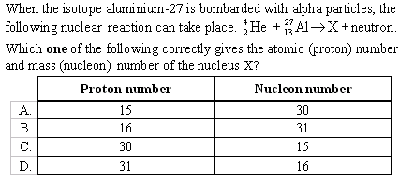
Topic 7: Atomic, nuclear and particle physics 7.2 – Nuclear reactions
Nuclear reactions
•A neutron is 1 nucleon and 0 charge.
•The left side has 31 nucleons.
•Therefore element X has a nucleon number of 30.
•(You can also deduce that the proton number is 15.)
1
n
0
Notes:
© 2006 By Timothy K. Lund

Slide 14
Topic 7: Atomic, nuclear and particle physics 7.2 – Nuclear reactions
Nuclear reactions
•The nucleon number is already balanced.
•The charge on the right is high.
•These two numbers are characteristic of the electron.
•The process is beta-minus decay.
•Don’t forget the antineutrino that goes with beta-minus.
0
e
ν
+
+
-1
Notes:
© 2006 By Timothy K. Lund

Slide 15
Topic 7: Atomic, nuclear and particle physics 7.2 – Nuclear reactions
Nuclear reactions
•Keep in mind that an electron has N = 0 and Z = -1.
•Thus only one of the above choices is possible..
Notes:
© 2006 By Timothy K. Lund

Slide 16
Topic 7: Atomic, nuclear and particle physics 7.2 – Nuclear reactions
The unified atomic mass unit
•In the world of nuclear reactions we have to keep very precise track of the mass of the nuclei if we are to determine the energy of a reaction.
•To this end we define the unified atomic mass unit (u) using a neutral carbon-12 atom as our standard of precisely 12.000000 u.
1 u = 1.661×10⁻²⁷ kg = 931.5 MeV c⁻²
unified atomic mass unit
EXAMPLE: How many AMUs is 25.32 g of anything?
SOLUTION:
(25.32 g)(1 kg / 1000 g)(1 u / 1.661×10⁻²⁷ kg)
= 1.524×10²⁵ u.
Notes:
© 2006 By Timothy K. Lund

Slide 17
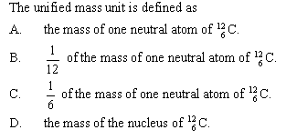
Topic 7: Atomic, nuclear and particle physics 7.2 – Nuclear reactions
The unified atomic mass unit
•Recall “To this end we define the unified atomic mass unit (u) using a neutral carbon-12 atom as our standard of precisely 12.000000 u.”
Notes:
© 2006 By Timothy K. Lund

Slide 18
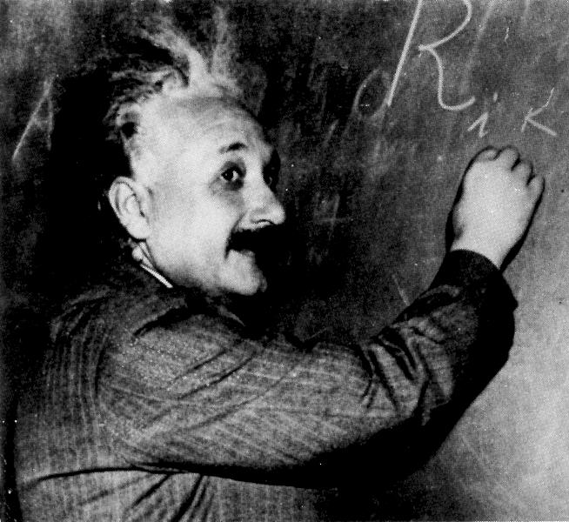
Topic 7: Atomic, nuclear and particle physics 7.2 – Nuclear reactions
Mass defect and nuclear binding energy
•To understand nuclear reactions we have to use Einstein’s mass-energy equivalence relationship:
•This equation is probably the most famous of all.
•What E = mc² means is that mass and energy are interchangeable.
E = mc² or ΔE = Δm c²
mass-energy equivalence
EXAMPLE: If one kilogram of anything is converted completely into energy, how much energy would be released?
SOLUTION: Using E = mc² we get
E = mc² = (1)(3.00×10⁸)² = 9.00×10¹⁶ J!
•1 megaton of TNT = 4.18400 × 10¹⁵ joules.
Notes:
© 2006 By Timothy K. Lund

Slide 19
Topic 7: Atomic, nuclear and particle physics 7.2 – Nuclear reactions
Mass defect and nuclear binding energy
•Finding the mass defect of a nuclear reaction takes three steps:
(1) Find the mass of the reactants.
(2) Find the mass of the products.
(3) Find the difference in mass.
•The difference in mass between the reactants and the products is called the mass defect ∆m.
EXAMPLE: Label the reactants and the products in the following nuclear reaction: 2(¹H) + 2n → ⁴He.
SOLUTION:
2(¹H) + 2n → ⁴He
reactants
product
Notes:
© 2006 By Timothy K. Lund

Slide 20
Topic 7: Atomic, nuclear and particle physics 7.2 – Nuclear reactions
Particle Masses
Mass defect and nuclear binding energy
Particle
Mass (u)
EXAMPLE: Using the table find the mass defect in the following nuclear reaction:
2(¹H) + 2n → ⁴He.
SOLUTION:
•For the reactants ¹H and n:
2(1.007825) + 2(1.008665) = 4.032980 u.
•For the single product ⁴He: 4.002603 u.
•The mass defect:
∆m = 4.002603 - 4.032890 = -0.030377 u.
-0.030377 u(1.661×10⁻²⁷ kg / u) = -5.044 ×10⁻²⁹ kg.
Electron
0.000548
Proton
1.00727
¹H atom
1.007825
Neutron
1.008665
⁴He atom
4.002603
FYI
•Thus ⁴He has less mass than its constituents!
Notes:
© 2006 By Timothy K. Lund

Slide 21
Topic 7: Atomic, nuclear and particle physics 7.2 – Nuclear reactions
Mass defect and nuclear binding energy
•The binding energy E_{b} of a nucleus is the amount of work or energy that must be expended to pull it apart.
EXAMPLE: What is the binding energy E_{b} in ⁴He in the nuclear reaction 2(¹H) + 2n → ⁴He?
SOLUTION: Since ⁴He is 5.044 ×10⁻²⁹ kg lighter than 2(¹H) + 2n, we need to provide enough energy to make the additional mass of the constituents.
•Using Einstein’s mass-energy equivalence E = mc²:
E_{b} = (5.044×10⁻²⁹)(3.00×10⁸)² = 4.54×10⁻¹² J.
•Thus, to pull apart the ⁴He and separate it into its constituents, 4.54×10⁻¹² J are needed to create that extra mass and is thus the binding energy.
Notes:
© 2006 By Timothy K. Lund

Slide 22
Topic 7: Atomic, nuclear and particle physics 7.2 – Nuclear reactions
Mass defect and nuclear binding energy
•A picture of the reaction 2(¹H) + 2n → ⁴He might help:
•The reverse process yields the same energy:
⁴He → 2(¹H) + 2n
BINDING ENERGY
+ 4.54×10⁻¹² J
→
+
Disassembling ⁴He will require energy.
2(¹H) + 2n → ⁴He
BINDING ENERGY
+
→
+ 4.54×10⁻¹² J
Assembling ⁴He will release energy.
Notes:
© 2006 By Timothy K. Lund

Slide 23
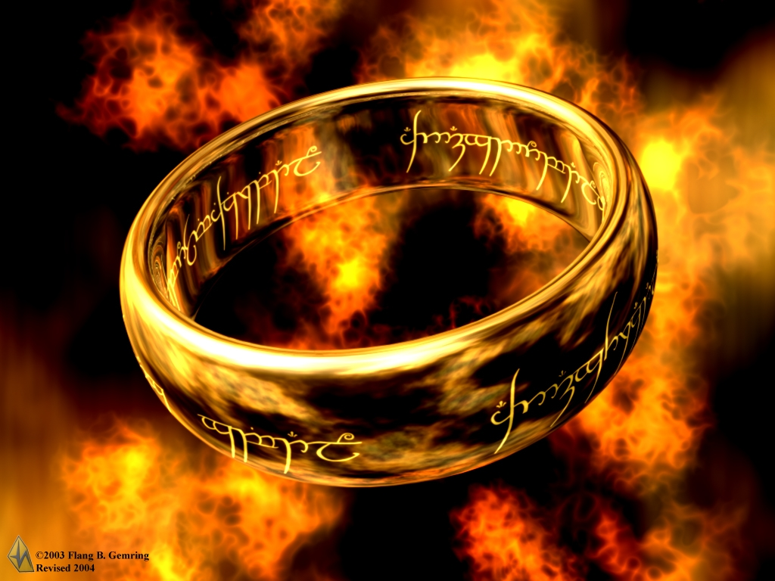
Topic 7: Atomic, nuclear and particle physics 7.2 – Nuclear reactions
Mass defect and nuclear binding energy
PRACTICE:
Did the one ring have binding energy?
SOLUTION:
Of course: “One ring to bring them all and in the darkness bind them.”
Notes:
© 2006 By Timothy K. Lund

Slide 24
Topic 7: Atomic, nuclear and particle physics 7.2 – Nuclear reactions
Solving problems involving mass defect and binding energy
PRACTICE: Radium-226 (²²⁶Ra) undergoes natural radioactive decay to disintegrate spontaneously with the emission of an alpha particle to form radon (Rn). Calculate the energy in Joules that is released.
SOLUTION:
Reactant: 226.0254 u.
Products: 222.0176 u + 4.0026 u = 226.0202 u.
Mass defect: ∆m = (226.0254 – 226.0202)u = 0.0052 u.
Energy released: E = 0.0052(1.661×10⁻²⁷)(3.00×10⁸)²
E = 7.77×10⁻¹³ J.
Notes:
© 2006 By Timothy K. Lund

Slide 25
Topic 7: Atomic, nuclear and particle physics 7.2 – Nuclear reactions
Solving problems involving mass defect and binding energy per nucleon
•The binding energy per nucleon E_{b} / A of a nucleus is simply the binding energy E_{b} divided by the number of nucleons A.
EXAMPLE: What is the binding energy per nucleon of ⁴He?
SOLUTION:
•⁴He has a binding energy of E_{b} = 4.54×10⁻¹² J.
•⁴He has four nucleons (2 p and 2 n → A = 4).
•Thus E_{b} / A = 4.54×10⁻¹² J / 4 nucleons
= 1.14×10⁻¹² J / nucleon.
Notes:
© 2006 By Timothy K. Lund

Slide 26
Topic 7: Atomic, nuclear and particle physics 7.2 – Nuclear reactions
Sketching and interpreting the graph of average binding energy per nucleon against nucleon number
•Rather than looking at the total binding energy of nuclei, we often look at the binding energy per nucleon.
•This number tells us about how difficult it is to remove each nucleon from the nucleus.
•The bigger the binding energy per nucleon, the more stable the nucleus.
FYI
•The bigger the binding energy per nucleon, the less likely a nucleus will be to want to lose one of its nucleons.
•Thus it is more stable, by definition.
Notes:
© 2006 By Timothy K. Lund

Slide 27
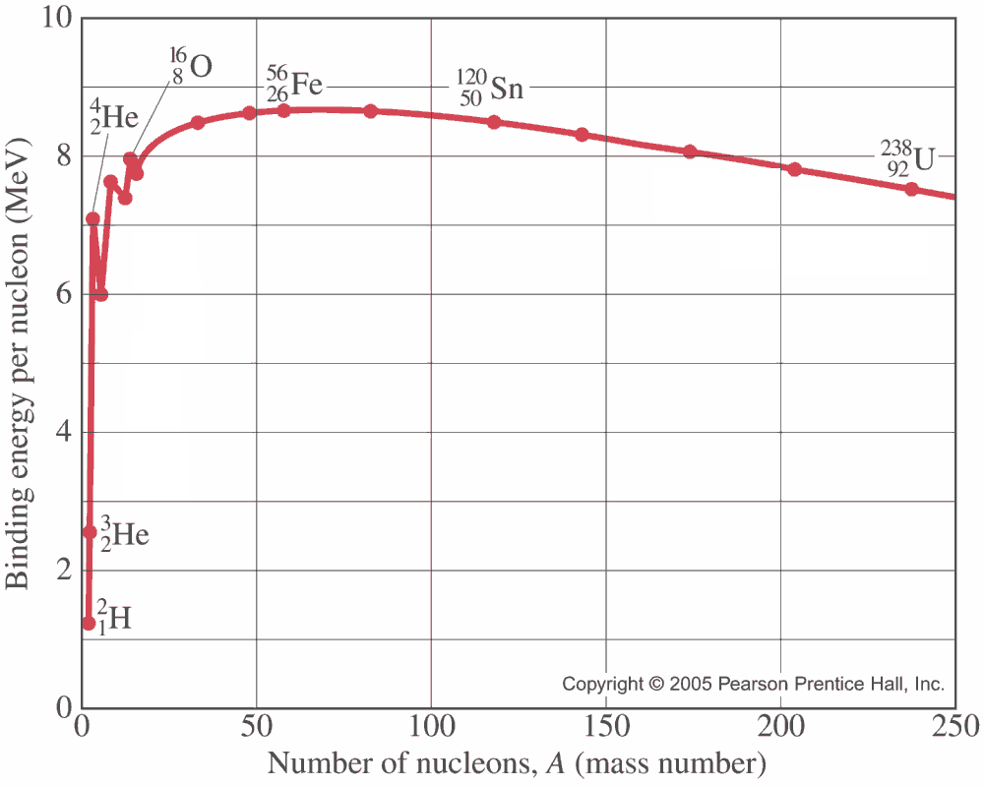
PRACTICE: Which is the most stable element?
SOLUTION:
•The bigger the binding energy per nucleon the more stable an element is.
•Iron-56 is the most stable element.
Notes:
© 2006 By Timothy K. Lund

Slide 28
PRACTICE: What is the binding energy of uranium-238?
SOLUTION:
•Note that the binding energy per nucleon of ²³⁸U is about 7.6 MeV.
•But since ²³⁸U has 238 nucleons, the binding energy is
(238)(7.6 MeV) = 1800 MeV.
Notes:
© 2006 By Timothy K. Lund

Slide 29
PRACTICE: What is the mass defect of uranium-238 if assembled from scratch?
SOLUTION:
•The mass defect is equal to the binding energy according to E = mc².
•We need only convert 1800 MeV to a mass.
•From the Physics data booklet we see that 1.661×10⁻²⁷ kg = 931.5 MeV c⁻² so that
(1800 MeV)(1.661×10⁻²⁷ kg / 931.5 MeV c⁻²)
= 3.21×10⁻²⁷ kg.
Notes:
© 2006 By Timothy K. Lund

Slide 30
Topic 7: Atomic, nuclear and particle physics 7.2 – Nuclear reactions
Sketching and interpreting the graph of average binding energy per nucleon against nucleon number
PRACTICE: ⁵⁴Fe has a mass of 53.9396 u. A proton (with electron) has a mass of 1.00782 u and a neutron has a mass of 1.00866 u.
(a) Find the binding energy of iron-54 in MeV c⁻².
SOLUTION: ⁵⁴Fe: A = 54, Z = 26, N = 54 - 26 = 28.
•The constituents of ⁵⁴Fe are thus
26(1.00782 u) + 28(1.00866 u) = 54.4458 u
•The mass defect is thus
∆m = 54.4458 u – 53.9396 u = 0.5062 u
•The binding energy is thus
E_{b} = (0.5062)(931.5 MeV c⁻²) = 471.5 MeV c⁻².
Notes:
© 2006 By Timothy K. Lund

Slide 31
Topic 7: Atomic, nuclear and particle physics 7.2 – Nuclear reactions
Sketching and interpreting the graph of average binding energy per nucleon against nucleon number
PRACTICE: ⁵⁴Fe has a mass of 53.9396 u. A proton (with electron) has a mass of 1.00782 u and a neutron has a mass of 1.00866 u.
(b) Find the binding energy per nucleon of iron-54.
SOLUTION: ⁵⁴Fe: A = 54, Z = 26, N = 54 – 26 = 28.
•The binding energy is E_{b} = 471.5 MeV c⁻².
•The number of nucleons is A = 54.
•Thus the binding energy per nucleon is
E_{b} / A = 471.5 MeV / 54 nucleons
= 8.7 MeV / nucleon.
•This is consistent with the graph.
Notes:
© 2006 By Timothy K. Lund

Slide 32
Topic 7: Atomic, nuclear and particle physics 7.2 – Nuclear reactions
Nuclear fission and nuclear fusion
•Nuclear fission is the splitting of a large nucleus into two smaller (daughter) nuclei.
•An example of fission is
•In the animation, ²³⁵U is hit by a neutron, and capturing it, becomes excited and unstable:
•It quickly splits into two smaller daughter nuclei, and two neutrons.
²³⁵U + ¹n → (²³⁶U*) → ¹⁴⁰Xe + ⁹⁴Sr + 2(¹n)
⁹² ⁰ ⁹² ⁵⁴ ³⁸ ⁰
⁹⁴Sr
¹⁴⁰Xe
Notes:
© 2006 By Timothy K. Lund

Slide 33
Topic 7: Atomic, nuclear and particle physics 7.2 – Nuclear reactions
Nuclear fission and nuclear fusion
•Note that the splitting was triggered by a single neutron that had just the right energy to excite the nucleus.
•Note also that during the split, two more neutrons were released.
•If each of these neutrons splits subsequent nuclei, we have what is called a chain reaction.
²³⁵U + ¹n → (²³⁶U*) → ¹⁴⁰Xe + ⁹⁴Sr + 2(¹n)
⁹² ⁰ ⁹² ⁵⁴ ³⁸ ⁰
1
2
Primary
4
Secondary
8
Tertiary
Exponential Growth
Notes:
© 2006 By Timothy K. Lund

Slide 34
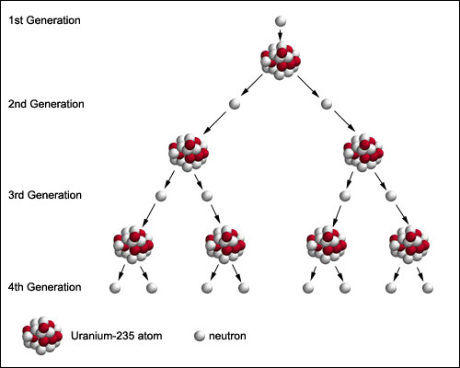
Notes:
© 2006 By Timothy K. Lund

Slide 35
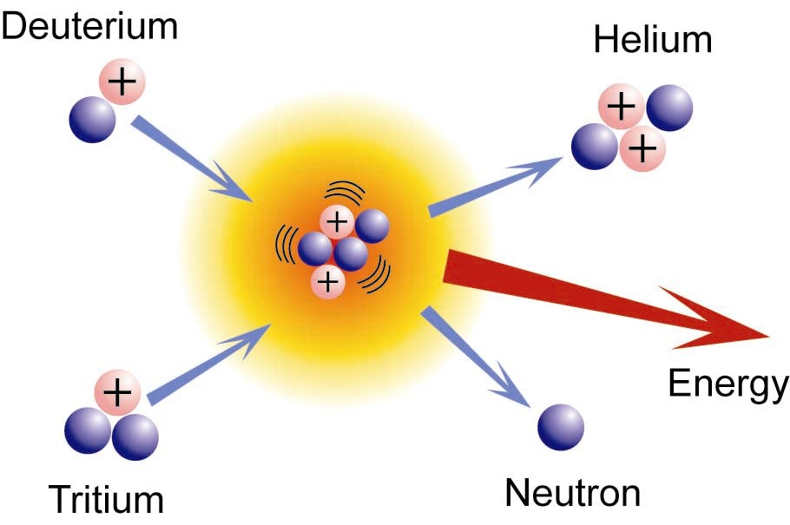
Topic 7: Atomic, nuclear and particle physics 7.2 – Nuclear reactions
Nuclear fission and nuclear fusion
•Nuclear fusion is the combining of two small nuclei into one larger nucleus.
•An example of fusion is
•In order to fuse two nuclei you must overcome the repulsive Coulomb force and get them close enough together that the strong force takes over.
•Stars use their immense gravitational force to overcome the Coulomb force.
²H + ³H → ⁴He + ¹n.
¹ ¹ ² ⁰
+
→
+
Notes:
© 2006 By Timothy K. Lund

Slide 36
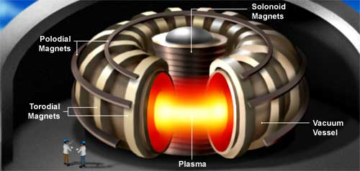
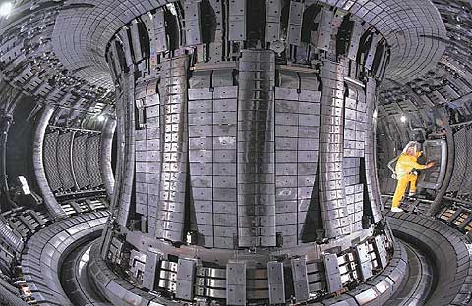
Topic 7: Atomic, nuclear and particle physics 7.2 – Nuclear reactions
Nuclear fission and nuclear fusion
•In our fusion reactors here on Earth, very precise and strong magnetic fields are used to overcome the Coulomb force.
•So far their energy yield is less than their energy consumption and are thus still experimental.
Notes:
© 2006 By Timothy K. Lund

Slide 37
•Returning to the E_{b} / A graph we see that iron (Fe) is the most stable of the nuclei.
•Nuclear fusion will occur with the elements below Fe because joining smaller nuclei forms bigger ones, which are higher on the graph (and thus more stable).
•Nuclear fission will occur with the elements above Fe because splitting bigger nuclei forms smaller ones, which are higher on the graph (and thus more stable).
Notes:
© 2006 By Timothy K. Lund

Slide 38
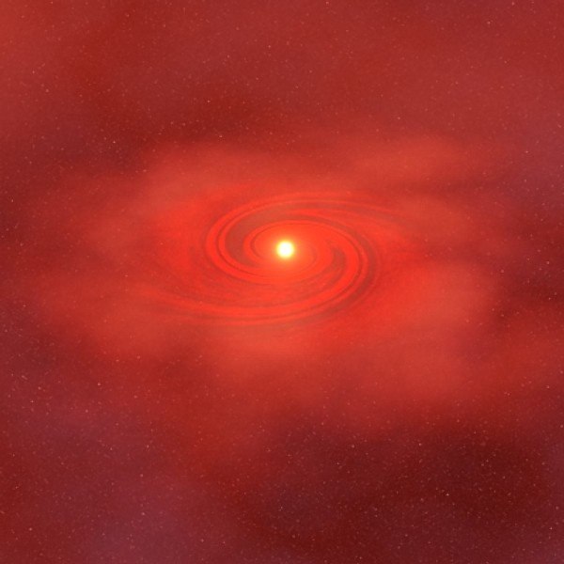
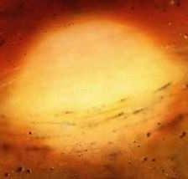
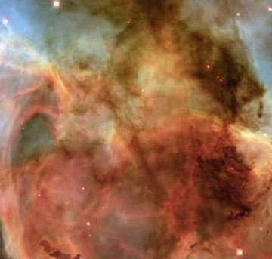
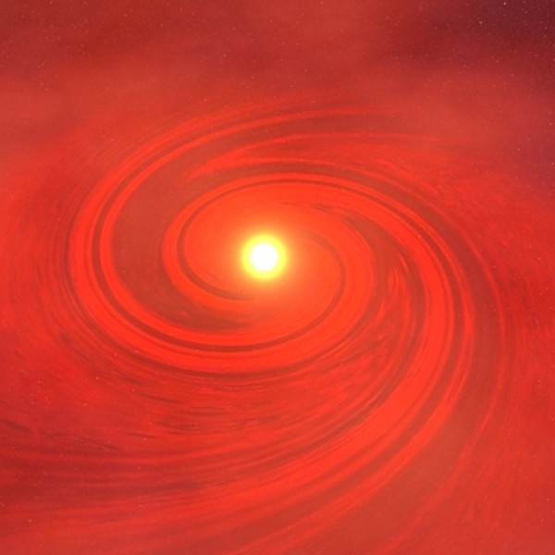
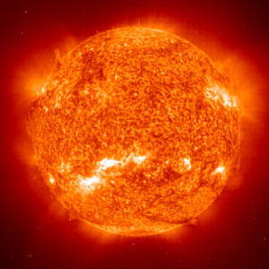
Topic 7: Atomic, nuclear and particle physics 7.2 – Nuclear reactions
Nuclear fission and nuclear fusion
•The reason fusion works on stars is because their intense gravitational fields can overcome the Coulomb repulsion force between protons.
Gravity
– Protostar phase
Fusion begins – Stellar phase
Gases
–Nursery phase
Density increases
– Protostar phase
Equilibrium between radiation and gravity
– Stellar phase
Notes:
© 2006 By Timothy K. Lund

Slide 39
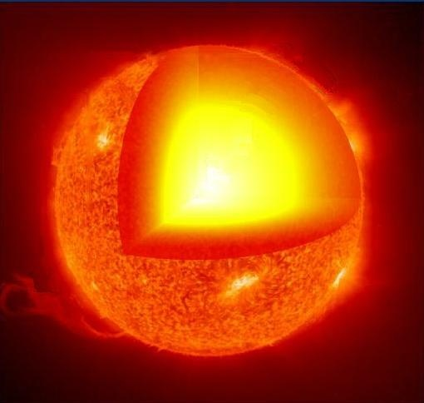
Topic 7: Atomic, nuclear and particle physics 7.2 – Nuclear reactions
Nuclear fission and nuclear fusion
•The gravitational force squishes hydrogen nuclei together overcoming the repulsive Coulomb force.
•The energy released by fusion prevents the gravitational collapse from continuing.
•Gravitation and radiation pressure reach equilibrium.
•They balance each other.
Notes:
© 2006 By Timothy K. Lund

Slide 40
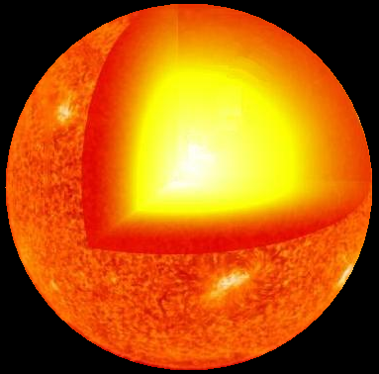
Topic 7: Atomic, nuclear and particle physics 7.2 – Nuclear reactions
Nuclear fission and nuclear fusion
•As the fusion progresses different elements evolve, and therefore different fusion reactions occur.
•At the same time, the mass of the star decreases a bit according to E = mc².
•As a result, a new equilibrium is estab- lished between gravity and the radiation pressure and the star grows.
Notes:
© 2006 By Timothy K. Lund

Slide 41
Topic 7: Atomic, nuclear and particle physics 7.2 – Nuclear reactions
Nuclear fission and nuclear fusion
•As the star evolves along the fusion side of the E_{b} / A curve, it slowly runs out of fuel to fuse and gravity again wins out.
•The star begins to shrink.
•For a star with the mass of the Sun, the shrinking will eventually stop and the sun will become a white dwarf and slowly cool down.
•Gravity will not be strong enough to fuse any more of the nuclei.
Notes:
© 2006 By Timothy K. Lund

Slide 42
Topic 7: Atomic, nuclear and particle physics 7.2 – Nuclear reactions
Nuclear fission and nuclear fusion
•For a more massive star, there is enough gravity to fuse the elements all the way up to iron.
•But there can be no more fusion when the star is completely iron. Why?
•Since the radiation pressure now ceases, gravity is no longer balanced and the star collapses into a neutron star.
•This is called the iron catastrophe.
FYI
•Where do the elements above iron come from?
Notes:
© 2006 By Timothy K. Lund

Slide 43
Topic 7: Atomic, nuclear and particle physics 7.2 – Nuclear reactions
Nuclear fission and nuclear fusion
•For an even more massive star, there is enough gravity to overcome the neutron barrier to collapse.
•Collapse continues and nothing can stop it!
•The star becomes a black hole.
•A black hole is an extremely dense body whose gravitational force is so strong that even light cannot escape it!
•Thus you cannot see it directly.
Notes:
© 2006 By Timothy K. Lund

Slide 44
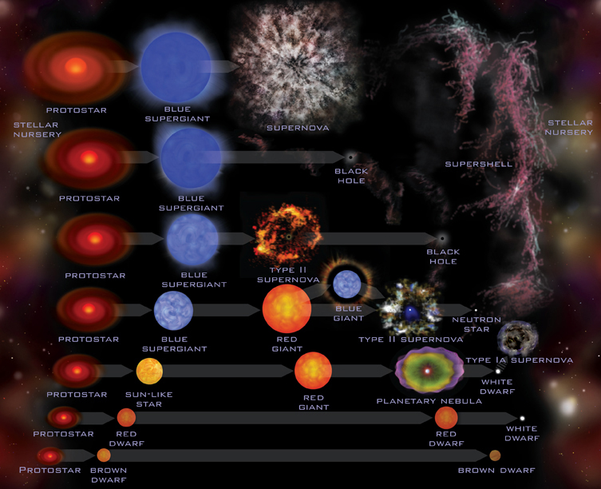
Notes:
© 2006 By Timothy K. Lund

