Slide 1
Topic 8: Energy, power, climate change 8.6 Global warming
8.6.1 Describe some possible models of global warming.
8.6.2 State what is meant by the enhanced greenhouse effect.
Notes:
© 2006 By Timothy K. Lund

Slide 2
Topic 8: Energy, power, climate change 8.6 Global warming
Describe some possible models of global warming.
•The Sankey diagram presented at the end of Topic 8.5 The greenhouse effect showed that overall, the intensity entering each interface balanced precisely with the intensity leaving each interface.
•But if the input and output intensities are balanced the temperature remains constant. We show our first “model” for global warming here:
340
75
195
30
165
520
70
GREENHOUSE ATMOSPHERE
350
325
40
100
490
GROUND
I_{in} – I_{out} = 0 ⇒ ∆T = 0
1st model constraint for temperature change
Notes:
© 2006 By Timothy K. Lund

Slide 3
Topic 8: Energy, power, climate change 8.6 Global warming
Describe some possible models of global warming.
•Our second model describes the temperature change when I_{in} – I_{out} ≠ 0…
•Recall the concept of surface heat capacity.
•Recall that intensity I = P/A and P = Q/∆t. Then
Q = C_{s}AΔT (surface heat capacity)
Q_{in} – Q_{out} = C_{s}AΔT (net heat gain/loss)
(P_{in} – P_{out})∆t = C_{s}AΔT (Q = P∆t)
(P_{in} – P_{out})∆t/A = C_{s}ΔT
(I_{in} – I_{out})∆t = C_{s}ΔT (I = P/A)
•Note: The 1st is just a special case of the 2nd.
C_{s} = Q / (AΔT)
surface heat capacity
C_{s} = 4×10⁸ J K⁻¹ m²
surface heat capacity
ΔT = (I_{in} – I_{out})∆t/C_{s}
2nd model constraint for temperature change
Notes:
© 2006 By Timothy K. Lund

Slide 4
Topic 8: Energy, power, climate change 8.6 Global warming
Describe some possible models of global warming.
PRACTICE: Our equilibrium model has been adjusted as shown. Use the 2nd model constraint to find the change in temperature over one year.
SOLUTION:
•At the interface of atmosphere and ground we have:
I_{in} = 165 + 335 = 500
I_{out} = 360 + 20 + 110 = 490
•1 year is ∆t = 1(365)(24)(3600 s) = 3.15×10⁷ s.
Thus ΔT = (I_{in} – I_{out})∆t/C_{s}
ΔT = (500-490)(3.15×10⁷)/(4×10⁸) = 0.79 K
340
75
195
30
165
540
70
GREENHOUSE ATMOSPHERE
360
335
20
110
500
GROUND
Notes:
© 2006 By Timothy K. Lund

Slide 5
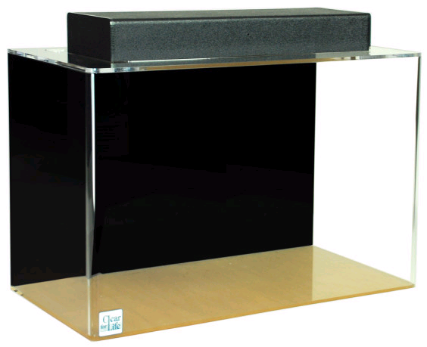
Topic 8: Energy, power, climate change 8.6 Global warming
Describe some possible models of global warming.
•Real global warming models are extremely complex, simply because the earth and all of its energy-exchanging and storing systems are extremely complex. Supercomputers are used with some success.
•To gain some sort of insight into computer modeling, consider the following simple model:
•5 kg of water is added to an aquarium once each second.
•10% of the water is removed from the aquarium once each second.
FYI
•The added water represents the incoming energy and the removed water is the outgoing energy.
Notes:
© 2006 By Timothy K. Lund

Slide 6
Topic 8: Energy, power, climate change 8.6 Global warming
Describe some possible models of global warming.
•At first glance it might appear that the water level will never stop increasing.
•But consider the time when 5 kg is exactly 10% of the total water in the aquarium.
•From that time on, the water will be removed exactly as fast as it is added.
•Thus, at that time the “energy” represented by the water mass will have reached equilibrium.
FYI
•The challenge is to find out how long it takes to reach equilibrium.
•Hand calculations are tedious but possible:
Notes:
© 2006 By Timothy K. Lund

Slide 7
Topic 8: Energy, power, climate change 8.6 Global warming
Describe some possible models of global warming.
PRACTICE: For the water model just proposed, complete the table:
SOLUTION:
•The next cell would be 8.55 + 5 = 13.55.
•The next cell would be 0.10(13.55) = 1.355.
•The next cell would be 13.55 – 1.355 = 12.195.
time / s | in / kg | pre-total / kg | out / kg | total/ kg
0 | 0 | 0.00 | 0.000 | 0.000
1 | 5 | 5.00 | 0.500 | 4.500
2 | 5 | 9.50 | 0.950 | 8.550
3 | 5
13.55
1.355
12.195
Notes:
© 2006 By Timothy K. Lund

Slide 8
Topic 8: Energy, power, climate change 8.6 Global warming
Describe some possible models of global warming.
EXAMPLE: Create a spreadsheet to determine what the mass will be when the aquarium reaches equilibrium and how many seconds it will take.
SOLUTION: Create a new spreadsheet with five columns as shown here:
•Highlight cell A3 and type in =A2+1 as shown.
•This will increment the A cells by 1 second.
Notes:
© 2006 By Timothy K. Lund

Slide 9
Topic 8: Energy, power, climate change 8.6 Global warming
Describe some possible models of global warming.
EXAMPLE: Create a spreadsheet to determine what the mass will be when the aquarium reaches equilibrium and how many seconds it will take.
SOLUTION:
•Highlight cell B2 and enter 5.
•Highlight cell C3 and type in =B3+E2 as shown.
•This will add the new input of 5 to the previous total.
Notes:
© 2006 By Timothy K. Lund

Slide 10
Topic 8: Energy, power, climate change 8.6 Global warming
Describe some possible models of global warming.
EXAMPLE: Create a spreadsheet to determine what the mass will be when the aquarium reaches equilibrium and how many seconds it will take.
SOLUTION:
•Highlight cell D3 and enter =0.1*C3.
•Highlight cell E3 and enter =C3-D3.
Notes:
© 2006 By Timothy K. Lund

Slide 11
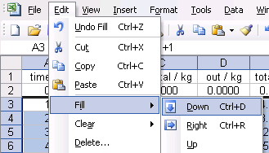
Topic 8: Energy, power, climate change 8.6 Global warming
Describe some possible models of global warming.
EXAMPLE: Create a spreadsheet to determine what the mass will be when the aquarium reaches equilibrium and how many seconds it will take.
SOLUTION:
•Highlight cells A3 through D3 all the way down to about row 100.
•Then select Edit→Fill→Down (or Ctrl+D) to copy down all of the formulas to each cell for all 100 rows.
Notes:
© 2006 By Timothy K. Lund

Slide 12
Topic 8: Energy, power, climate change 8.6 Global warming
Describe some possible models of global warming.
EXAMPLE: Create a spreadsheet to determine what the mass will be when the aquarium reaches equilibrium and how many seconds it will take.
SOLUTION:
•Finally, make a graph or read the spreadsheet:
•The graph shows that the mass of water will be 45 kg at equilibrium.
•This will occur after about 45 seconds.
equilibrium
Notes:
© 2006 By Timothy K. Lund

Slide 13
Topic 8: Energy, power, climate change 8.6 Global warming
Describe some possible models of global warming.
EXAMPLE: Compare the following two images showing the world weather for July 1, 1998:
60 N
Actual satellite view
30 N
0
30 S
60 S
60 N
Hadley Centre's computer simulation
30 N
0
30 S
Note the minor differences
60 S
0 90E 180 90W
Notes:
© 2006 By Timothy K. Lund

Slide 14
Topic 8: Energy, power, climate change 8.6 Global warming
State what is meant by the enhanced greenhouse effect.
•Global warming (and cooling) are both natural processes and fluctuate in a periodic manner. The four causes of global warming and cooling are:
-The sun’s varying power output.
-The Milankovitch cycles.
-Greenhouse gas fluctuation.
-Radioactivity.
•We will discuss each in turn on the following slides.
•The enhanced greenhouse effect is that portion of the greenhouse effect that is caused by humans.
Notes:
© 2006 By Timothy K. Lund

Slide 15
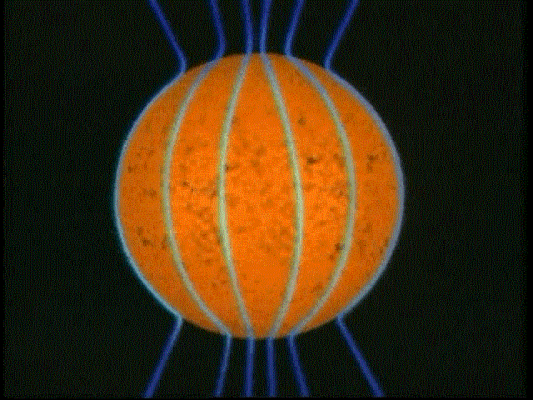
Topic 8: Energy, power, climate change 8.6 Global warming
State what is meant by the enhanced greenhouse effect.
The sun’s varying power output
•Because the sun is fluid rather than solid, different latitudes rotate at different rates in a process called differential rotation.
•Differential rotation causes an 11-year sunspot and solar flare variation (with changing power output) and magnetic pole reversal.
Notes:
© 2006 By Timothy K. Lund

Slide 16
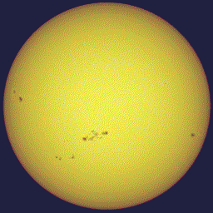
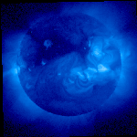
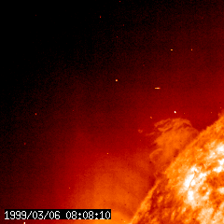
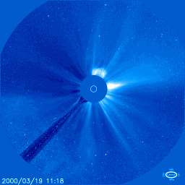
Topic 8: Energy, power, climate change 8.6 Global warming
State what is meant by the enhanced greenhouse effect.
The sun’s varying power output
•The first animation shows sunspots during a single rota- tion of the sun on its axis.
•The next animations show how far-reaching solar flares are.
Notes:
© 2006 By Timothy K. Lund

Slide 17
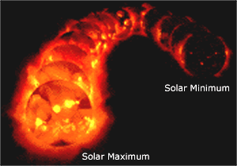
Topic 8: Energy, power, climate change 8.6 Global warming
State what is meant by the enhanced greenhouse effect.
The sun’s varying power output
•There is also a centuries-long variation in overall power output of the sun, with the 11-year sunspot activity superimposed:
FYI
•The Maunder Minimum was a mini ice-age.
Centuries
11 years
1645 - 1715
Present
The Maunder Minimum
Notes:
© 2006 By Timothy K. Lund

Slide 18
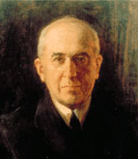
Topic 8: Energy, power, climate change 8.6 Global warming
State what is meant by the enhanced greenhouse effect.
The Milankovitch cycles
•These extraterrestrial factors were enumerated in 1941 by Serbian Milutin Milankovitch in his great work on ice ages.
•Factor 1: The elliptical cycle.
-In a 100,000-year long cycle the earth's elliptical orbit changes its shape.
-Currently, our orbit is nearly circular: The fluctuation in the solar radiation reaching us between January and July is only 6%.
-When the orbit is at its most eccentric fluctuation can be as great as 30%.
Notes:
© 2006 By Timothy K. Lund

Slide 19
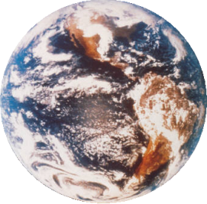
Topic 8: Energy, power, climate change 8.6 Global warming
State what is meant by the enhanced greenhouse effect.
The Milankovitch cycles
•These extraterrestrial factors were enumerated in 1941 by Serbian Milutin Milankovitch in his great work on ice ages.
•Factor 2: The tilt cycle.
-In a 42,000-year long cycle the earth's rotational axis tilt varies between 21.8° and 24.4° (Currently, our tilt is 22.5°).
-Tilt determines at which latitude most of the solar radiation falls.
21.8°
22.5°
24.4°
Notes:
© 2006 By Timothy K. Lund

Slide 20
Topic 8: Energy, power, climate change 8.6 Global warming
State what is meant by the enhanced greenhouse effect.
The Milankovitch cycles
•These extraterrestrial factors were enumerated in 1941 by Serbian Milutin Milankovitch in his great work on ice ages.
•Factor 3: The wobble cycle.
-In a 22,000-year long cycle the earth's rotational axis wobbles like a precessing top.
-Currently, our north pole is aimed at Polaris, the Pole Star.
-The axis can also point to Vega, and all points in between.
Vega
Polaris
FYI
•When Vega marks true north the in- tensity of the seasons is much more extreme.
Notes:
© 2006 By Timothy K. Lund

Slide 21
Topic 8: Energy, power, climate change 8.6 Global warming
State what is meant by the enhanced greenhouse effect.
The Milankovitch cycles
•These extraterrestrial factors were enumerated in 1941 by Serbian Milutin Milankovitch in his great work on ice ages.
•Milankovitch’s work was not recognized until the late 1960s because it was in Serbian.
•In the 60s just such cycles were being discovered in sediment and ice-core studies.
FYI
•At their most extreme, Milankovitch cycles bring an annual variation of the sun’s power of less then 1/10th of 1 percent.
•Yet this seemingly trivial variation causes Earth’s average temperature to rise or fall by 9°F!
Notes:
© 2006 By Timothy K. Lund

Slide 22
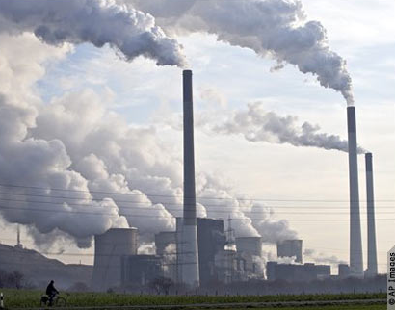
Topic 8: Energy, power, climate change 8.6 Global warming
State what is meant by the enhanced greenhouse effect.
Greenhouse gas fluctuation
•Both solar fluctuation and the Milankovitch cycles are extraterrestrial sources of global warming and cooling.
•One of the two terrestrial causes are the greenhouse gases. (The other is the earth’s interior heat.)
•Carbon dioxide, water vapor, methane, and nitrous oxide are all greenhouse gases which are capable of absorbing a portion of the IR energy emitted by the earth.
FYI
•The enhanced greenhouse effect is caused by humans increasing their levels.
Notes:
© 2006 By Timothy K. Lund

Slide 23
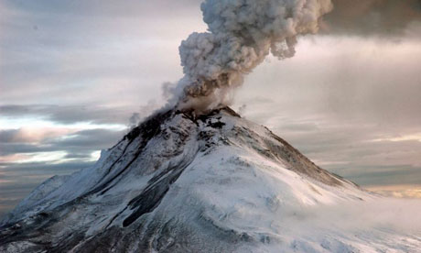
Topic 8: Energy, power, climate change 8.6 Global warming
State what is meant by the enhanced greenhouse effect.
Radioactivity
•The interior of the earth itself is quite hot.
•The two sources of internal heat are
-radioactive minerals within the mantle, which provides about 80-90% of Earth’s internal heat,
-and accretion remnants, which is the energy left over from the forming of the earth through accretion.
FYI
•These effects are quite minimal in the global warming scenario. Recall that volcanoes only add about 1% of the CO₂ added yearly to the atmosphere as compared to human-added CO₂.
Notes:
© 2006 By Timothy K. Lund

Slide 24
Topic 8: Energy, power, climate change 8.6 Global warming
State what is meant by the enhanced greenhouse effect.
The controversies
•Data may or may not convince one of the first controversy but probably Earth is warming.
•Given that humans produce greenhouse gases we can probably rule out the second controversy.
•Extremely complex computer simulations are integral to deciding the third controversy, which helps to explain its divisiveness.
Global warming is really happening.
Global warming is not really happening.
Global warming is enhanced by man.
Global warming is not enhanced by man.
Enhanced greenhouse effect is a significant portion of the overall global warming.
Enhanced greenhouse effect is not a signifi- cant portion of the overall global warming.
Notes:
© 2006 By Timothy K. Lund

Slide 25
Topic 8: Energy, power, climate change 8.6 Global warming
8.6.3 Identify the increased combustion of fossil fuels as the likely major cause of the enhanced greenhouse effect.
8.6.4 Describe evidence that links global warming to increased levels of greenhouse gases.
8.6.5 Outline some of the mechanisms that may increase the rate of global warming.
-Increased Greenhouse gases caused by burning fossil fuels.
-Decreased albedo caused by melting ice caps.
Notes:
© 2006 By Timothy K. Lund

Slide 26
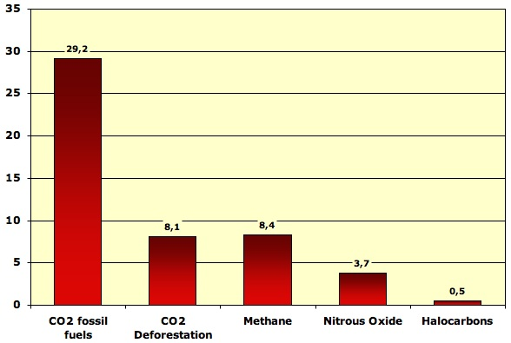
Topic 8: Energy, power, climate change 8.6 Global warming
Identify the increased combustion of fossil fuels as the likely major cause of the enhanced greenhouse effect.
•Note that deforestation accounts for only 8.1 / (29.2 + 8.1 + 8.4 + 3.7 + 0.5) = 16% of human-caused greenhouse gas production. Thus fossil fuels produce 84% of our greenhouse emissions.
Breakdown of world greenhouse gas emissions in 2004 by gas (except ozone), in billion tonnes CO₂ equivalent. From IPCC, 2007.
Notes:
© 2006 By Timothy K. Lund

Slide 27
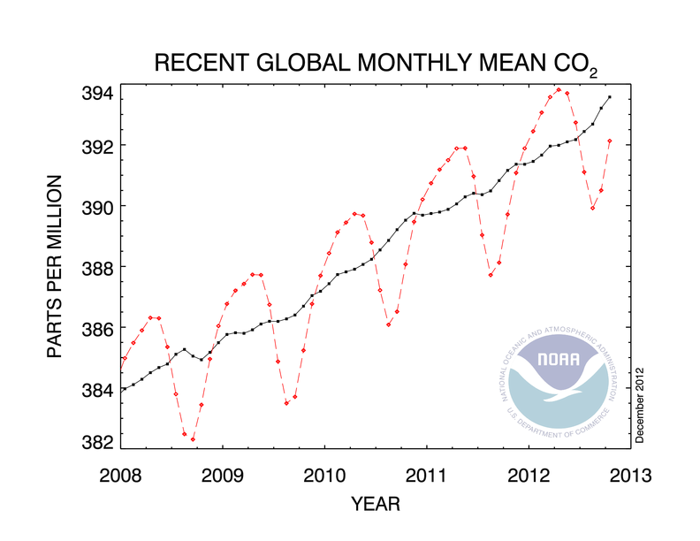
Topic 8: Energy, power, climate change 8.6 Global warming
Describe evidence that links global warming to increased levels of greenhouse gases.
•The graph shows the seasonal variation of atmospheric CO₂.
•Note the seasonal fluctuations showing an increase in cooling months and a decrease in warming months.
•Note the overall increase in CO₂ levels.
warming months
cooling months
Notes:
© 2006 By Timothy K. Lund

Slide 28
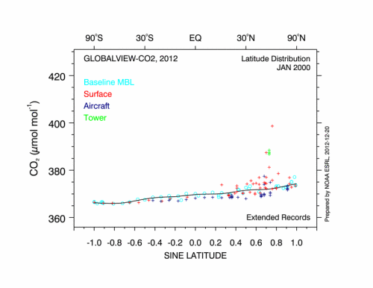
Notes:
© 2006 By Timothy K. Lund

