Slide 1
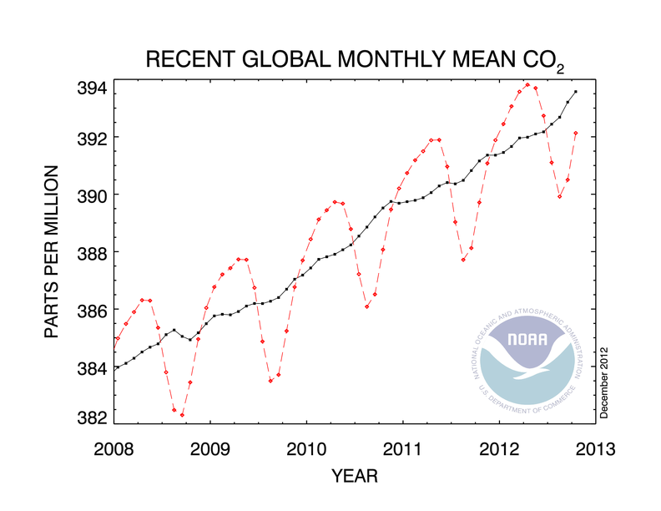
Topic 8: Energy, power, climate change 8.6 Global warming
Describe evidence that links global warming to increased levels of greenhouse gases.
PRACTICE: Explain why the atmospheric concentration of CO₂ increases in winter and decreases in summer.
SOLUTION:
•It’s is all about living carbon sinks that store CO₂ in the summer and release it in the winter: Namely- plants and their respiration and decomposition.
Notes:
© 2006 By Timothy K. Lund

Slide 2
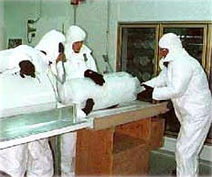
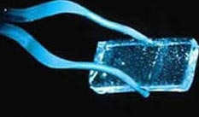
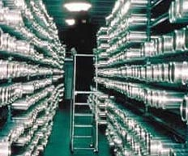
Topic 8: Energy, power, climate change 8.6 Global warming
Describe evidence that links global warming to increased levels of greenhouse gases.
•The previous data shows a steady increase in atmospheric CO₂. But how does this correlate to average temperature? And how do we determine the geological correlations?
•The answer is ice cores.
•From the concentration of the isotopes of hydrogen in the water we can determine the mean global temperature.
•From the trapped air we can determine the greenhouse constituents of the atmosphere.
Ice core sections stored at the National Ice Core Laboratory in Colorado
Notes:
© 2006 By Timothy K. Lund

Slide 3
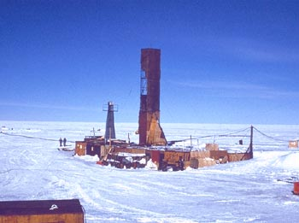
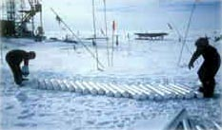
Topic 8: Energy, power, climate change 8.6 Global warming
Analysis of the core has been completed to a depth of 3350 meters, representing about 440,000 years of climate history.
Vostok ice core drilling site, Antarctica
Notes:
© 2006 By Timothy K. Lund

Slide 4
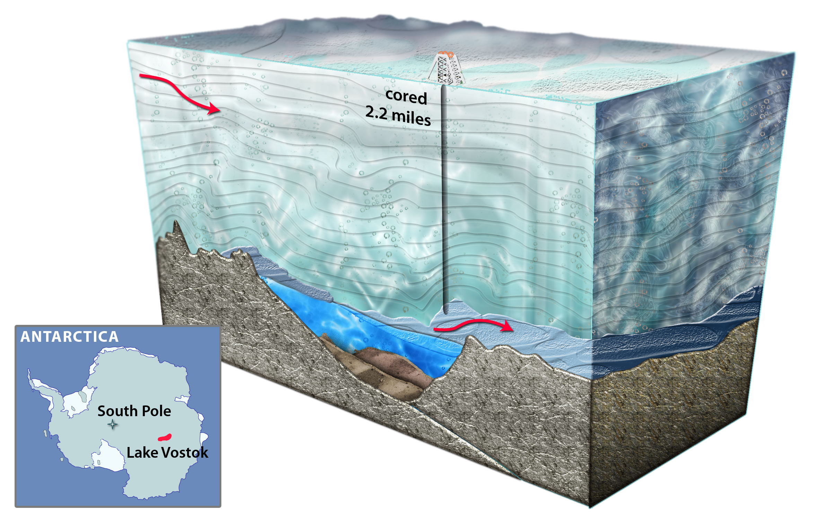
Topic 8: Energy, power, climate change 8.6 Global warming
Notes:
© 2006 By Timothy K. Lund

Slide 5
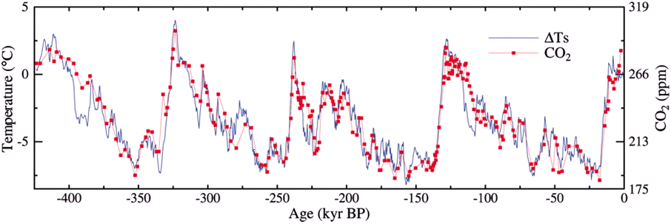
Topic 8: Energy, power, climate change 8.6 Global warming
Describe evidence that links global warming to increased levels of greenhouse gases.
•The graph shows the results of the Vostok ice core analyses, representing CO₂ levels and temperatures going back 425,000 years (before present).
•Note the very strong correlation between them.
Which Milankovitch cycle seems to be driving this variation?
100000 y
The elliptical variation.
Notes:
© 2006 By Timothy K. Lund

Slide 6
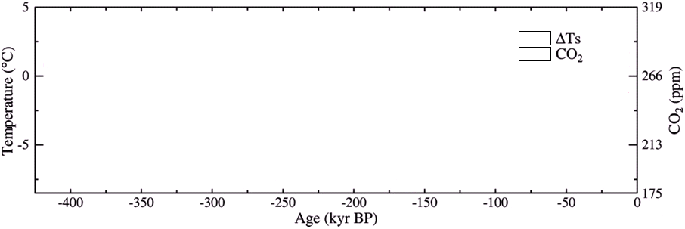
Topic 8: Energy, power, climate change 8.6 Global warming
Describe evidence that links global warming to increased levels of greenhouse gases.
•The temperature and CO₂ overlays show approximately that sometimes temperature change leads, and sometimes it follows change in CO₂ levels:
•So which change causes the other to change?
Notes:
© 2006 By Timothy K. Lund

Slide 7
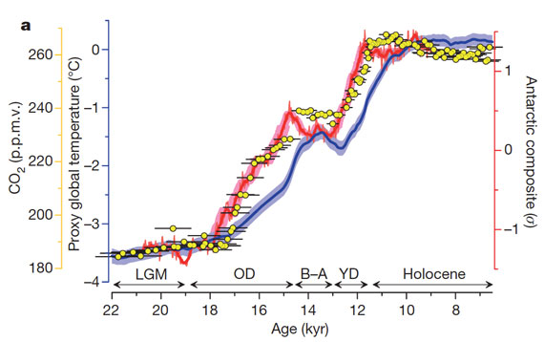
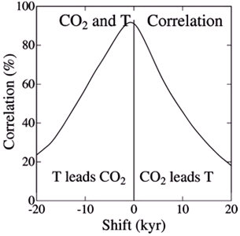
Topic 8: Energy, power, climate change 8.6 Global warming
Describe evidence that links global warming to increased levels of greenhouse gases.
•A more detailed plot shows perhaps that CO₂ change leads temperature in change. But the overall percentages from the previous graph gives the lead slightly to temperature…
Notes:
© 2006 By Timothy K. Lund

Slide 8
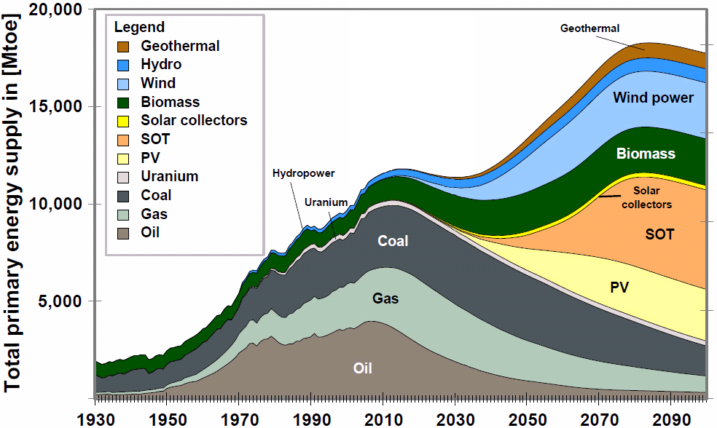
Topic 8: Energy, power, climate change 8.6 Global warming
Outline some of the mechanisms that may increase the rate of global warming.
•Obviously, increased need for energy leads to increased burning of fossil fuels (or biomass) which leads to more greenhouse gases, which would increase the rate of global warming.
FYI
•This graph is compiled by the wishful thinkers located at http://www.via-azul.eu/
Notes:
© 2006 By Timothy K. Lund

Slide 9
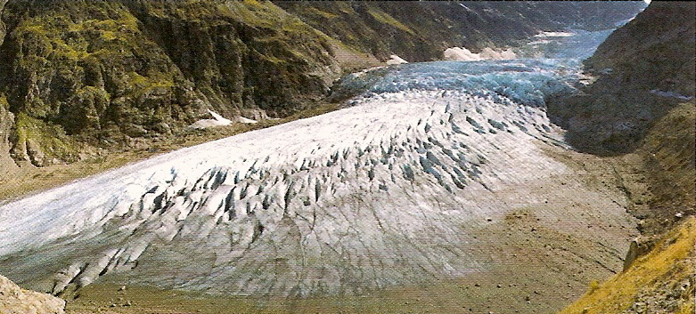
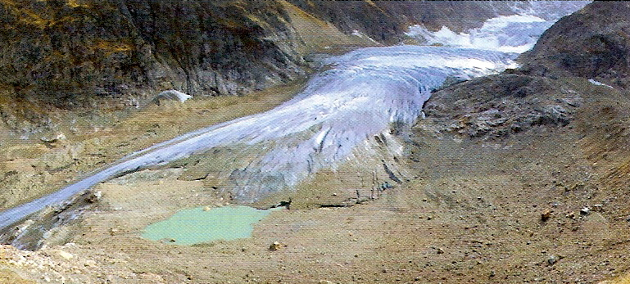
Topic 8: Energy, power, climate change 8.6 Global warming
Outline some of the mechanisms that may increase the rate of global warming.
•Another mechanism would be the decreased albedo caused by melting ice caps. Ice and snow have the highest albedo (0.6) of any terrestrial landscape. Less light would be reflected by snow and ice and more would be absorbed.
Anecdotal evidence - Observations of changes in the environment in our lifetimes...
Notes:
© 2006 By Timothy K. Lund

Slide 10
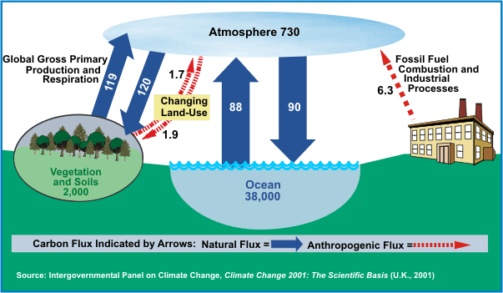
Topic 8: Energy, power, climate change 8.6 Global warming
Outline some of the mechanisms that may increase the rate of global warming.
•Deforestation is also a factor. Forests are active carbon sinks, removing CO₂ from the atmosphere during respiration.
Notes:
© 2006 By Timothy K. Lund

Slide 11
Topic 8: Energy, power, climate change 8.6 Global warming
8.6.6 Define coefficient of volume expansion.
8.6.7 State that one possible effect of the enhanced greenhouse effect is a rise in mean sea level.
8.6.8 Outline possible reasons for a predicted rise in mean sea level.
Notes:
© 2006 By Timothy K. Lund

Slide 12
Topic 8: Energy, power, climate change 8.6 Global warming
•Define coefficient of volume expansion.
•Substances E X P A N D as they are warmed up according to the equation
where β is the coefficient of volume expansion.
•The formula shows that the change in volume of an object is proportional to its original volume times the temperature change.
•This formula works for both solids and liquids.
ΔV = βV₀ΔT
expansion due to ∆T
Notes:
© 2006 By Timothy K. Lund

Slide 13
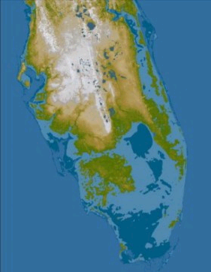
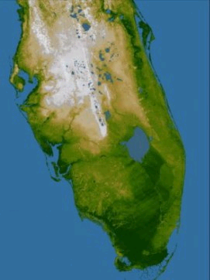
Topic 8: Energy, power, climate change 8.6 Global warming
State that one possible effect of the enhanced greenhouse effect is a rise in mean sea level.
•As the ocean warms up its seawater expands, taking up more volume. Thus global warming will cause the sea level to rise.
•Furthermore as Earth warms up, landlocked glaciers will melt, adding to the rise in sea level.
FYI
•During ice ages when the land ice is enhanced by continental-sized glaciers, the sea level can decrease by 100 meters!
•The ice melt we are most concerned most with, in terms of present-day sea level rise, is glaciers and the Antarctic ice shield.
Notes:
© 2006 By Timothy K. Lund

Slide 14
Topic 8: Energy, power, climate change 8.6 Global warming
8.6.9 Identify climate change as an outcome of the enhanced greenhouse effect.
8.6.10 Solve problems related to the enhanced greenhouse effect. Problems could involve volume expansion, specific heat capacity and latent heat.
Done!
Notes:
© 2006 By Timothy K. Lund

Slide 15
Topic 8: Energy, power, climate change 8.6 Global warming
Solve problems related to the enhanced greenhouse effect.
ΔV = βV₀ΔT
expansion due to ∆T
From the formula we can solve for β:
β = ΔV / V₀ΔT = (V₂-V₁)/V₁(T₂-T₁).
Notes:
© 2006 By Timothy K. Lund

Slide 16
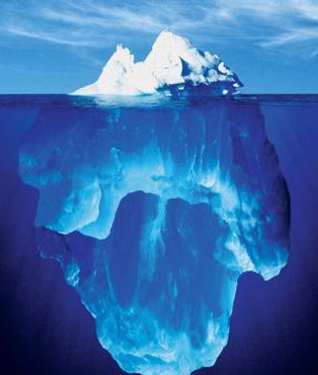
Topic 8: Energy, power, climate change 8.6 Global warming
Solve problems related to the enhanced greenhouse effect.
PRACTICE: The land ice sheet consists of landlocked glaciers (in mountains) and the Antarctic ice shield. The north polar ice sheet is over water (floating). Explain why melting the north polar ice shield does not change the sea level, whereas melting the Antarctic ice shield does.
SOLUTION:
•A floating object displaces water equal to its weight.
•Thus when floating ice becomes water, it just fills in the space in the ocean it already took up and doesn’t change its depth.
Notes:
© 2006 By Timothy K. Lund

Slide 17
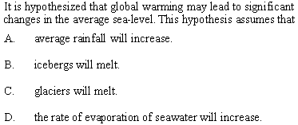
Topic 8: Energy, power, climate change 8.6 Global warming
Solve problems related to the enhanced greenhouse effect.
Notes:
© 2006 By Timothy K. Lund

Slide 18
Topic 8: Energy, power, climate change 8.6 Global warming
8.6.11 Identify some possible solutions to reduce the enhanced greenhouse effect.
-Increase power production efficiency.
-Replace coal and oil with natural gas.
-Use combined heating and power systems (CHP).
-Use renewable energy and nuclear power.
-Use CO₂ capture and storage.
-Use hybrid vehicles.
Notes:
© 2006 By Timothy K. Lund

Slide 19
Topic 8: Energy, power, climate change 8.6 Global warming
8.6.12 Discuss international efforts to reduce the enhanced greenhouse effect.
-Intergovernmental panel on climate change (IPCC),
-Kyoto Protocol,
-Asia-Pacific Partnership on Clean Development and Climate (APPCDC).
Notes:
© 2006 By Timothy K. Lund

