Slide 1
Unit 7.3 Review

Slide 2
Force Carrier
The Electromagnetic Force
The electromagnetic force operates between particles which contain electric charge. The force carrier for the electromagnetic force is the photon. Photons, which are commonly called light waves, and referred to as gamma rays, X-rays, visible light, radio waves, and other names depending on their energy. Photons have no mass, which means that, according to the previous calculation, there is no limit on the distance of effect of the electromagnetic force. Photons also have no electric charge, no color, no strangeness, charm, topness, or bottomness, but do possess a spin of 1.
The electromagnetic force has a strength proportional to the product of the electric charges of the particles, and inversely proportional to the square of the distance between the particles' centers of mass. The electromagnetic force is the second strongest force, behind the strong force by two orders of magnitude at the distances in a nucleus, but can be either attractive or repulsive. Like charges attract and unlike charges repel. Over large scale measurements, the overall charge of an area is most often neutral, and the electromagnetic force has no overall effect. It does have residual attractive forces between electrically neutral atoms that constrain the atoms into molecules. These interactions between atoms are referred to by chemists as chemical bonds, dipole-dipole interactions, or other such terms.

Slide 3
Force Carrier
The Gravitational Force
The gravitational force is an interaction between mass-energy, and is thus experienced by all particles to some degree. The gravitational force is proportional to the product of the total energies of the interacting particles, and inversely proportional to the square of the separation between the particles. However, this implies that the gravitational force has no distance limit. By the previously determined relationship, the force carrier of the gravitational force must have no mass for gravity to have no limit to its distance. This particle, known as the graviton, had not been discovered, and is only hypothesized. However, it must exist for the current understanding of forces to be correct.
An interesting fact about gravity is that, although the weakest force, 42 factors of magnitude weaker than the strong nuclear force, it has the greatest effect in large scales. This is because total energies can only be positive, and gravity can therefore only be attractive. Over large areas, the qualities that the other charges act on tend to cancel out, but the effect of gravity merely increases as more mass-energy is involved.

Slide 4
Force Carrier
The Weak Nuclear Force
The weak nuclear force is a force of interactions between quarks and leptons, both of which are fermions with spin 1/2. The force only affects particles which are spinning counter-clockwise while going away. In other words, the weak nuclear interaction affects left-handed particles. (and right-handed anti-particles) Leptons come in electron, muon, and tau flavors of charge -1, each with associated neutrinos of neutral charge. Quarks appear as the up and down, charm and strange, and top and bottom flavors. The flavors are conserved, and weak interactions transform leptons to other leptons and quarks to other quarks, while preserving this conservation.
The weak nuclear force has a limit in range of only 10 to the -18th meters. This means that the carrier particles must indeed have mass. The weak nuclear force is found to have three carrier particles, two W bosons, one charged -1 and one charged +1, and the electrically neutral Z boson. The W bosons have a mass of 80.22 GeV/(c squared), and the Z boson has a mass of 91.187 GeV(c squared). All cariers have a spin of 1, however. The weak force, as its name implies, is weaker than the electromagnetic or strong nuclear force, about five factors of magnitude smaller than the strong nuclear force distances in an atom's nucleus. However it is very important in beta decay and pair annihilation/production, as well as other interactions.

Slide 5
Force Carrier
The Strong Nuclear Force
The strong nuclear force is an interaction between color, and particles that possess color. Quarks possess one of three colors, green, red, or blue, and the strong force is an attractive force between these and the mediating particle, gluons. Gluons have two colors, one normal color and one anti-color. The strong force has no theoretical limit to its range, as gluons have no mass. In addition, they have no electric charge, and a spin of 1. In reality, the strong force is so strong that all color-charged gluons and quarks are bound tightly together into color neutral hadrons, either the mesons which consist of a quark and antiquark with corresponding color and anticolor, or the baryons, which consist of three quarks of the three colors, which cancel to color-neutrality. Since color does not appear outside of any hadrons, the strong force only directly has effects inside a hadron, at distances around 10 to the negative 17th power.
The previous paragraph describes the direct effects of the strong force, usually referred to as the fundamental strong interaction. The strong force also has a residual effect. The color-neutral hadrons can interact with the strong force due to their color-charged constituents, similar to the electromagnetic interaction. The force carriers in this case are the mesons, and all hadrons are affected. The mesons, which include the pions, the kaons, the rhos, the Ds, the etas, and many others, have masses ranging from .140 Gev/(c squared) to around 3 Gev/(c squared). This gives the residual effects of the strong force a maximum distance to interact of about 10 to the negative 15 meters.
Strong force interactions are important in quark-antiquark reactions, and in holding hadrons together. The fundamental strong interaction holds the constituent quarks of a hadron together, and the residual force holds hadrons together with each other, such as the proton and neutrons in a nucleus.

Slide 6
Quark confinement
Color-charged particles cannot be found individually. For this reason, the color-charged quarks are confined in groups (hadrons) with other quarks. These composites are color neutral.
The development of the Standard Model's theory of the strong interactions reflected evidence that quarks combine only into baryons (three quark objects), and mesons (quark-antiquark objects), but not, for example, four-quark objects. Now we understand that only baryons (three different colors) and mesons (color and anticolor) are color-neutral. Particles such as ud oruddd that cannot be combined into color-neutral states are never observed

Slide 7
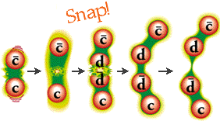
Quark confinement
The quarks in a given hadron madly exchange gluons. For this reason, physicists talk about the color-force field which consists of the gluons holding the bunch of quarks together.
If one of the quarks in a given hadron is pulled away from its neighbors, the color-force field "stretches" between that quark and its neighbors. In so doing, more and more energy is added to the color-force field as the quarks are pulled apart. At some point, it is energetically cheaper for the color-force field to "snap" into a new quark-antiquark pair. In so doing, energy is conserved because the energy of the color-force field is converted into the mass of the new quarks, and the color-force field can "relax" back to an unstretched state.

Slide 8
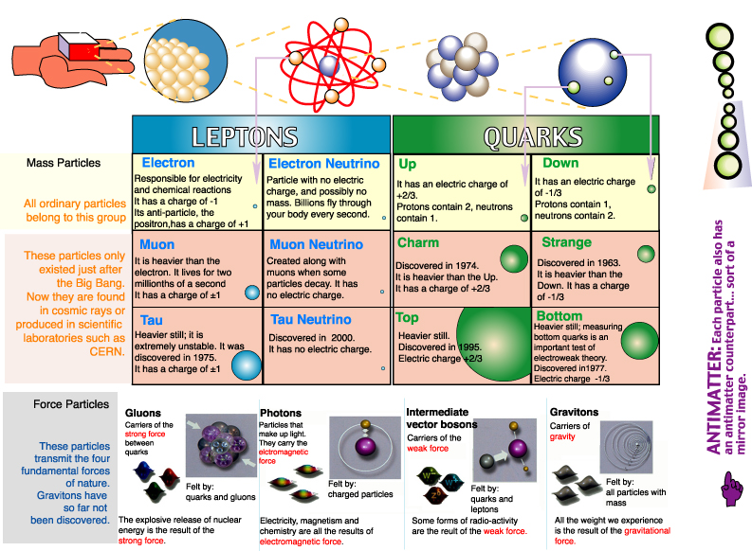
FAMILY OF QUARKS AND LEPTONS

Slide 10
Lepton Conservation
Lepton type conservation Leptons are divided into three lepton families: the electron and its neutrino, the muon and its neutrino, and the tau and its neutrino.
We use the terms "electron number," "muon number," and "tau number" to refer to the lepton family of a particle. Electrons and their neutrinos have electron number +1, positrons and their antineutrinos have electron number -1, and all other particles have electron number 0. Muon number and tau number operate analogously with the other two lepton families.
One important thing about leptons, then, is that electron number, muon number, and tau number are always conserved when a massive lepton decays into smaller ones

Slide 11
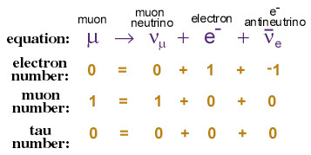
Lepton Conservation
Let's take an example decay.
A muon decays into a muon neutrino, an electron, and an electron antineutrino:
As you can see, electron, muon, and tau numbers are conserved. These and other conservation laws are what we believe define whether or not a given hypothetical lepton decay is possible.

